Slide 1
IHÉDATE at Frans Schartau Business Institute 10th of May 2022

Slide 2
Welcome to Frans Schartau Business Institute
Sirpa Wahlberg-Borgström
Susanne Gustafsson
Notes:
Thank you Margareta for the presentation about how the HVE-system works. On behalf of Sirpa Wahlberg-Borgström, our Dean and myself Susanne Gustafsson assistant Dean I would like to welcome you to ”our house”, Frans Schartau Business Institute. I hope you enjoyed visiting our groups of students earlier.

Slide 3
Swedish National Agency for Higher Vocational Education
Notes:
The difference from universities is as Margareta mention the close collaboration with the business community. We have more lectures, spend more time at school, we mix practical and theoretical sessions and networking is always promoted

Slide 4
16 Higher Vocational programs
Pharmacy Technician
Pediatrician specialist assistant nurse
Retail and Groceries Store Manager (Hybrid studies)
Hotel Management
IT-Test Specialist
Pharmaceutical technicians
Salary economist – specialized in system knowledge
Medical secretary
Procurement Officer
Production Manager for Feature Film and TV production
Revenue Management & Data Analyst (Distance studies)
Project Management – Sustainable Meetings & Events
Specialist-trained assistant nurse - anesthesia, surgery and intensive care
Theater, Event, & Stage Technician
TRAC Tourism- and Travel Consultant
Visual Merchandise
Notes:
We educate leaders and specialists. Six different areas: Finance, adminstration & sales, IT, Healthcare & Nursing, Culture, Media & Design, Hospitality & tourism and Manufacturing. 16 programs conducted by FSH, distansen Learning non synchronized and hybrid is synchronized

Slide 5
Notes:
Our pedagogical model that leads to Functional competence. How we work strategically to enable our students to be a golden star, that graduates on Friday and goes to a job the following Monday. Specifika ämneskunskaper 1, 1,5 eller 2 år
Förutom de specifika yrkeskunskaperna väver vi in andra viktiga kompetenser som behövs i ert framtida yrkesliv.
Kritiskt tänkande, så ni får en strategisk kompetens.
Innovativ tillämpning – dvs. att man inte är rädd för att pröva nytt och man blir starkare i sig själv ju mer man lär sig.
Hållbarhet är ett alltid närvarande tema. Hållbar utveckling Frans Schartau har hållbarhet med som en viktig del i alla program och miljöfrågan är ständigt aktuell. Under LIA kommer ni att överföra tankar och idéer som gagnar mottagande företag Det ger möjligheter till utveckling för att växa både smart och hållbart.
Regler och redskap är det ni behöver i er framtida yrkesroll.
Interaktiv kommunikation tränas och alla program innehåller kurser i som antingen är helt på engelska eller där ni tränas på andra sätt i att uttrycka er professionellt i olika arbetssituationer.

Slide 6
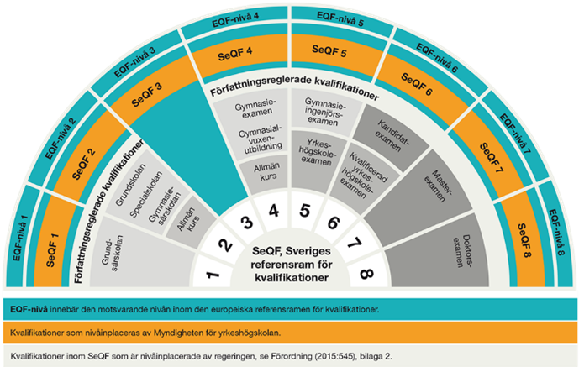
SeQF and EQF
Notes:
Two levels SeQF5 och SeQF6 diplomas. I leave the floor to Binta and after her you will meet Louise

Slide 7
Student Hotel Management program, level SeQF6
Hotel Management
Higher Vocational Education
Courses at school
Teachers and lectures
Work Placements
Networking opportunities
My future
Student Anastasia Depranos
Notes:
Why I choose Hotel Management
Why I choose Higher Vocational Education
Course examples at school that helped me reach my goals
Teachers and lectures, some example about what they brought
Work Placements – what it meant to me
Networking opportunities (a bit Covid affected but still…)
When I graduate I will..

Slide 8
Procurement Officer at the Royal Swedish Opera
Procurement Officer
Higher Vocational Education
Courses at school
Teachers and lectures
Work Placements
Networking opportunities
Graduation and employment
Former student Louise Matsson
Notes:
Why I choose Procurement Officer
Why I choose Higher Vocational Education
Courses at school that helped me reach my goals
Teachers and lectures, some example about what they brought
Work Placements – what it meant to me
Networking opportunities (a bit Covid affected)
When I graduated and what I’m doing now.

Slide 9
Board member for the program Revenue Management & Data Analyst
Strategical importance
Shaping the programmes and adjust course plans
Quality assurance
Review the admission process
Lectures
Work placements
Study Visits
Approve graduation diploma
What is in it for Scandic Hotels?
Area Revenue Manager Scandic Hotels Charlotta Olofsson
Notes:
Strategical importance – to discuss what is happening in the business sector and at the labour market
Shaping the programmes and adjust course plans if new competence is needed
Quality assurance – go through student surveys and discuss improvments
Review the admission process – being updated about how many applicants and how many that meet the requirements to be accepted
Doing lectures
Handel work placements
Arrange Study visits
Whats in it for Scandic Hotels? Ni får påverka innehållet i utbildningarna så att de passar de kompetensbehov ni har
En första ”tjing” på duktiga praktikanter!
En god rekryteringsbas för framtida rekryteringar, delta i branschdagar (meet & greet).

Slide 10
Management of Higher Vocational Education programs
The role in general
Teaching your area of expertise
Steering committee
Student influence on the program
Curriculum
Quality Assurance, finding the right talent
Work placements
Networking
Marketing
Program Director Marcus Hellström

Slide 11
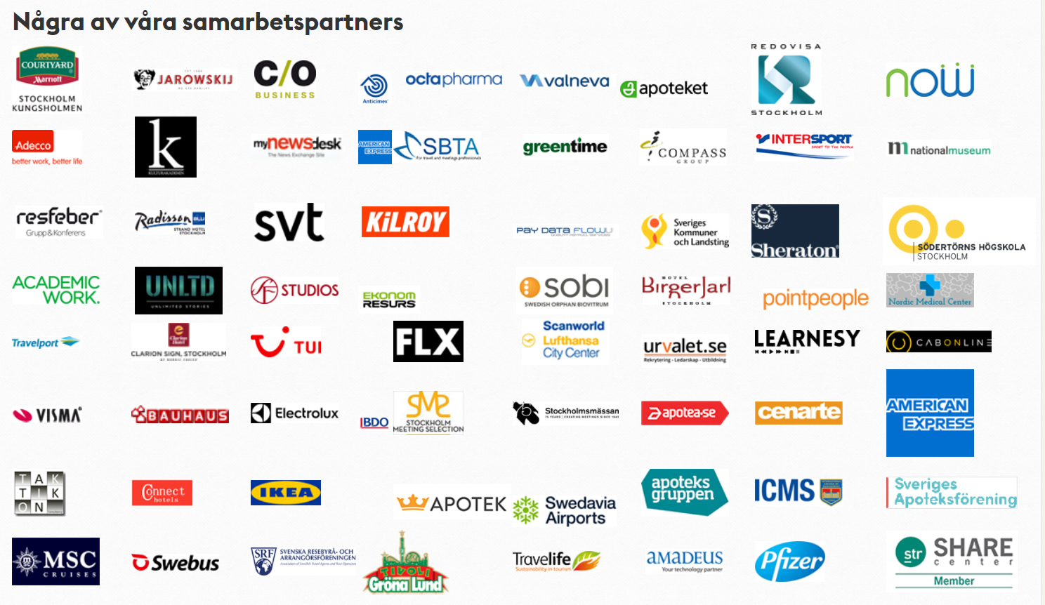

Slide 12
Questions?
Thank you for listening!

