Slide 1
Regional development in Czechia – Trends, Policies, Challenges
Alexandre Reznikow
Head of Analytical Unit – Ministry of Regional Development
Ihédate study visit in Czechia – March 2026
31/03/2026

Slide 2
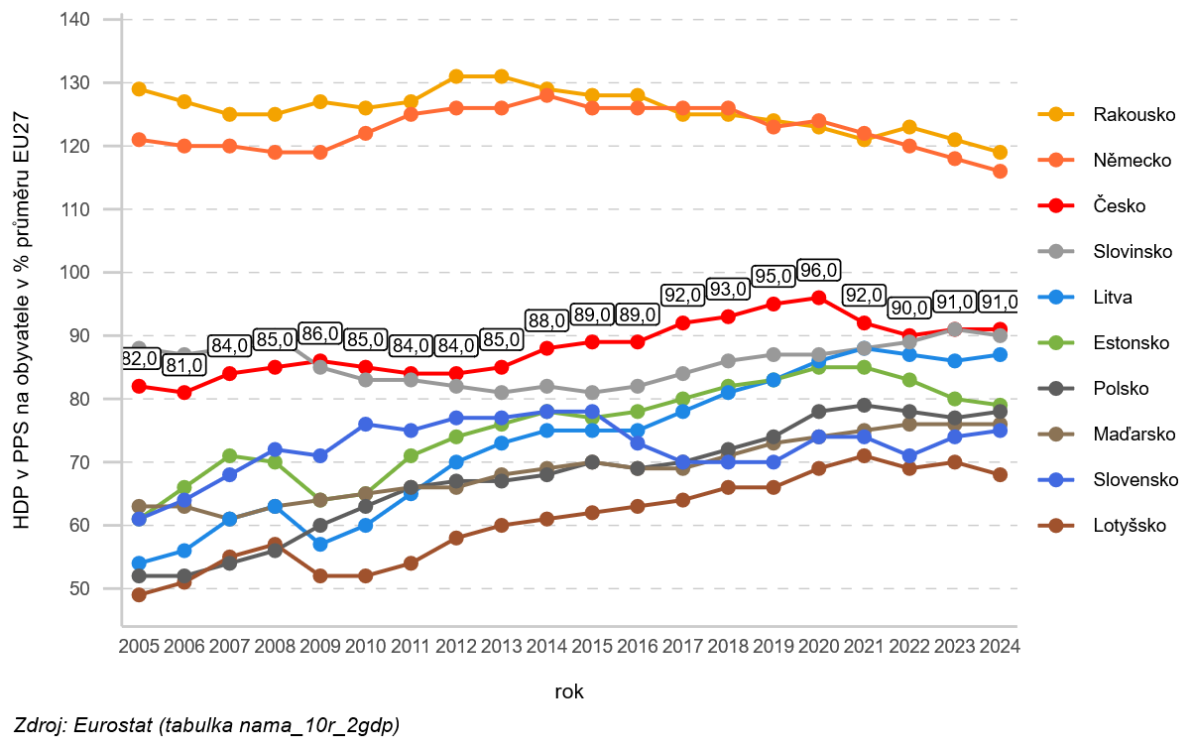
A national convergence success story…
Since 1990…
  … life expectancy increased by 8-10 years (67/75 -> 77/83)
  … GDP/capita reached EU average (2005: 82% -> 2024: 91%)
  … CO2 emisions per capita were divided by 2 (15 t -> 7 t)

Slide 3
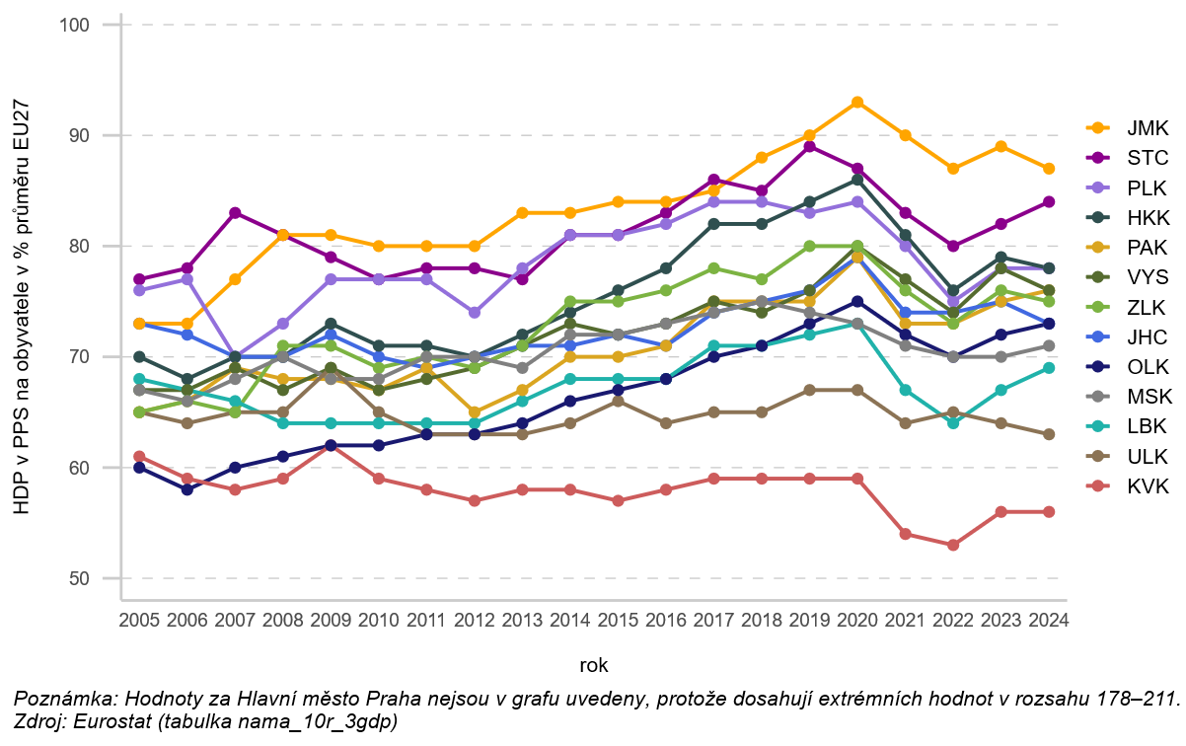
…masking persistent territorial asymmetries.
GDP/capita (PPS) as % of EU average (EU = 100 %)

Slide 4
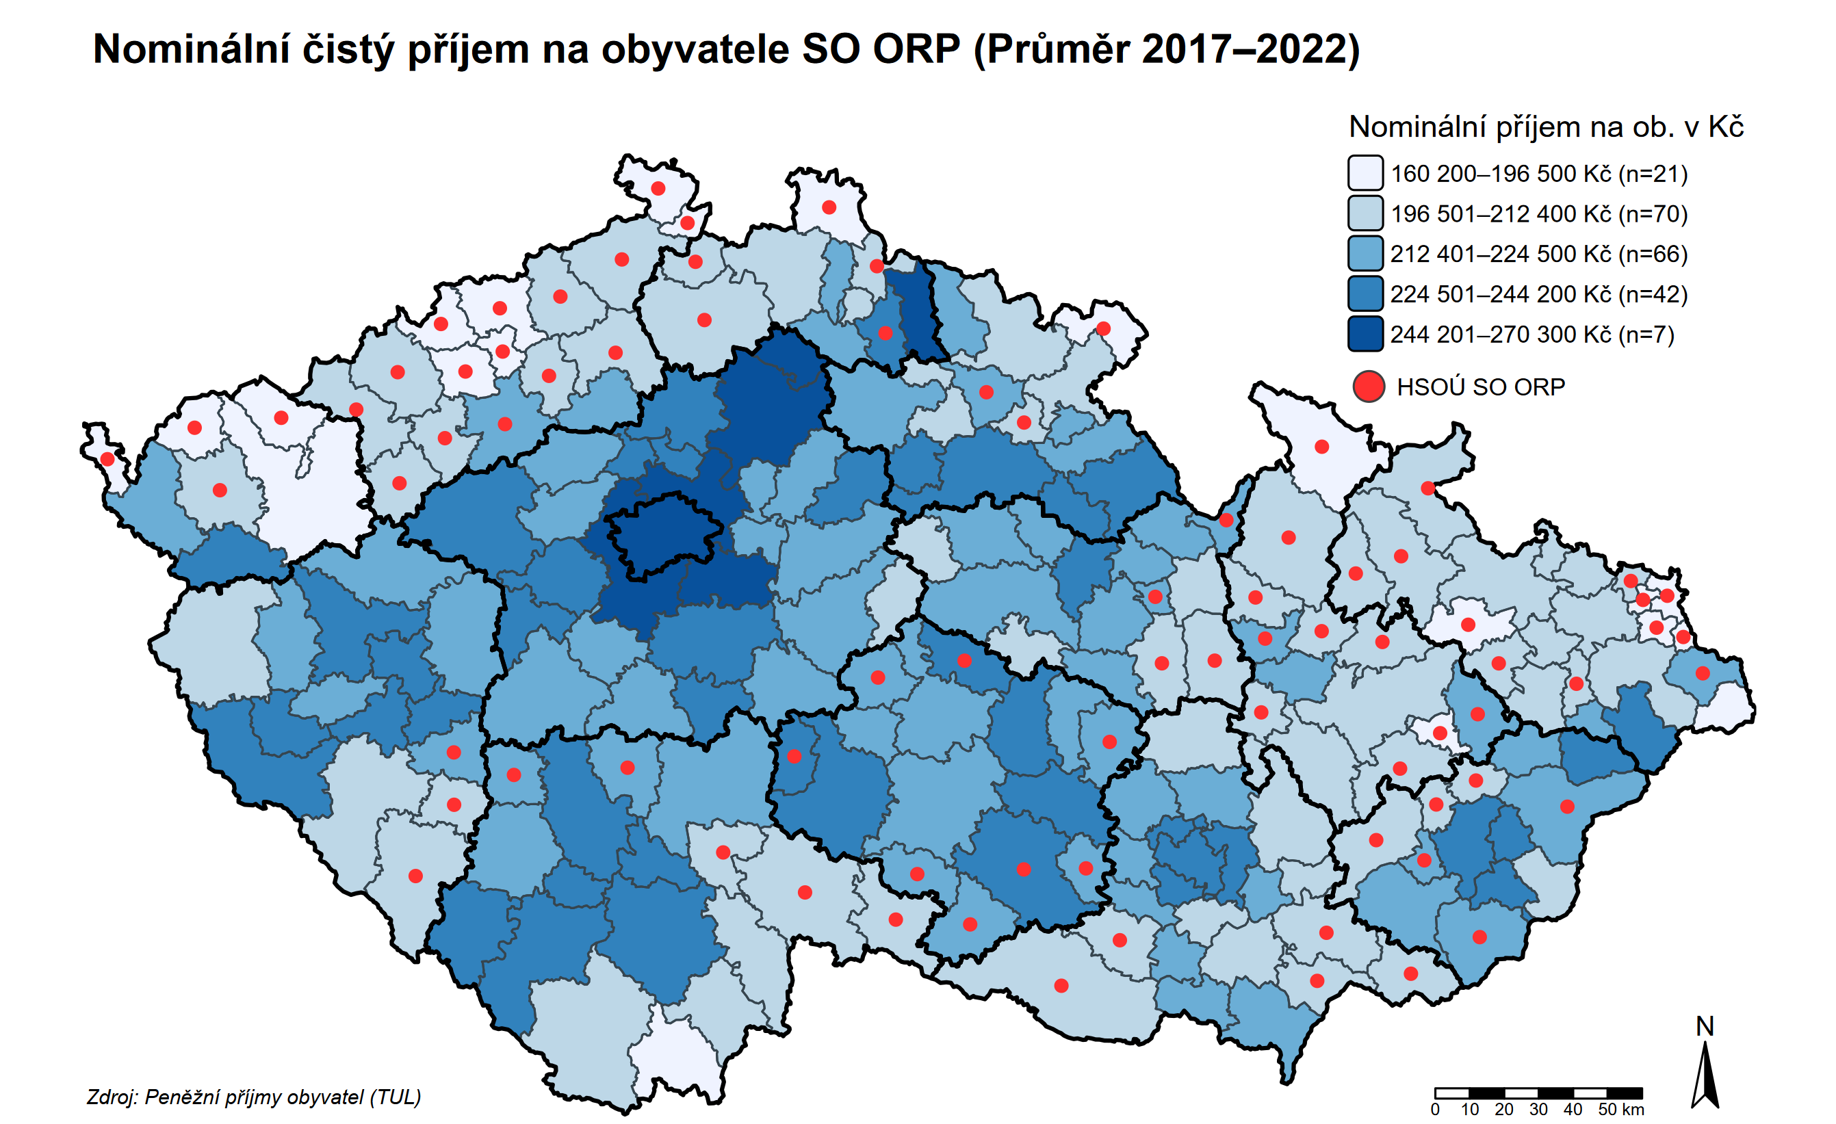
…masking persistent territorial asymmetries.
Nominal net income per capita (average 2017-2022)

Slide 5
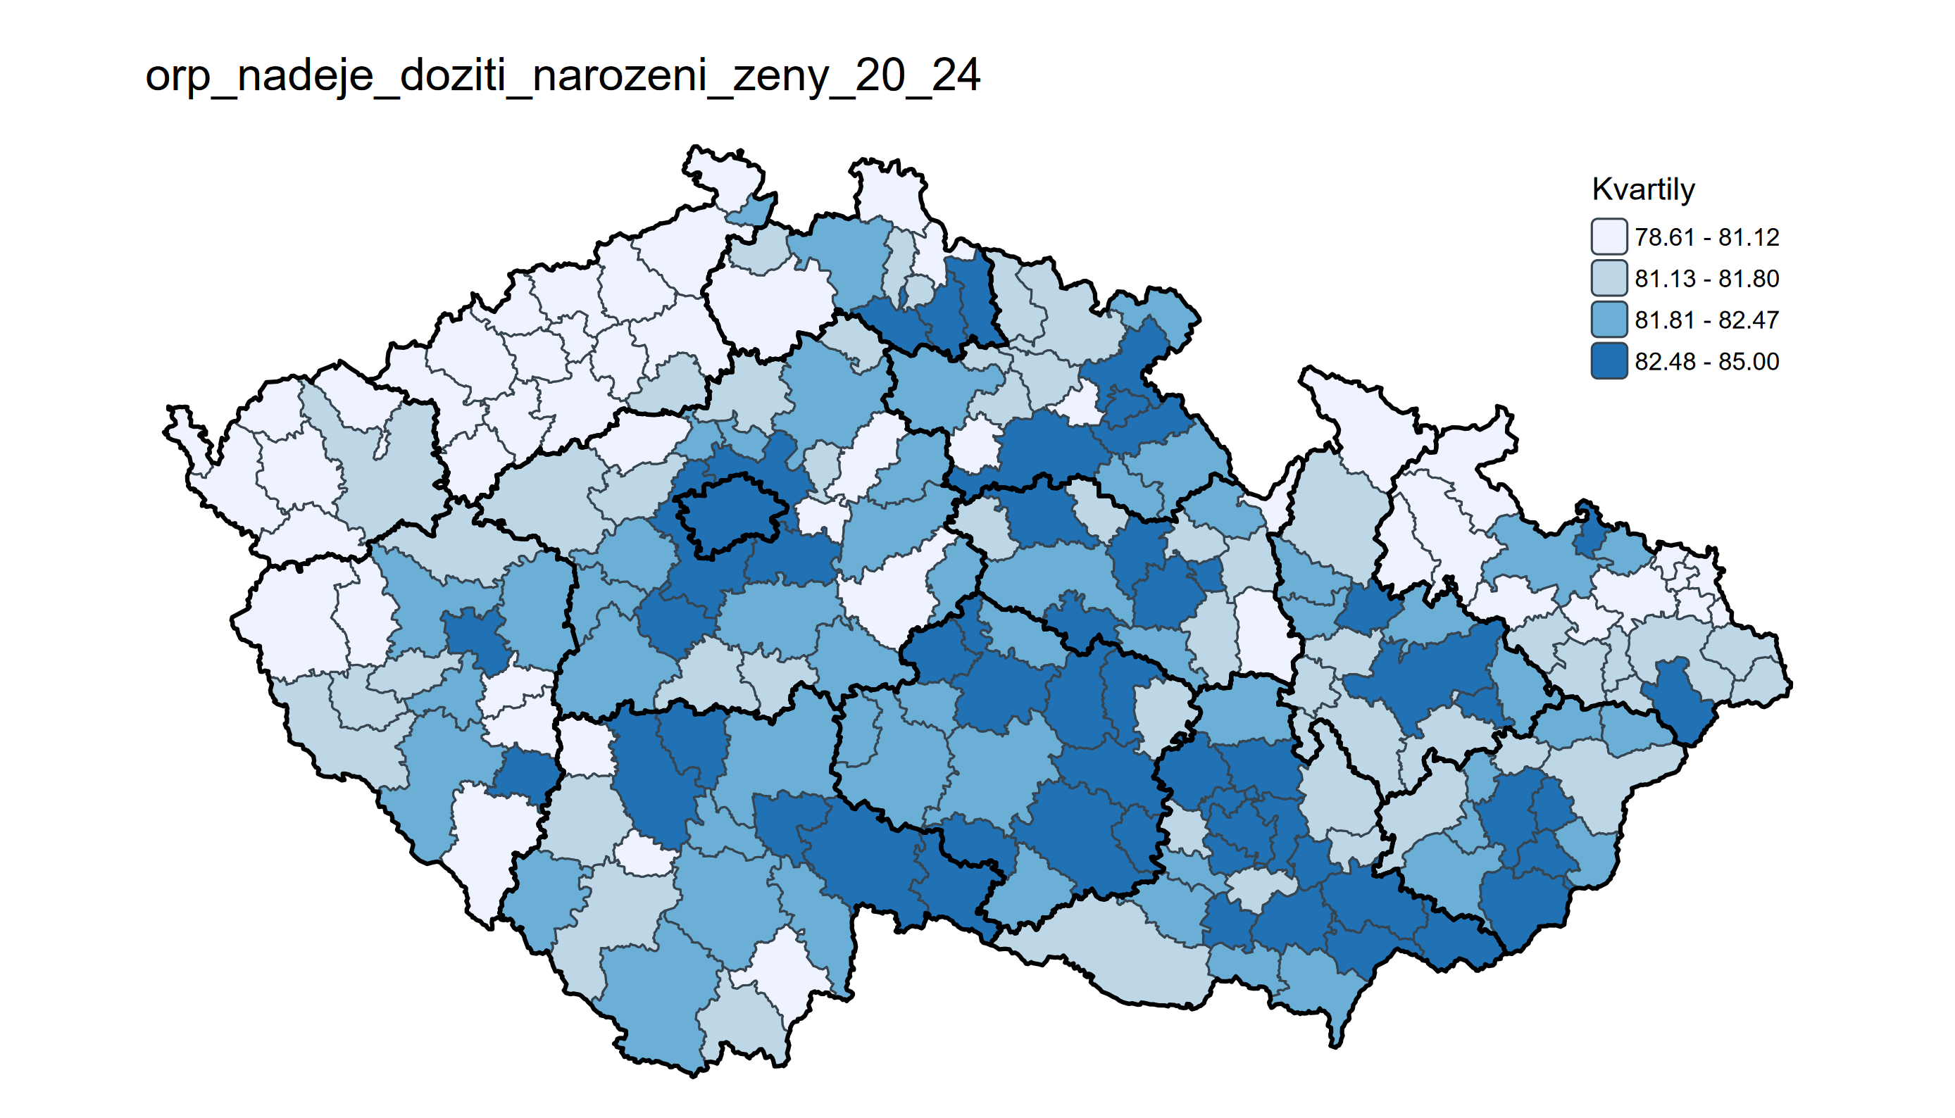
…masking persistent territorial asymmetries.
Life expectancy at birth (women, 2020-2024)

Slide 6
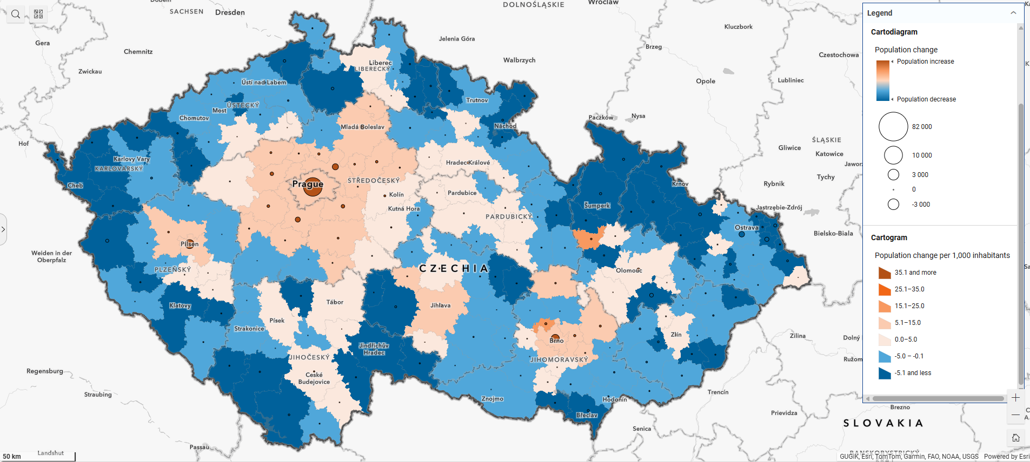
…masking persistent territorial asymmetries.
Population change (per 1000 inhabitants, 2024)

Slide 7
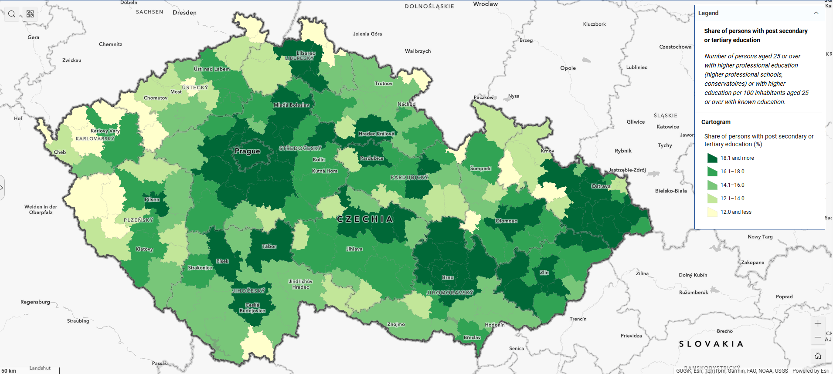
…masking persistent territorial asymmetries.
Share of population with higher education (national average = 25-30 %)

Slide 8
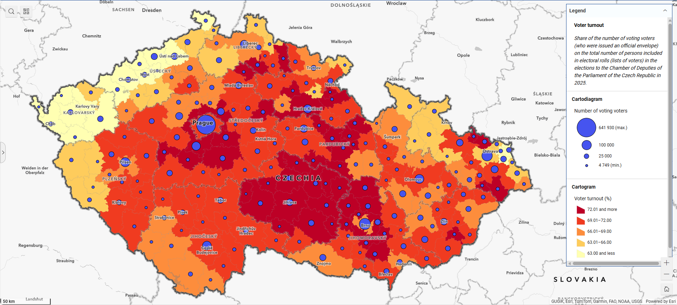
…masking persistent territorial asymmetries.
Voter turnout – Parliamentary elections 2025 (national average = 69 %)

Slide 9
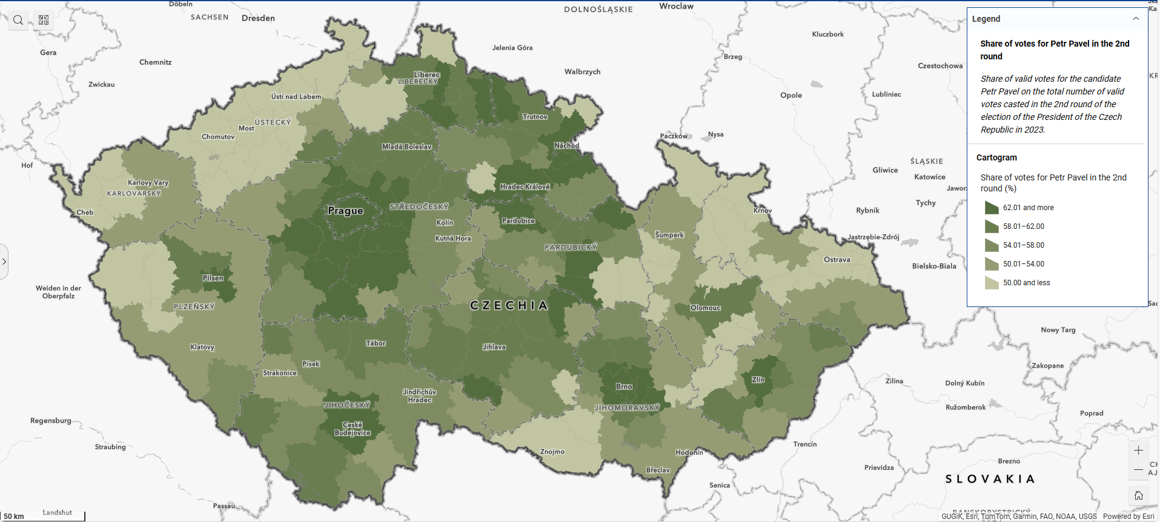
…masking persistent territorial asymmetries.
% of votes for Petr Pavel – Presidential elections 2023 (national average = 58 %)

Slide 10
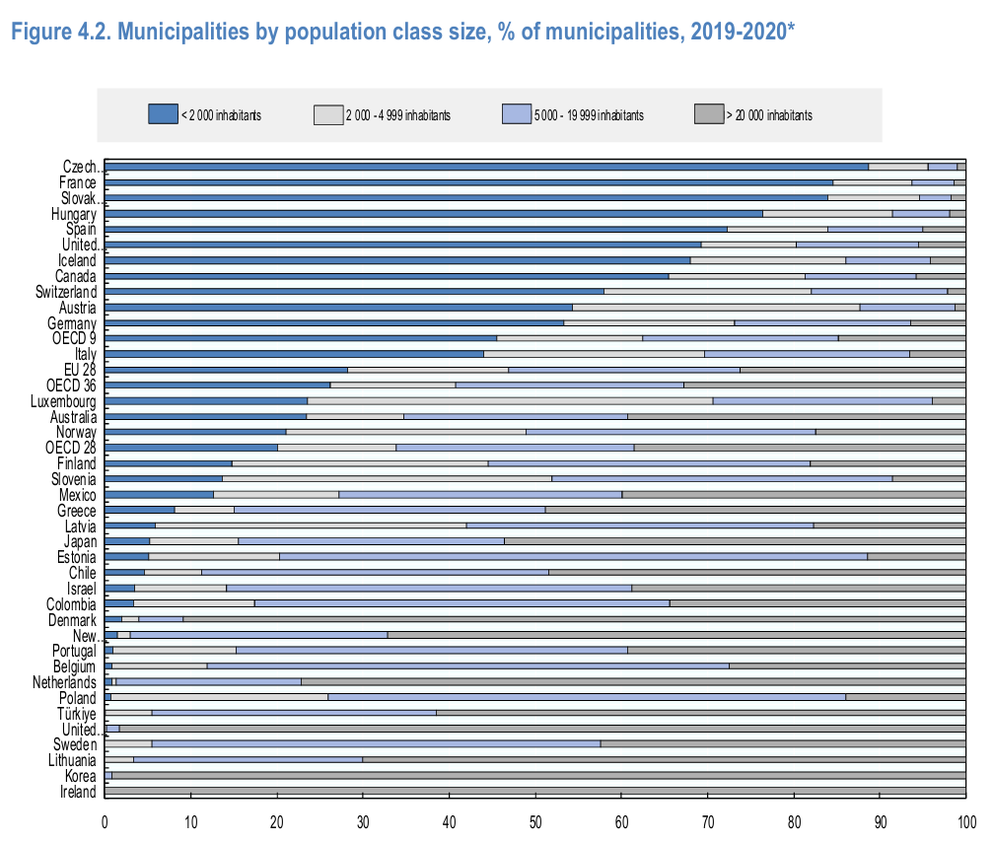
A unitary state with strong territorial fragmentation
National level
11 million inhabitants
Kraj: Regional level (NUTS 3)
14 regions with population ranging
from 300 000 to 1,5 million
Obec: Municipal level (NUTS 4)
6258 municipalities with population ranging from 16 to 1,4 million (Prague)
Notes:
Czechia is a unitary state with 14 self-governing regions and 6,258 municipalities
This means relatively few formal territorial layers compared with France, but a highly fragmented local map.

Slide 11
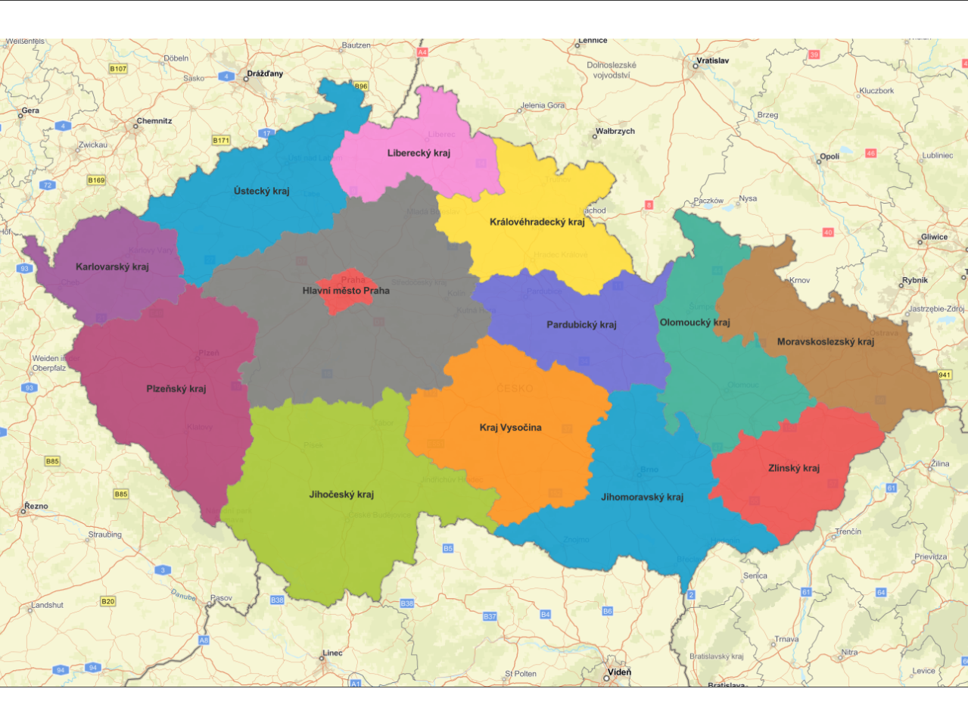
Regions (Kraj)
Self-governing body
Exclusive competencies:
  Coordination of social services
  Environmental protection
  Regional transport infrastructure
  Health (hospitals)
  Education (secondary)
No fiscal autonomy, transfer-based funding and delegation

Slide 12
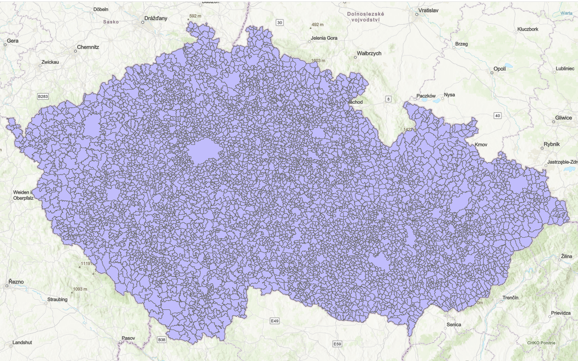
Municipalities (Obec)
Self-governing body
Exclusive competencies:
  Social services (children protection)
  Environmental protection
  Local transport infrastructure
  Health (primary care)
  Education (pre-school & primary)
  Housing
  Spatial planning
Low fiscal autonomy (< 10 %)

Slide 13
Funding of subnational governments
Model based on shared taxes and earmarked transfers, minimal own resources
Regions (kraje)
~ 15% of public budget (4% GDP)
shared taxes (1/3) + transfers (2/3)
shared taxes allocation formula based on surface
no own fiscal revenues
slightly positive balance
Municipalities (obce)
~ 25 % of public budget (6 % GDP)
shared + own taxes (2/3), transfers and non-tax revenues (1/3)
shared taxes allocation formula based mainly on population
own taxes: property tax (~ 4,5 % of budgets)
positive balance

Slide 14
Delegated powers – a unique „hybrid model“
Not a millefeuille, rather oignon layers with incremental power delegation
All municipalities (6258): elections, population records, water management, local roads
Municipalities with delegated authority (338): building authority, registry offices, some environmental and agricultural agenda, social work provision
Municipalities with extended powers (205): law enforcement offences, road authorities, registries and document issuance
Hybrid, because:
Clerks are employed by municipalities, who receive transfers to cover expenses
BUT offices under the authority and supervision of a national body (e.g. MoRD for construction, Ministry of Culture for heritage)
de iure autonomy, but collusions in practice (e.g. bonuses and HR management, equipment…)

Slide 15
Current challenges and policy dilemmas
Fragmentation: towards the French model of municipal cooperation (but no obligation and no own fiscal resources, limited scope of competencies), urban functional areas not explicitely addressed
Delegated powers: decentralisation (spatial planning) vs centralisation (building permitting), delegation vs independence & autonomy, funding, absence of deconcentrated bodies (e.g. préfet)
Infrastructure and capital expenses: autonomy and own resources vs transfer dependency, lack of capacities at local level for planning and commissioning
Funding: low debt (and high balance), but under-investment and massive transfers
Shared taxes: efficiency vs solidarity dilemma, weak link to economic activity, allocation formula parameters to accommodate everyone
Own resources and economic instruments: low and regressive property taxes (based on surface, not value), weak land management and limited public/social housing stock
Spatial planning: rigid and procedural, clashes of public interests, limited use of economic spatial planning instruments, weak link to strategic planning

Slide 16
Regional policy: from targeted to place-based and integrated approaches
Before 2014: Traditional approach to regional policy
  Targeting most deprived areas
  Support exogenous factors of growth (infrastructure, FDI, employment support)
  Policy Toolbox:
    Investment incentives
    Subsidies (EU and national) with (limited) territorial dimension
    Agencies & institutions (Agency for social inclusion, regional universities)
After 2014: Functional areas and smart specialisation
  More strategic regional policy
  Support endogenous factors of growth (innovation ecosystems) and functional area development
  Policy Toolbox:
    Regional Smart specialisation
    Integrated territorial instruments (ITI/CLLD)
    Capacity building

Slide 17
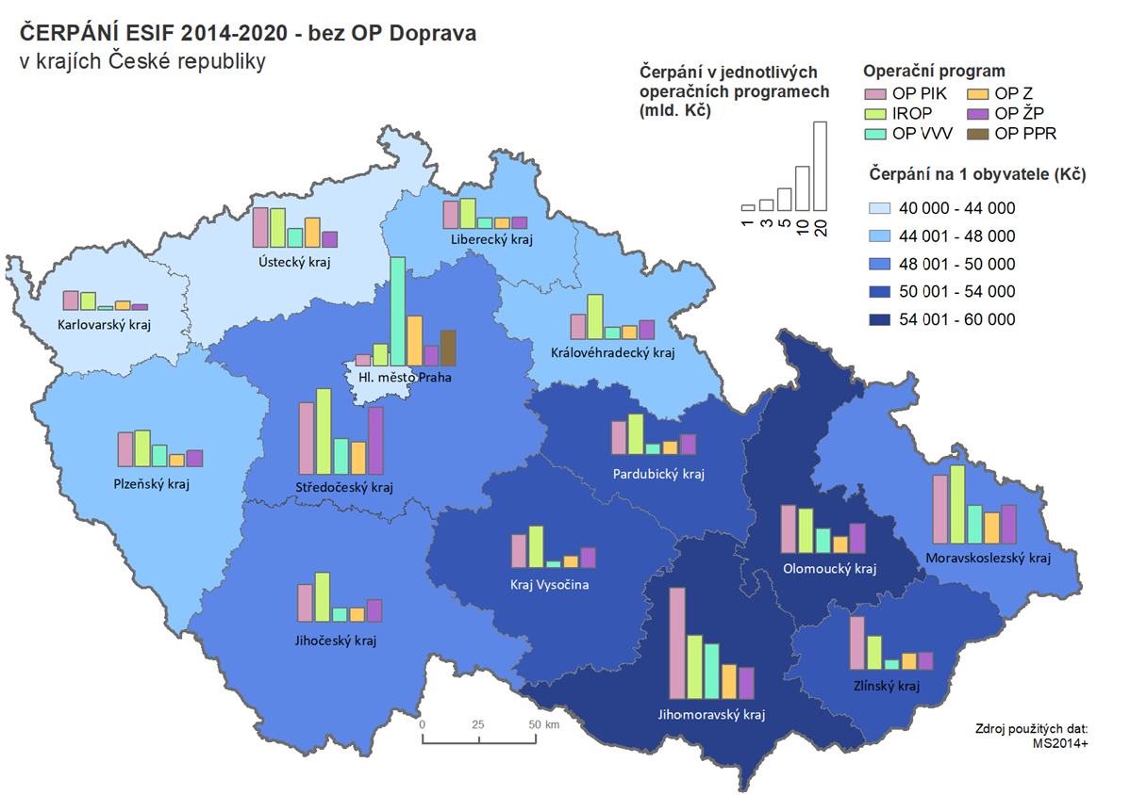
EU Funds: the main source of funding
EU funds since 2004: EUR 75bn. in transport, health, environment, R&I, social policies…
  ~ 5% of public budgets, up to 50% of capital expenses
  Positive impact nationally (GDP/GVA, productivity, R&D, environment and social indicators) but mixed results in terms of convergence
  Concentration in urban areas resulting from expense typology (urban transport, health, education, institutions, digitalisation), territorial dimension at NUTS 2 level
Conflicting goals:
  fast and complete drawing vs targeting / value for money
  investments in „concrete“ vs in human capital
  administrative burden vs tailored approaches

Slide 18
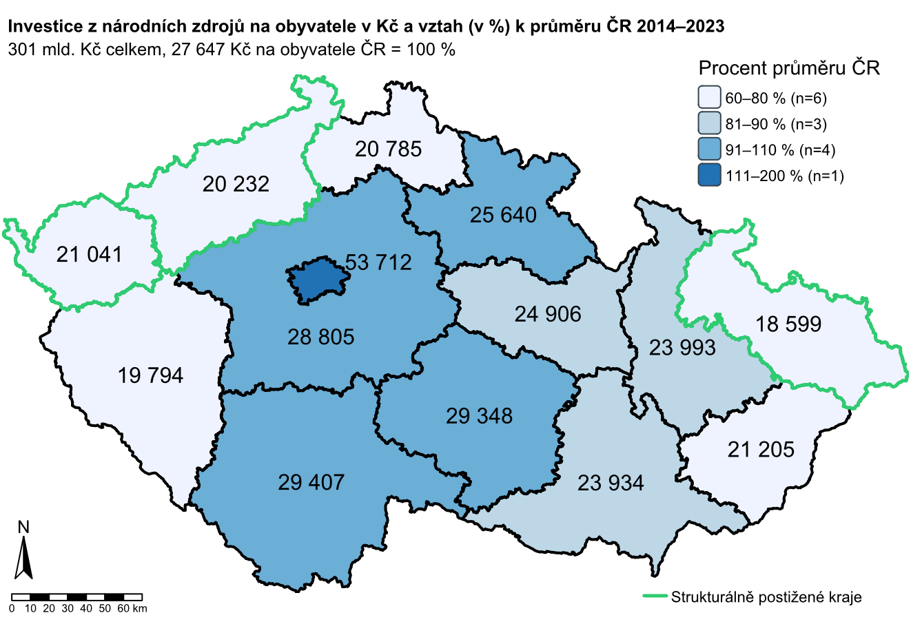
National funds: complementary funding
National investments since 2014: EUR 12-15bn.
  explicit regional policy represents only 2% of public investments
  concentration in Prague and dominantly rural areas
  + investment support schemes (~ EUR 14 bn.)
Conflicting goals:
  sectoral policies vs regional policies
  fragmented governance and weak coordination
  administrative burden and inefficiencies
  strong output monitoring and auditing, but rare outcome & impact evaluations

Slide 19
Governance and coordination of regional policy
Legislation: Act 248/2000 – coordination and supervision at national (MoRD) and regional level (kraj), priority areas delineation (kraj and microregional), strategic framework, territorial impact assessments (RIA)
Strategy: Regional development strategy (MoRD) and regional strategies, territorial dimension of EU Funds, territorial objectives, action plans
Tools: regional allocation and co-financing, bonification, integrated instruments, strategic alignment
Partnership and coordination: National and Regional standing conferences, consultations with partners, institutional cooperation (Governmental Committees)

Slide 20
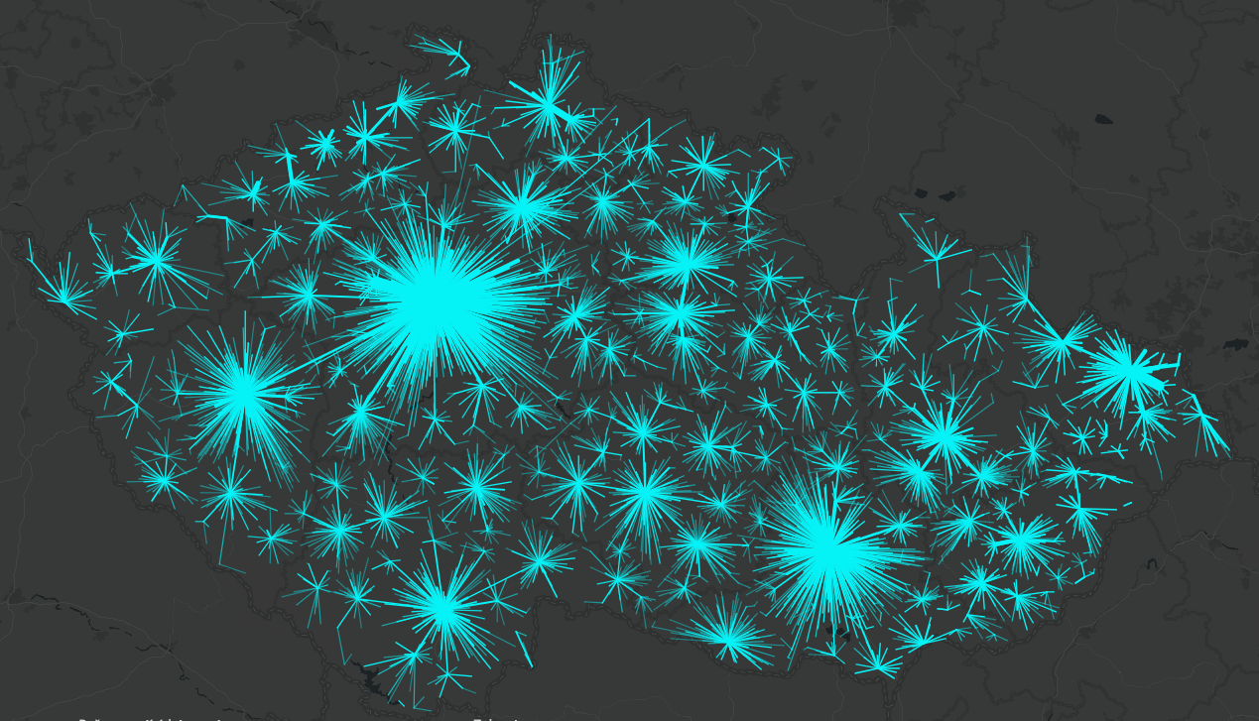
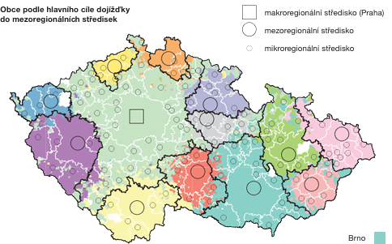
Metropolitan areas: growth, congestion, diffusion
Prague and Brno metro areas: the economic engines
  Raising congestion costs (esp. housing) and greenfield suburbanisation (land use)
  Saturated and inefficient public services in suburbia (schools, health, transport) and low density in urban cores
  Limited diffusion to hinterlands
Other agglomerations:
  Ostrava part of a dynamic metro area with Katowice
  Regional champions (Olomouc in R&D, Pardubice & Jihlava in manufacturing)
  Signs of decline in some cities (shrinking cities)

Slide 21
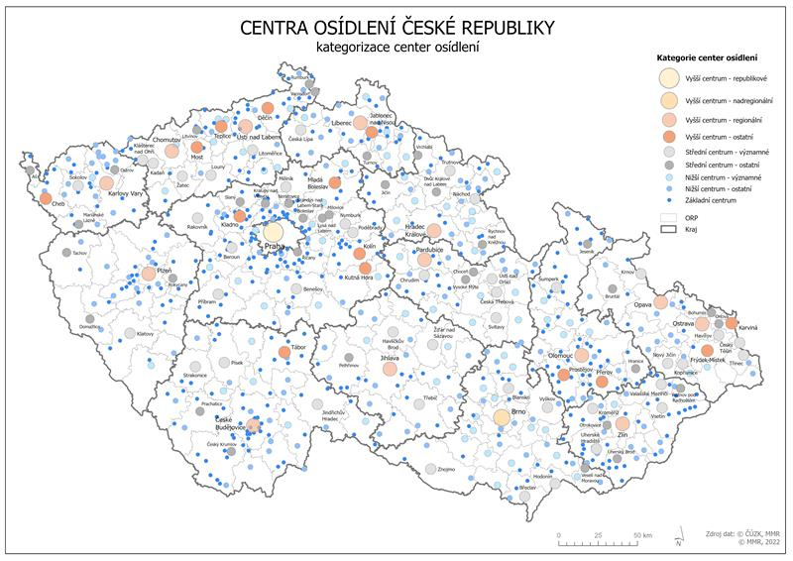
Small and medium sized cities
Dense network od small and medium sized cities (10 to 50 000 inhabitants) with a strong centrality function (local labour, education and service hubs)
Heterogeneous development trends:
  Peripherality and connectivity
  Economic dependence and specialisation
  Lack of qualified workforce and opportunities
  Access to quality services
Objectives of deconcentrating growth, but:
  lack of targeted support programs
  lack of obligation / motivation (and/or resources)
  lack of capacities (human, administrative)

Slide 22
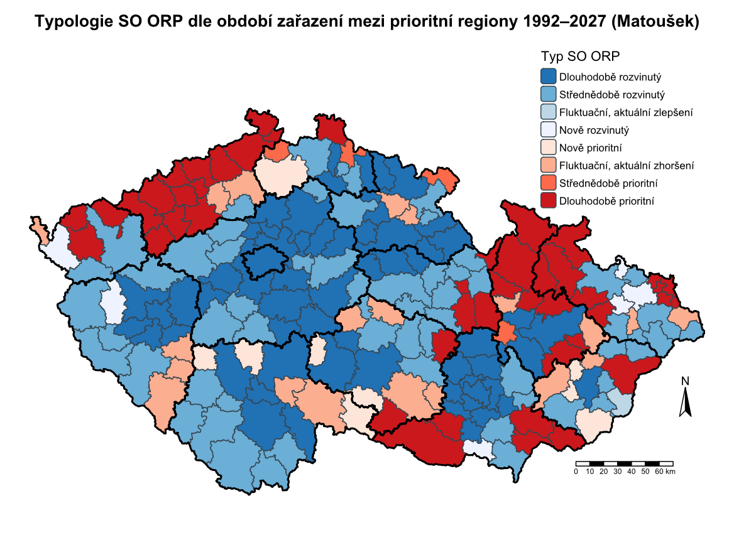
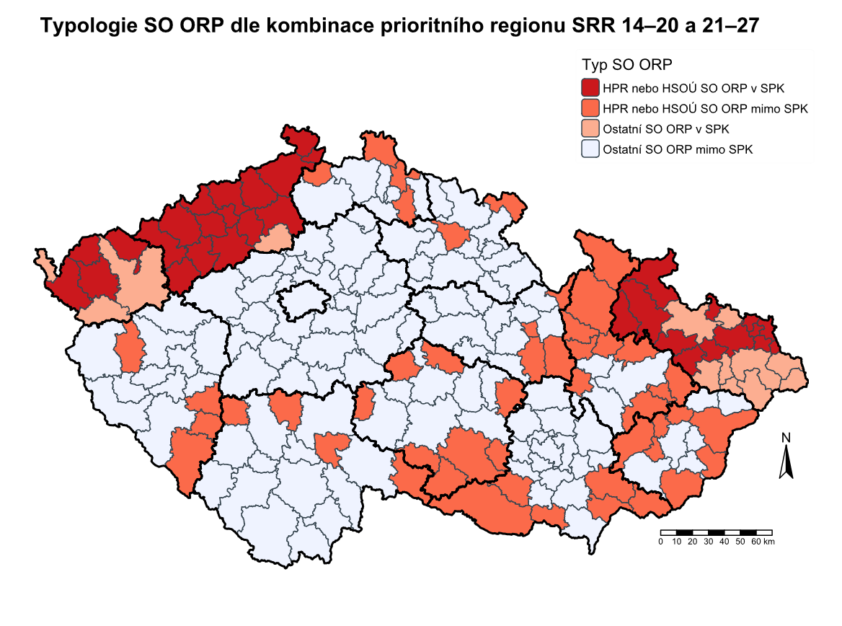
Structurally disadvantaged regions
By law „regions with concentrated support“
Defined at regional level (coal-mining regions - JTF) and microregional level ~ 25-30 % of Czech population
  Socioeconomic deprivation indicators (ageing, unemployment, educational achievement, indebtedness, segregation)
Interacting factors:
  outmigration and sociospatial segregation
  deindustrialisation and urban decay
  environmental degradation
  peripherality and ageing in rural areas
  quality of government and services, historical factors

Slide 23
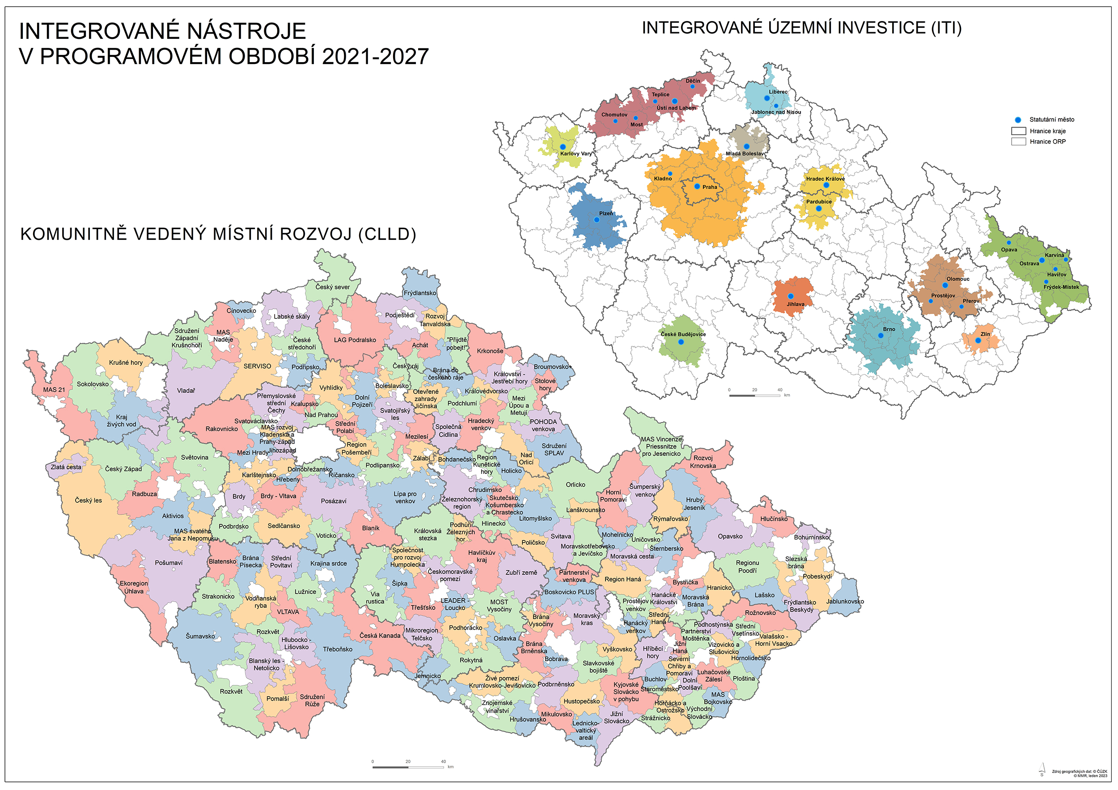
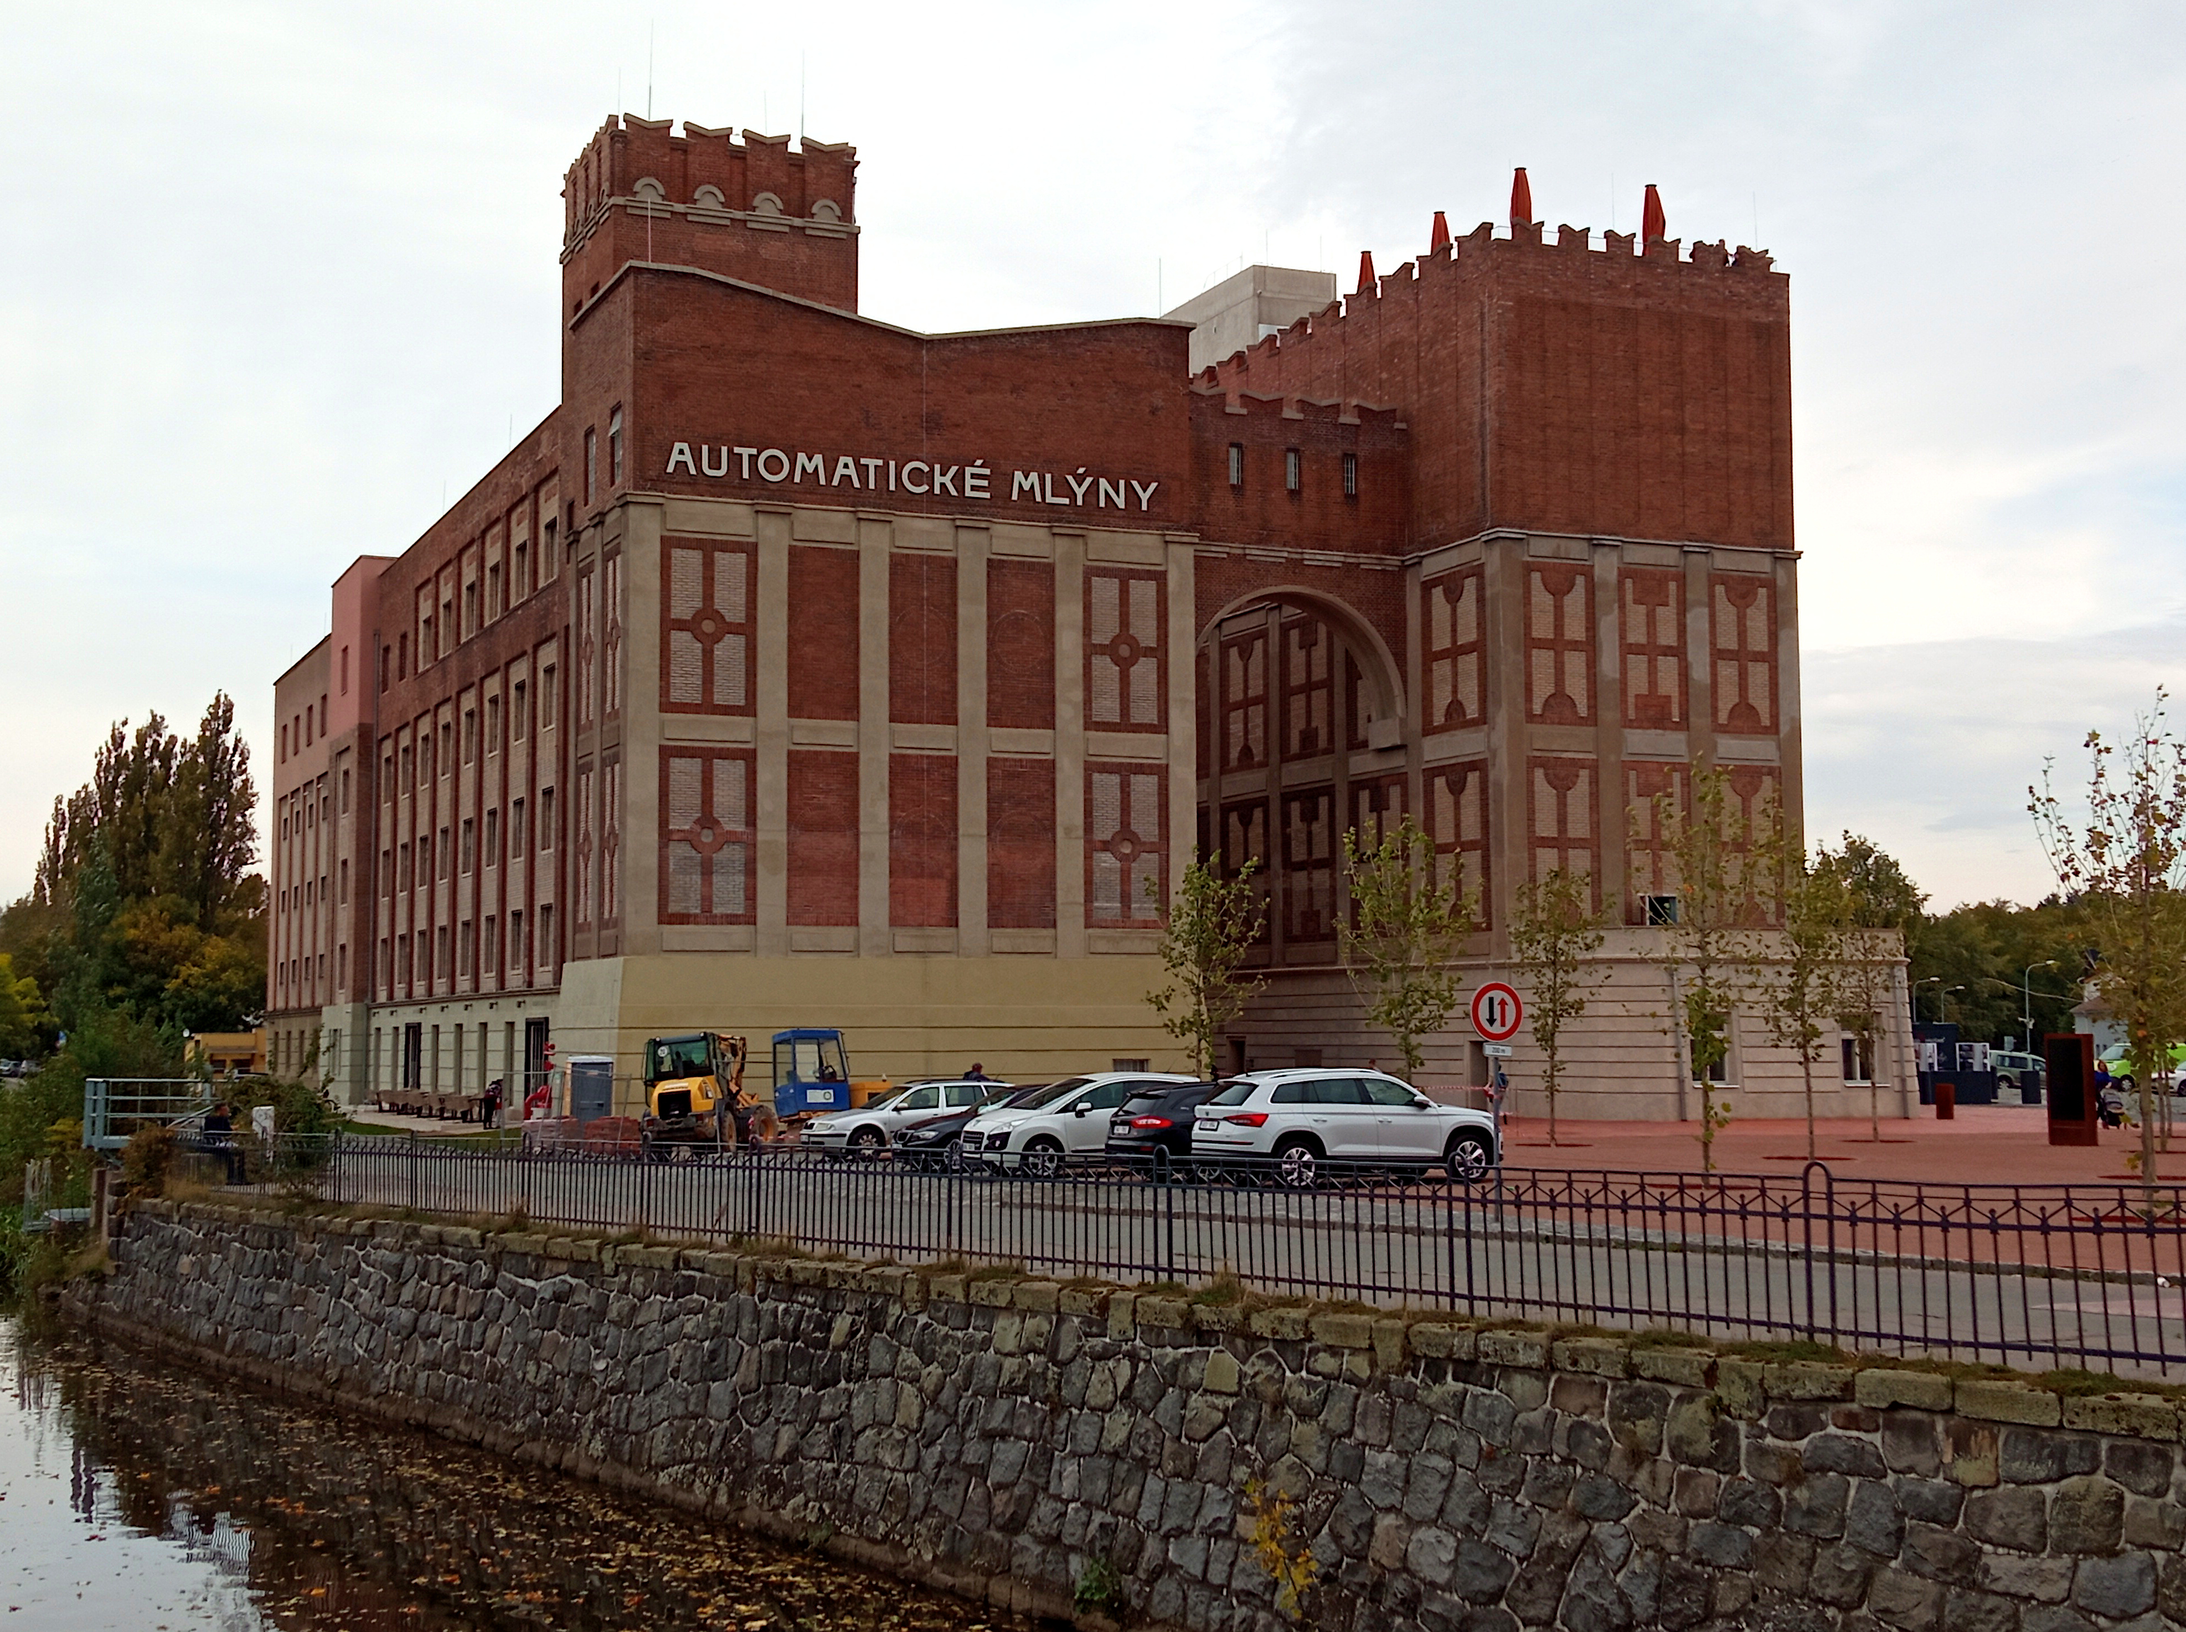
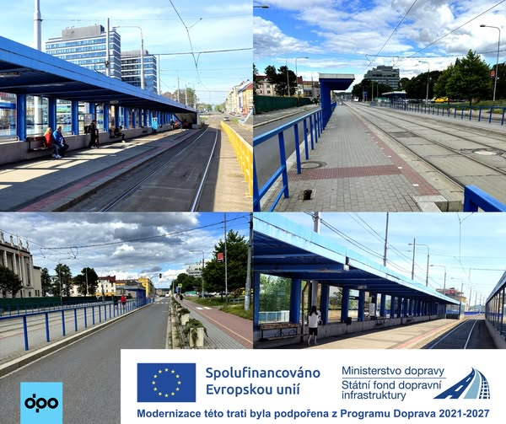
Integrated approaches (ITI/CLLD)
Sustainable Urban Development (8 % of ERDF allocation)
  13 functional metropolitan areas
  integrated strategic frameworks and municipal cooperation (ITI)
  connecting cores with hinterlands (mainly transport infrastructure)
CLLD (LEADER)
  185 Local Action Groups
Challenges:
  governance, strategic / spatial planning
  responsibilities and accountability (trust)
  capacities (human, administrative, financial)
  economic development policies

Slide 24
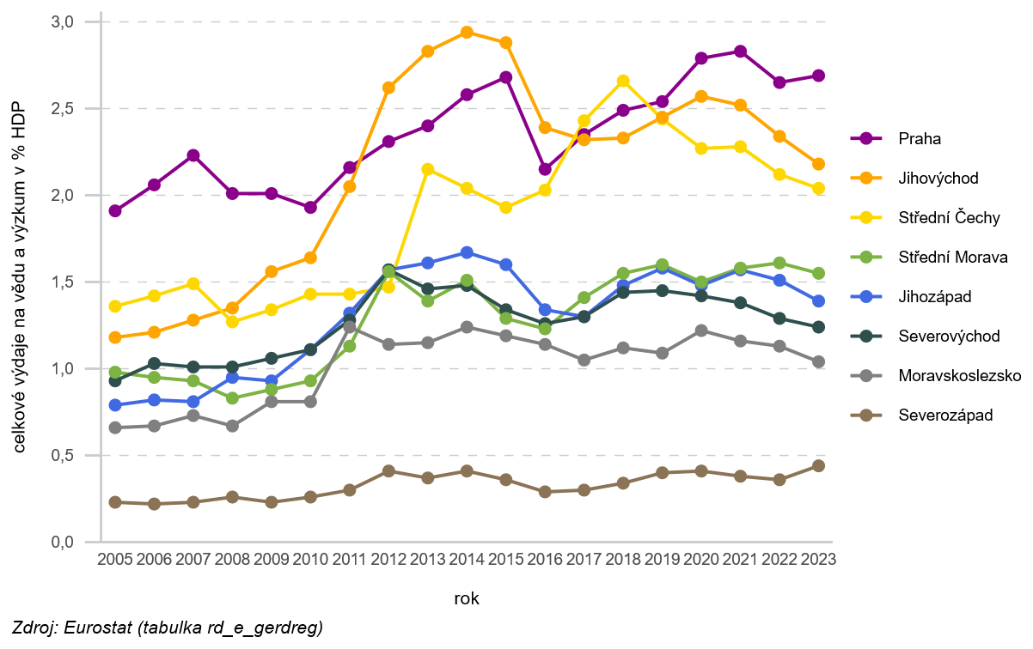
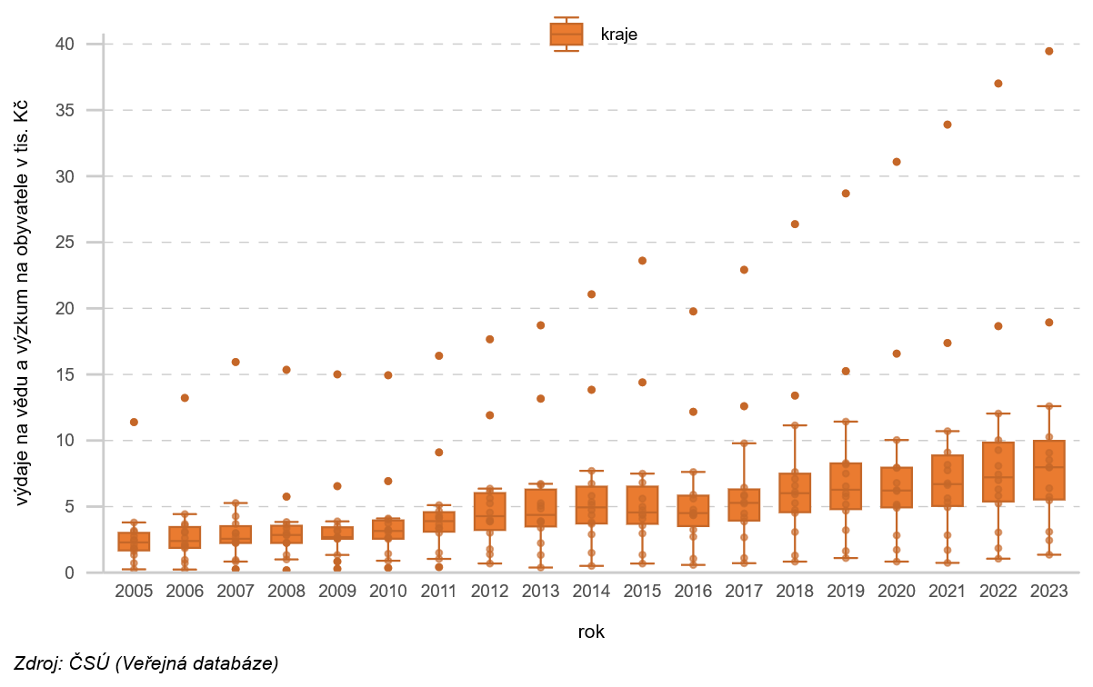
Smart specialisation
Pure place-based approach
  build on regional strengths (domains of specialisation)
  nurture innovation ecosystems and capacity building (e.g. innovation vouchers)
  ex ante conditionality (EU Funds and national research programs)
Sectoral platforms at national and regional levels (e. g. automotive, cultural industries)
Challenges:
  weak central coordination and uneven local capacities
  no dedicated funding allocation
  (too) many priorities and domains of specialisation

Slide 25
Wrapping it up
National convergence x Regional divergence
Metropolisation and peripheralisation trends
Strong market mechanisms, limited agency of national and regional institutions
Mixed outcomes despite substantial public funding
Quality of governance matters, key role of „regional champions“ and central coordination

Slide 26
What future lies ahead - EU Cohesion policy after 2028
Less funds and higher co-financing, more targeted / concentrated, performance-oriented, use of financial instruments, tighter alignment to EU objectives (incl. defence)
    Needs will be increasingly saturated by national budget (but growing deficits…)
    Prioritisation will require trade-offs, it´s a zero-sum game (but pork barrel…)
    Performance budgeting and financial instruments will disadvantage the already disadvantaged (capacity building and absorption crucial)
    Governing functional areas will require institutional reforms (potentially constitutional amendments)
Other challenges include reducing administrative burden, financing not link to costs, flexibility for crisis reaction, funds blending (CAP and Cohesion, Competitiveness, EU direct funding)

Slide 27
What future lies ahead – national policies
What objectives?
    Regional convergence or global competitiveness?
    Targeted support to growth engines or deprived areas?
    Resolving sectoral vs regional policy conflicting objectives?
What institutions and coordination? From strategic alignment „on paper“ to responsibility and accountability for results
    Contract-based regional policy (French model)?
    Extending decentralisation and fiscal autonomy?
    Special economic areas?
    Diffusion in functional areas (esp. hinterlands) and urban / metropolitan governance?
What policy tools and resources?
    Pressures on public budgets, PPPs, financial instruments
    Institutional inertia – reforms, capacity building, learning
    Monitoring and evaluation, territorial impact assessment

Slide 28
Last remarks / questions
What is an (un)acceptable level of territorial inequalities?
Are convergence and competitiveness necessarily conflicting goals?
What is the role of the state in addressing territorial inequalities?
What is „quality of institutions“? How do we improve it?

Slide 29
Thank you for your attention
Alexandre Reznikow
alexandre.reznikow@mmr.gov.cz

