Slide 1
Vocational education – LO and Svenskt Näringsliv common positions
May 2022

Slide 2

Background
Both general unemployment and youth unemployment are too high.
Long term unemployment is problematic.
At the same time: many vacancies.
8 of 10 companies experienced difficulties when recruiting
3 of 10 attempts to recruit fails.

Slide 3
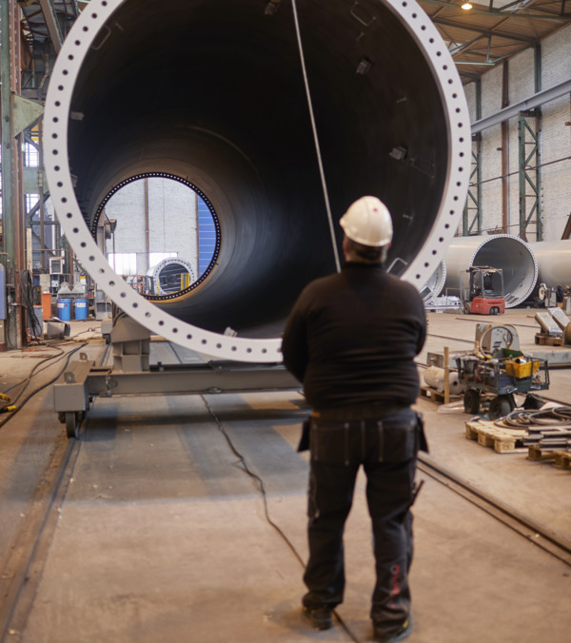
Upper secondary VET is the most sought-after education.

Slide 4
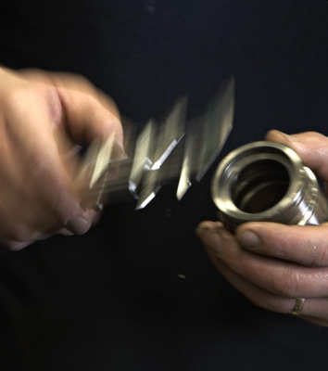
Sweden needs more students in VET
There will be a shortage of 290,000 vocationally trained people in Sweden by the year 2035
To meet need on the labor market, the proportion who graduate from vocational programs and vocational adult education needs to increase to 40 percent.

Slide 5

The supply of vocational programs does not match the demands of the labor market

Slide 6

Attractiveness and quality of VET needs to increase

Slide 7
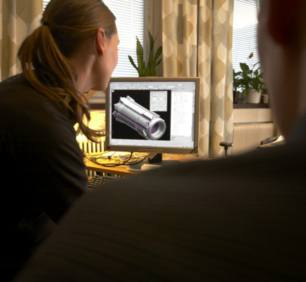
LO and Svenskt Näringsliv - common positions
More students need to graduate.
Vocational programs must be dimensioned correctly
Adult education must match the needs of the labor market
Study and career guidance must be strengthened
increase the power and influence of branches and social partners

