Slide 1


Regional development & regional policy in Czechia (current challenges and opportunities)
Prof. Jiří Blažek
Economic Geography and Regional Development Centre
Dept. of Social Geography and Regional Development
Charles University, Science Faculty
Prague April 1st, 2026

Slide 2
Outline
1. Conceptual and research framework for understanding regional development
2. Regional development and policy in Czechia
3. Application of European smart specialisation strategy in Czechia

Slide 3
Motto: „the success of an actor does not depend only on its abilities and resources, but also on the quality of its surroundings“
Two basic understandings of the „surrounding environment“ 1. geographical proximity and associated regional identity – clusters, regional innovation systems (RIS) 2. relationships within the value chains (GVC) (customers and suppliers are often located in different regions, countries and continents)
GVCs= vertical innovation system Companies are often affected by both "surroundings" at the same time

Slide 4
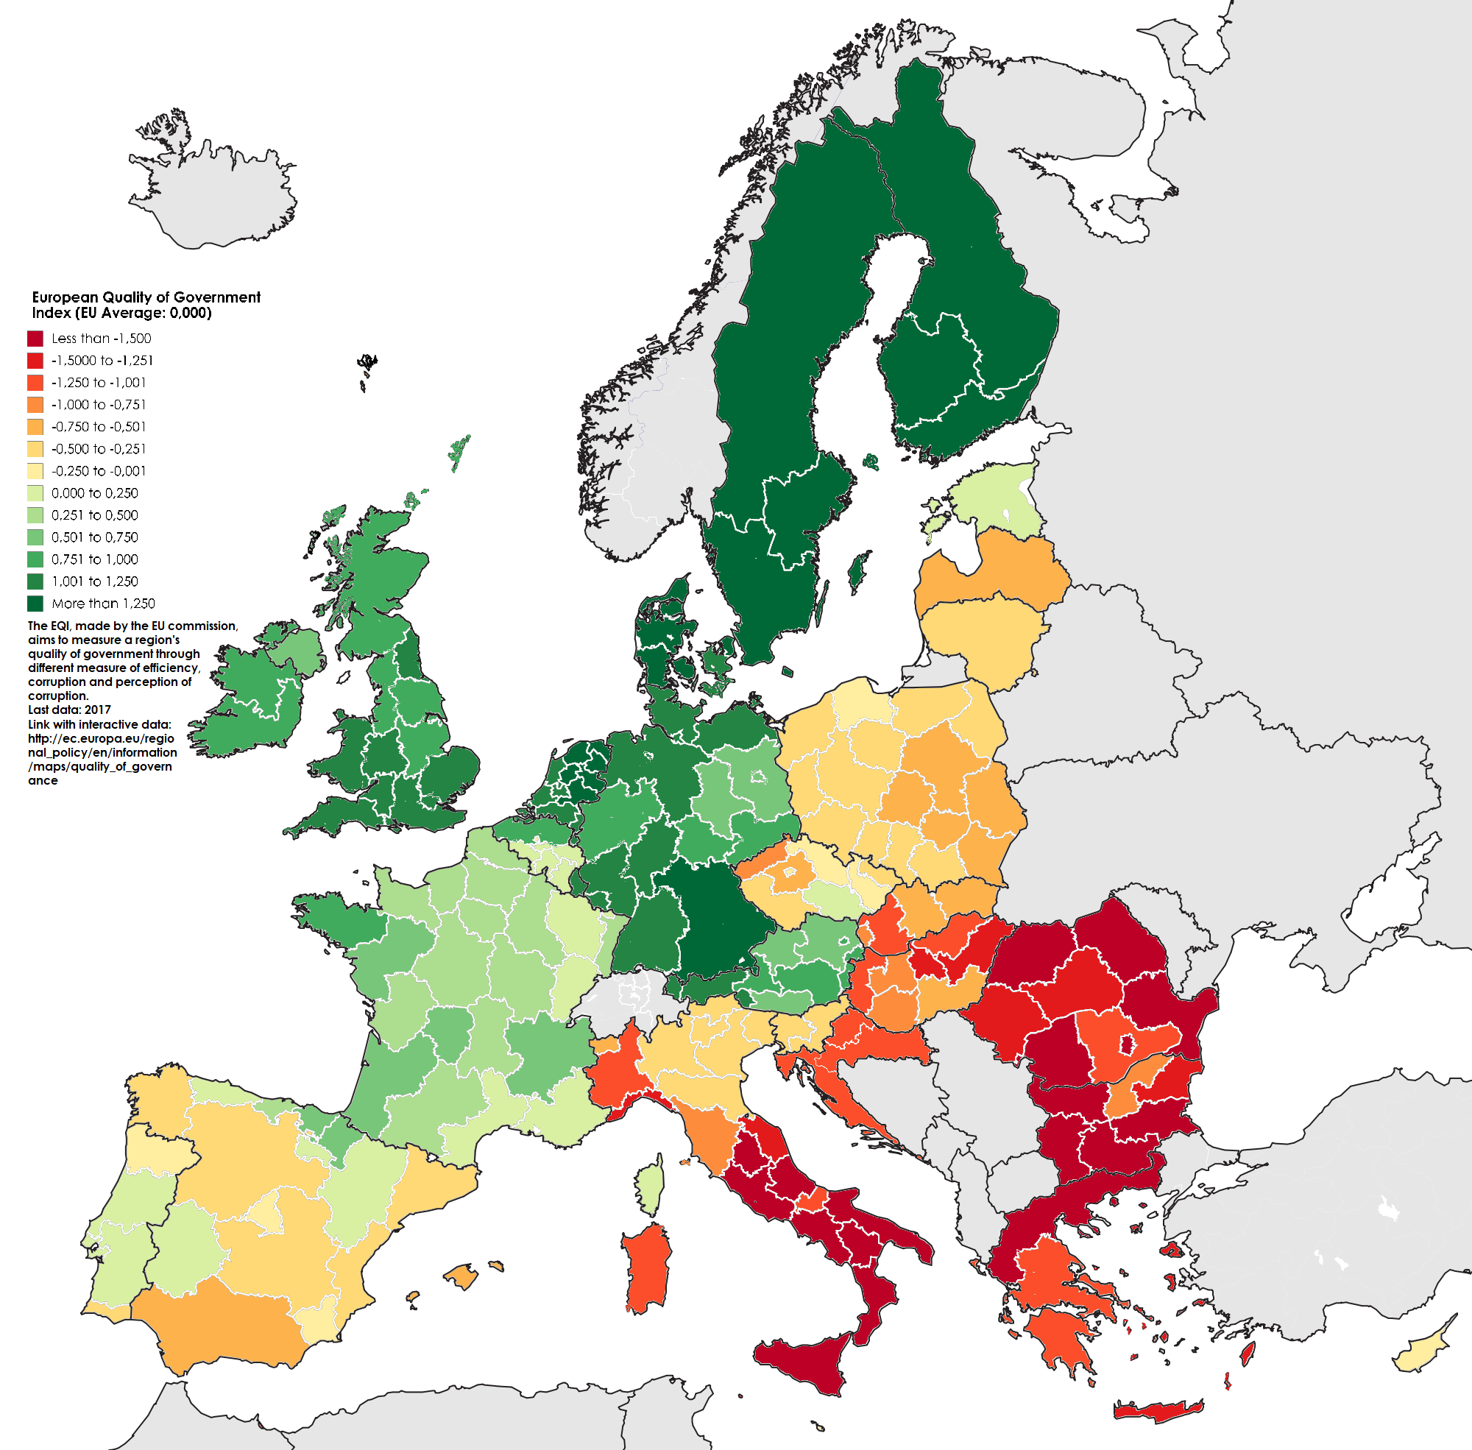
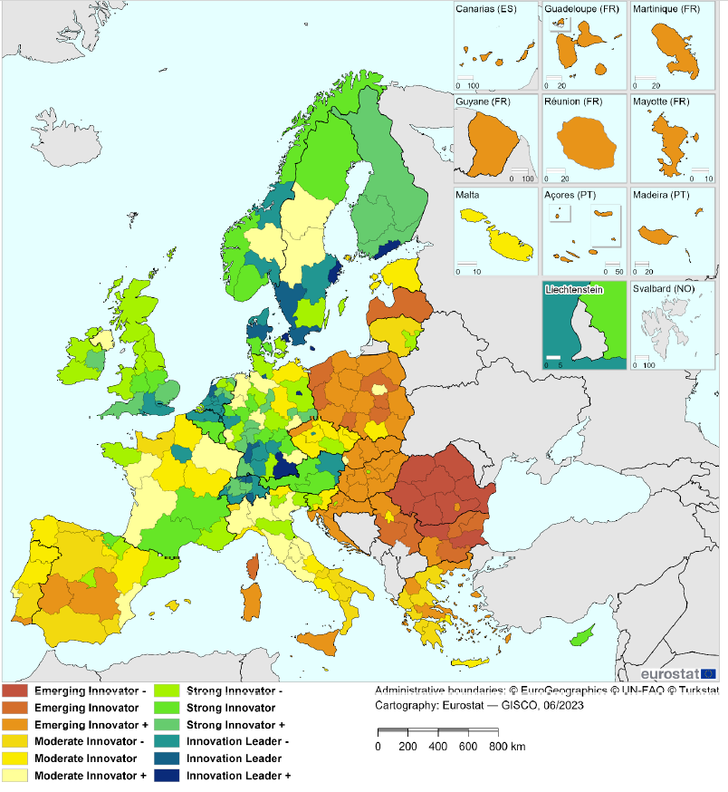
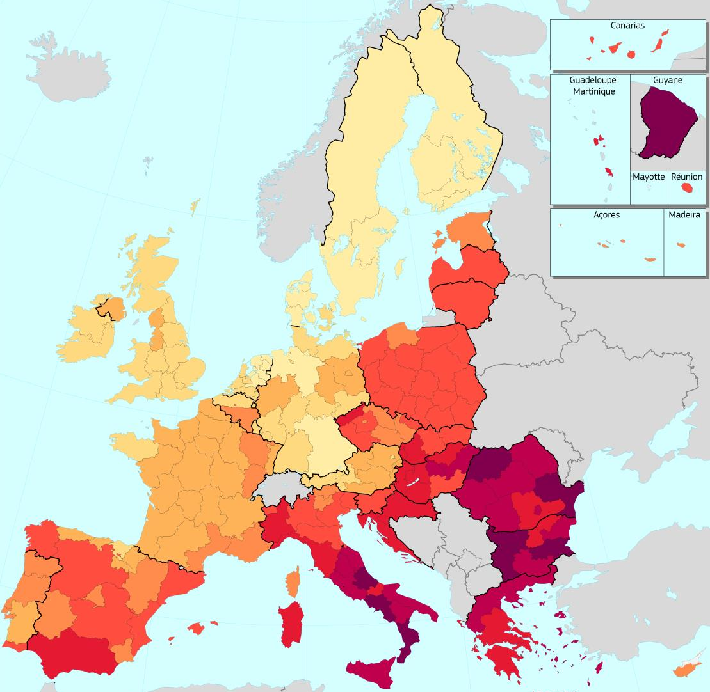
nadpis
Tady bude běžný text.

Slide 5
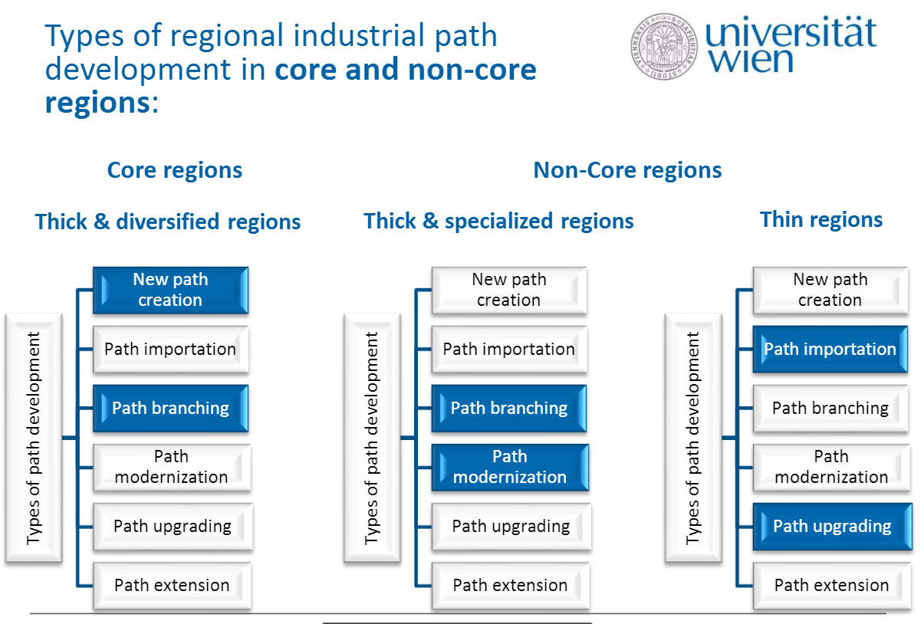
Isaksen, Trippl, 2016
Surrounding environment matters!

Slide 6
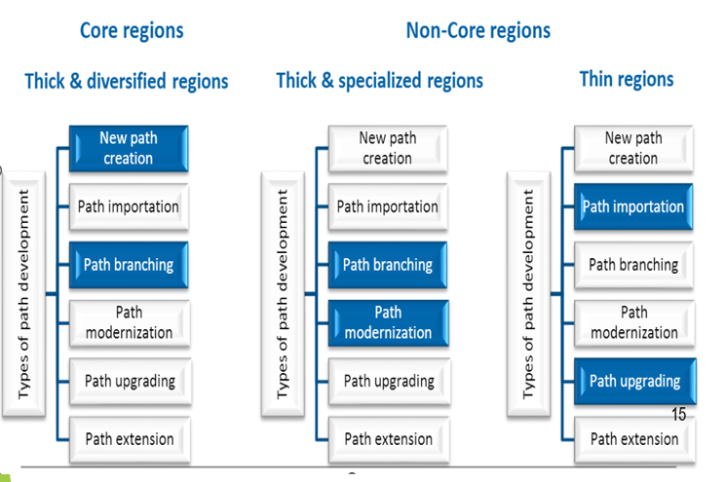
Summary: 4 main reasons why to enhance RIS
1) The success of a company, university, etc. depends not only on its capabilities, but also on the quality of its surrounding environment
2) The link between the quality of the reg. innovation system and the evolutionary trajectories of industries in the region (quality RIS - wider range of trajectories, reduces risks for companies).
3) The link between the quality of the regional innovation system and the position of firms in the GPNs
4) The link between the quality of the reg. innovation system and the ability to respond to grand societal challenges (climate, geopolitics,…)

Slide 7
Regional development and policy in Czechia

Slide 8
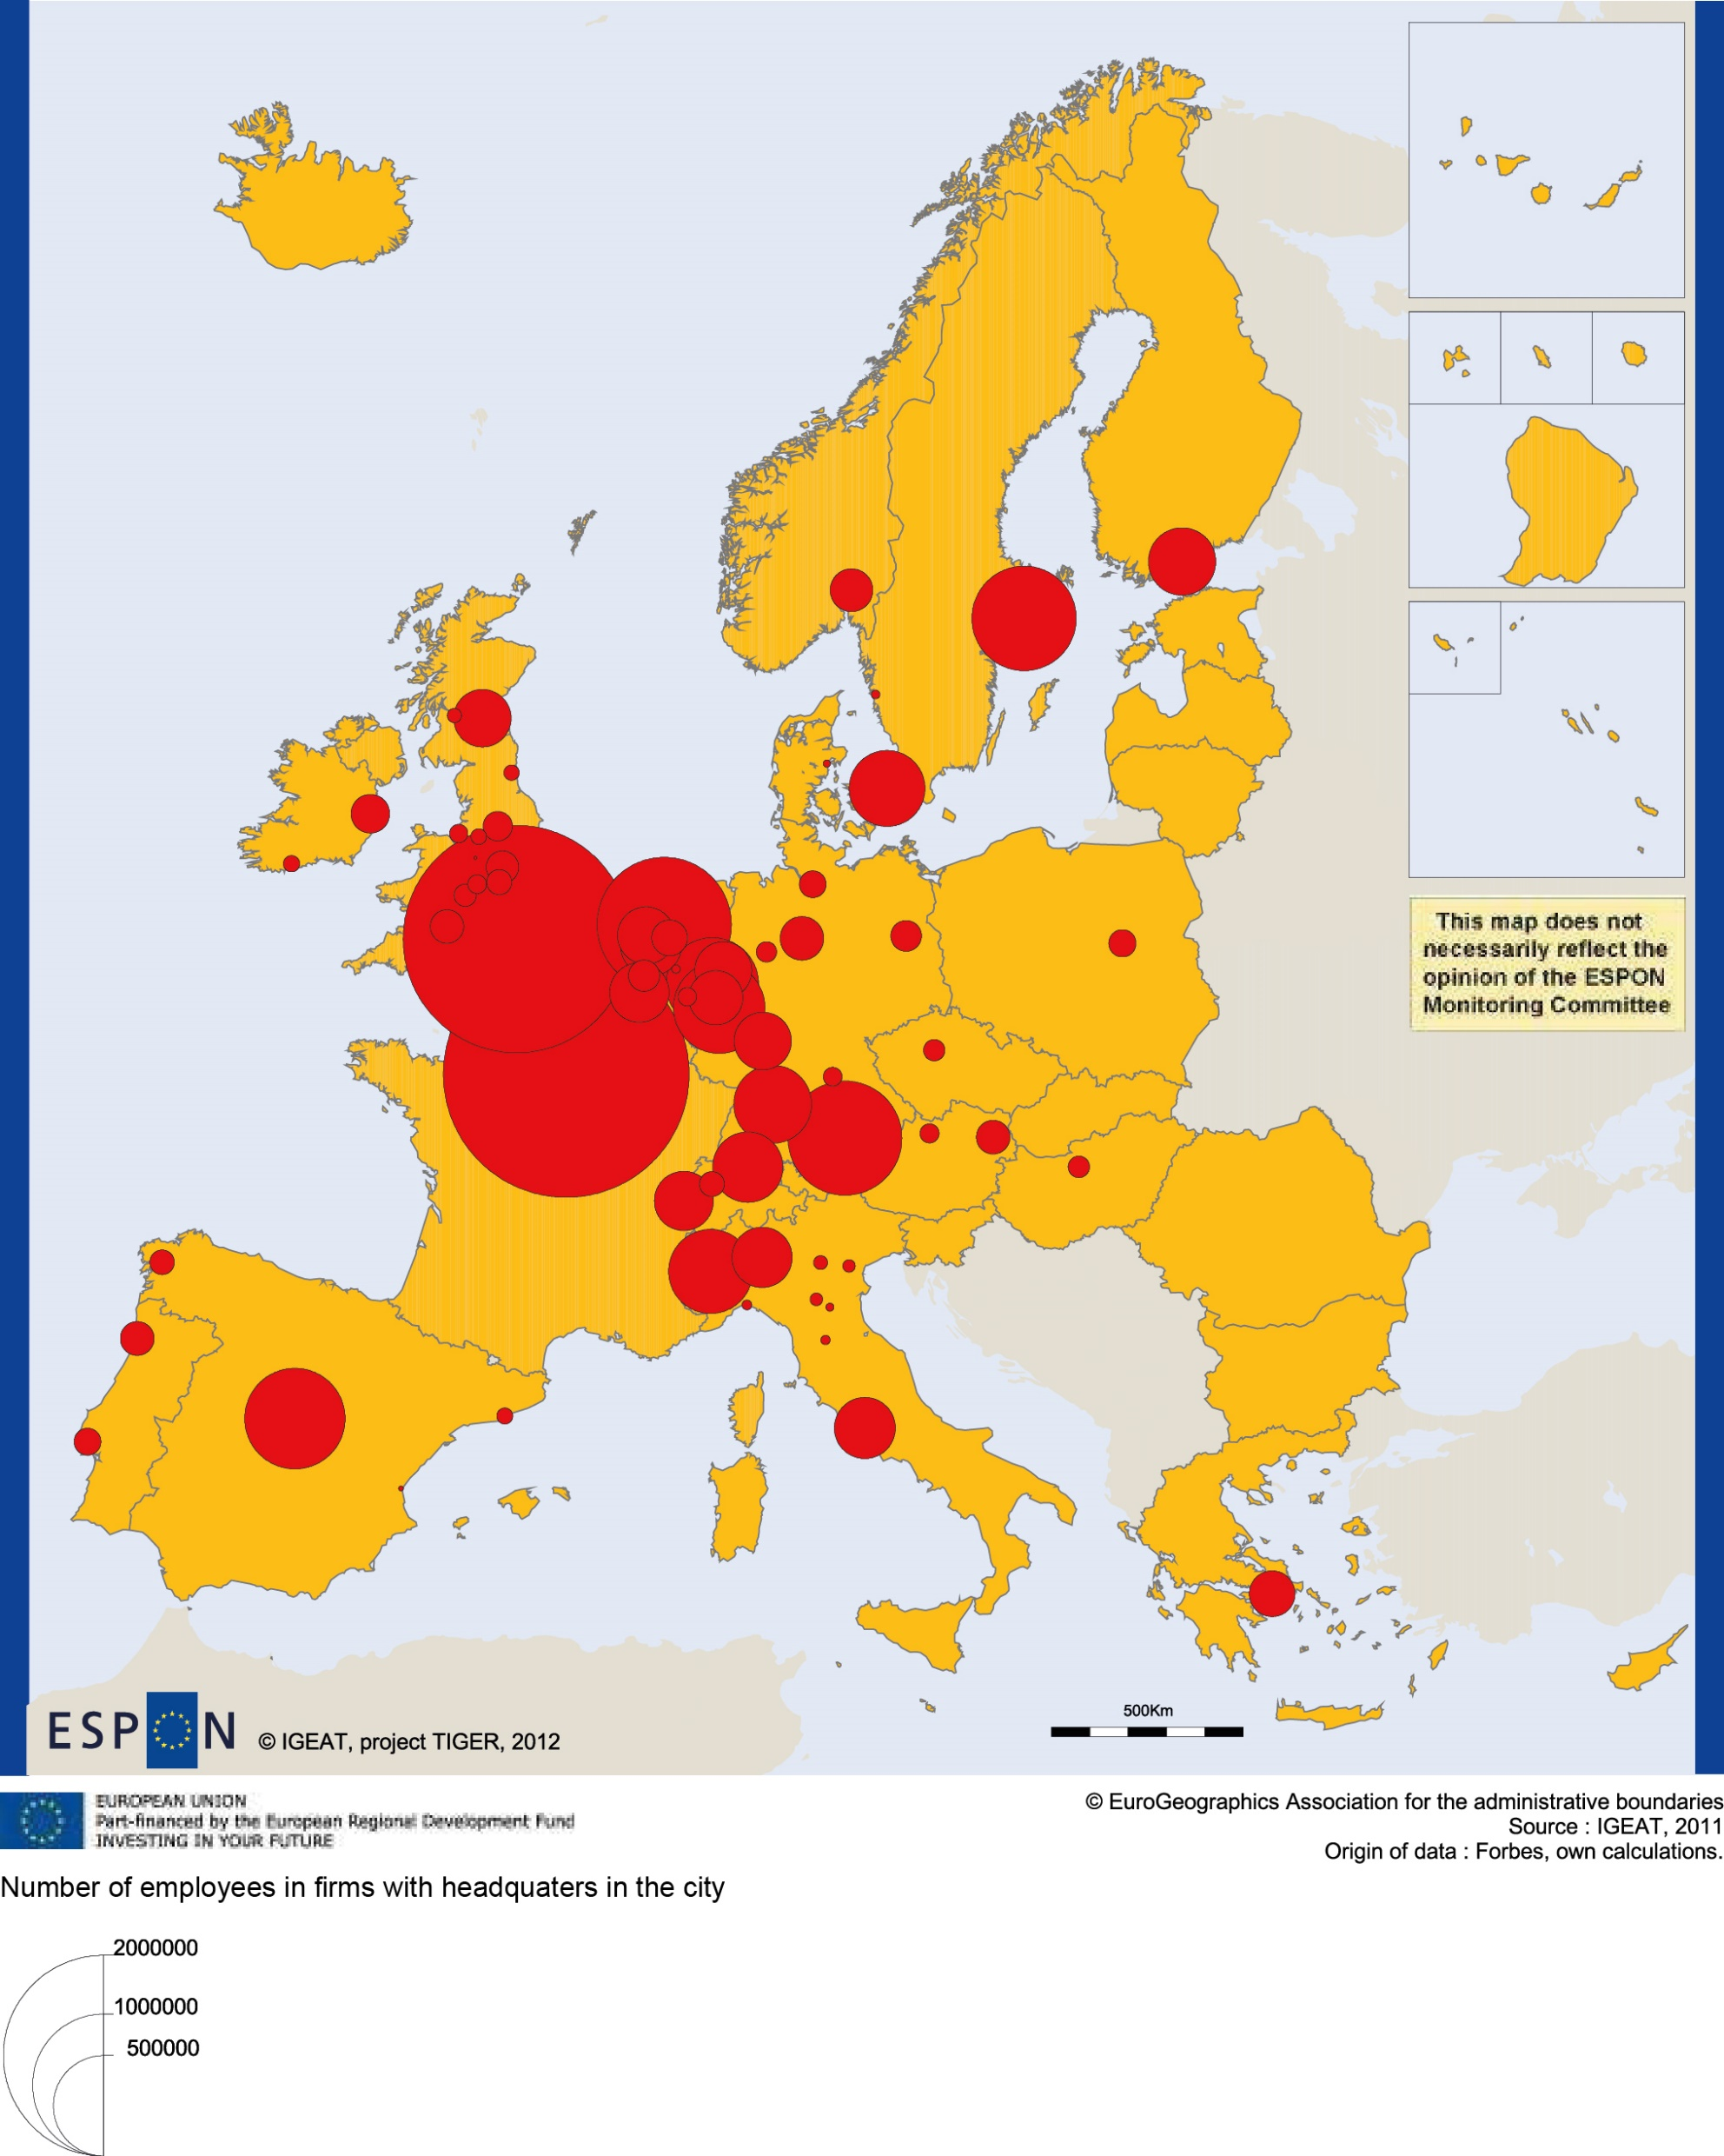
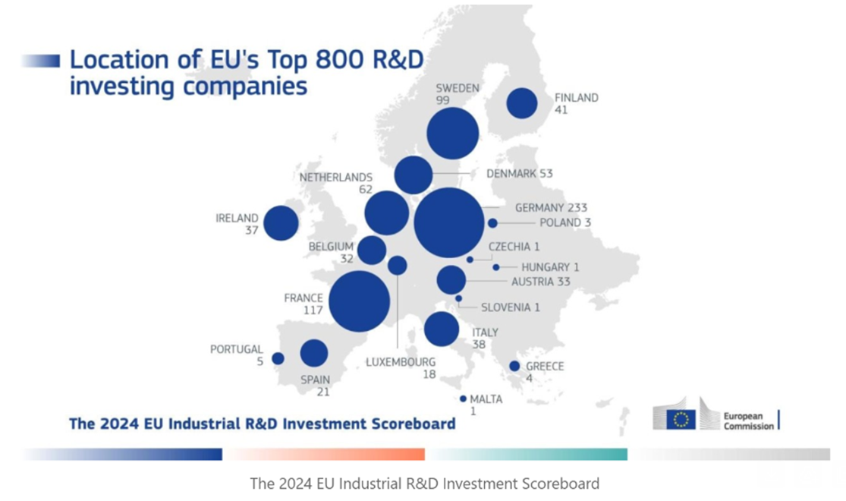
Two specific challenges for Czechia
1) Czechia is extremely dependent on foreign investments (e.g. more than 95% of R&D capacities in „Czech“ automotive is concentrated in foreign-owned companies).
2) Lock-in of endogenous companies in lower-tiers of global production networks (financial squeeze by powerful buyers, e.g. open-book approach - 3-5% profit margin only)

Slide 9
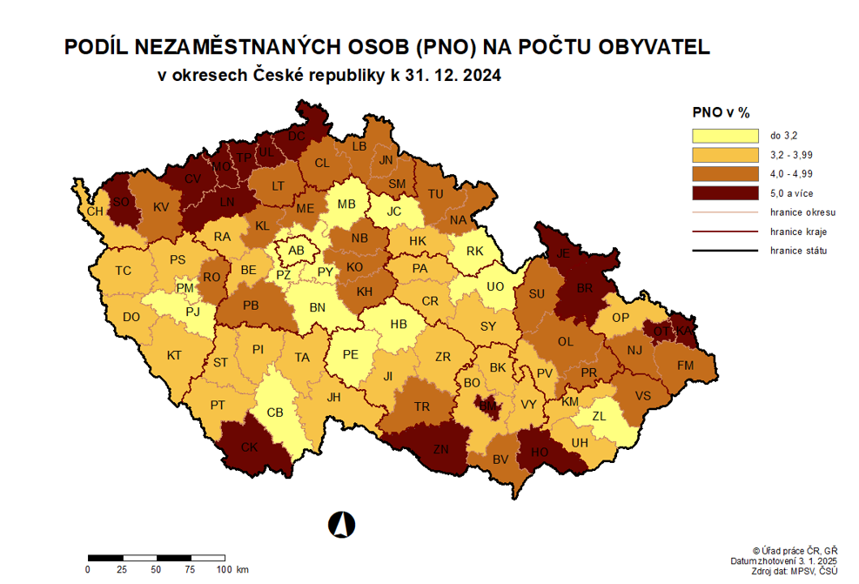
Rate of unempl., Dec 31, 2024

Slide 10
Current regional development trends
Stabilization of the scale of disparities at the regional level
but on already achieved (rather high!) level
Therefore, different trends of different indicators (wages, GDP, unempl., age structure) can be observed.
Main factor - vertical geographic position (Prague++)
Increase of granularity at the municipal and micro-regional level (neighboring municipalities are becoming less and less similar at least according to the rate of unemployment).
Ageing and depopulation of rural areas.

Slide 11
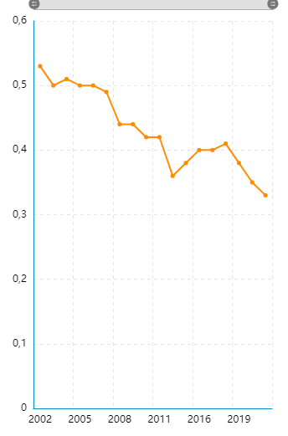
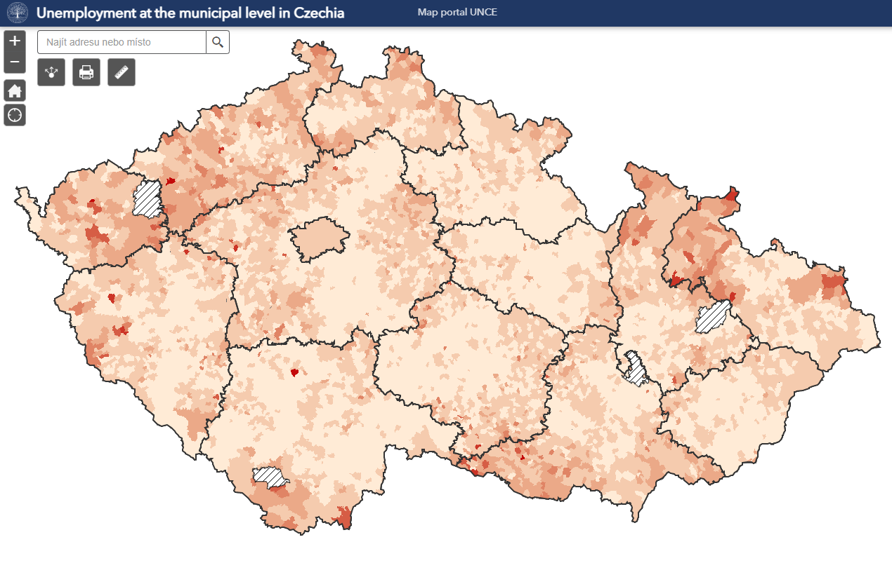
Moran´s I criterion on rate of unemployment
20

Slide 12
Regional policy in Czechia
Responsibility of the Ministry for Regional Development
Support to municipalities in assisted areas (infrastructure, schools, libraries, community centers and activities) (minor role, tiny resources).
Graduall effort to develop place-sensitive sectoral policies (e.g. Active Labour Market Policy)
Largest „sectoral“ policy – the system of local and regional government financing – equal sharing of revenues from selected taxes
Vigorous support from the EU Cohesion Policy – infrastructure, human resources and business support.
Highly variegated bottom-up regional initiatives (strong regional initiatives - South Moravia, Moravia-Silesia, Plzeňský region, etc.) – informal network of regional innovation agencies.

Slide 13
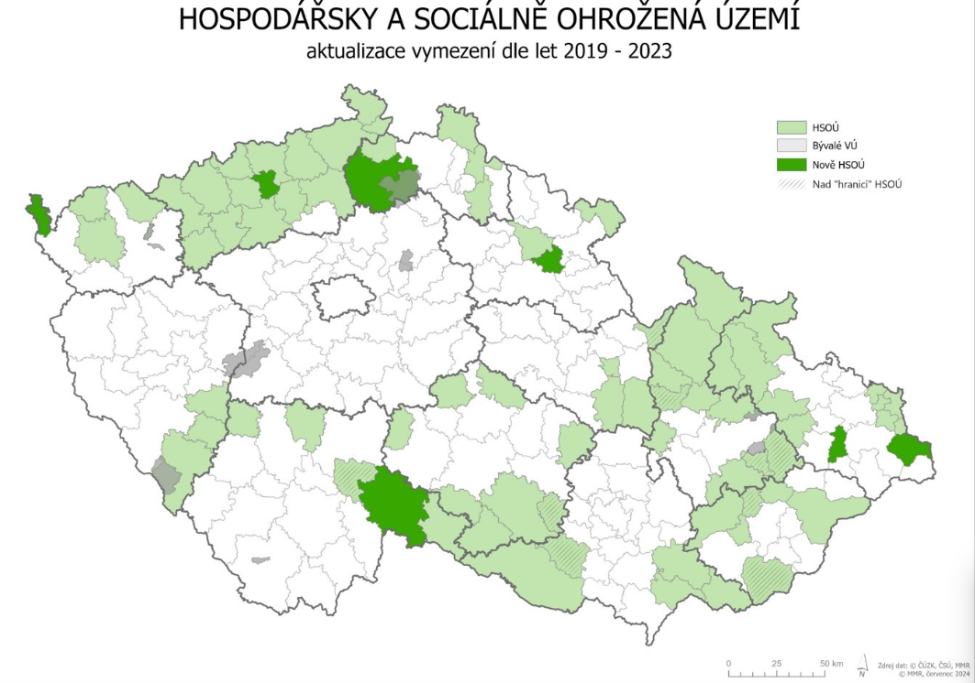
Assisted regions in Czechia (Gov. Resolution Dec. 11, 2024)
36

Slide 14
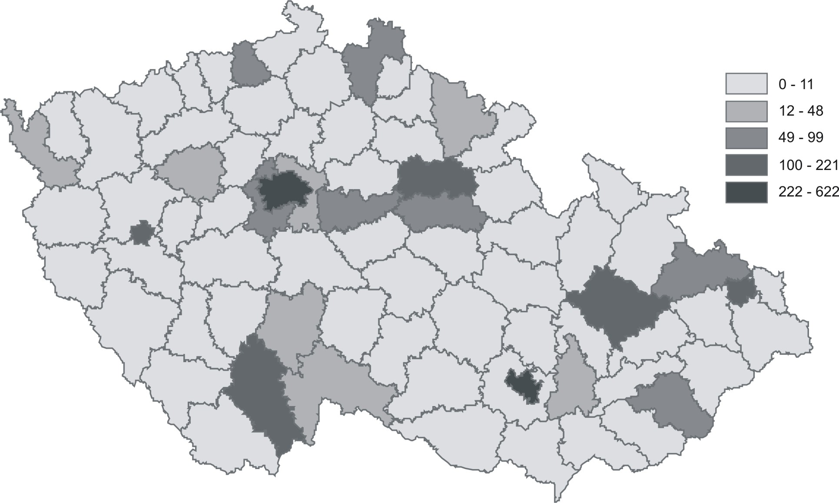
State capital expenditure into research and development (Czech average = 100%)

Slide 15
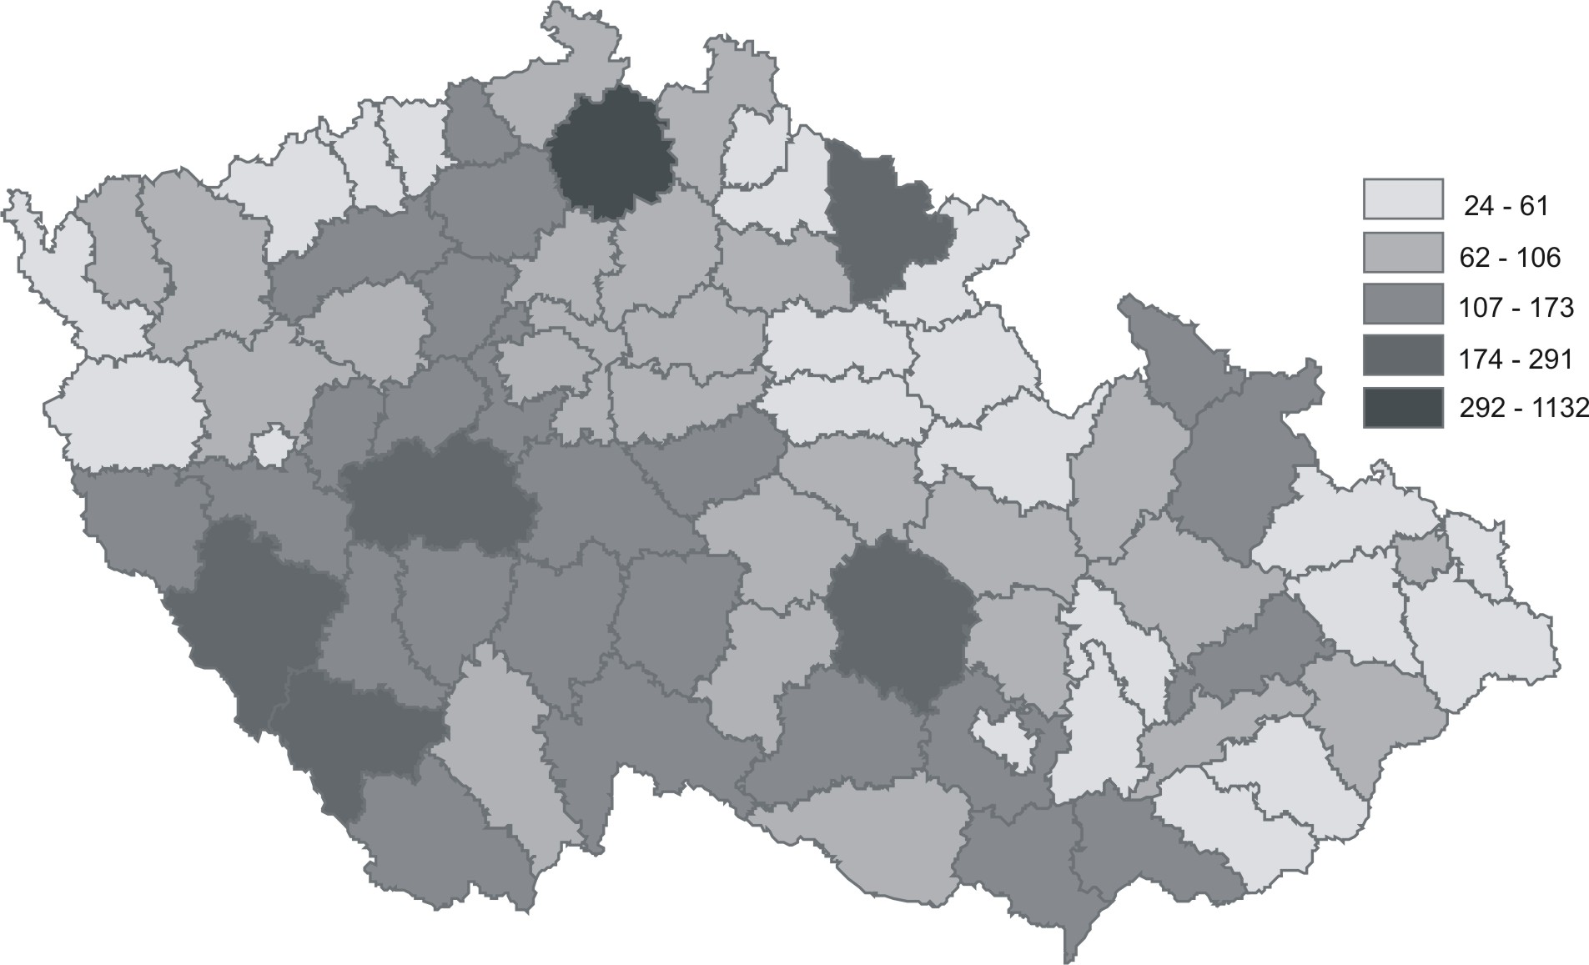
State capital expenditure on environment (Czech average = 100%)

Slide 16
Application of European smart specialisation strategy in Czechia

Slide 17
Main objective of S3
Change of sectoral structure to sectors with high added value (increasing competitiveness and reducing unemployment) Main architect: Prof. Dominique Foray
In Czechia:
Shifting responsibility (1. Ministry of Education, 2. PM Office, 3. Ministry of Industry and Trade) Double track approach – national strategy and regional strategies

Slide 18
Czech RIS3 strategy
National level
+ reasonable and widely discussed strategy
+ significant analytical effort, RIS3 www portal established
+ contacts with a wide spectrum of stakeholders and support providers established
- relatively weak impacts of EDP so far, i.e. modest contribution to enhancement of innovation performance. Regional level – heterogeneity, from weak to strong and sophisticated inn. policy
Three common features:
1) support to start-ups
2) support to university - business collaboration (e.g. Innovation Vouchers)
3) support to technical education and training of young people
- Often without genuine EDP, emphasis is often on horizontal measures and work with individual companies, few regions have a substantial mass of companies in specific field or with common R&D interests
+ enhanced evaluation culture, feedback, learning, objectivization of impact

Slide 19
Examples of interesting initiatives
TechStarter established program to bring secondary-school students closer to technical fields and connecting schools and companies (Liberec).
DigiLab: A joint teaching and technology center of UJEP, ICUK, and Ústecký region that allows students to engage in educational activities, access modern technologies, and foster creativity.
Virtual Laboratory of Professions (VR PROFILAB): uses virtual reality to help pupils and students transition from merely "learning" to "feeling" the job content, which may influence their future choice of study field (K. Vary)
MIH – Mobility Innovation Hub: A project in the Plzeň Region focused on supporting start-ups in the mobility sector

Slide 20
Strategic Projects Focused on Transformation and Innovation
South Moravia - a Climate Action Plan to reduce emissions, increase energy self-sufficiency, and adaptability to climate change.
Hradec Králové - three missions focused on sustainability: Dekarbo, Textile, and Brain Drain, all supported by vouchers from the regional government.
SIC CONNECT - tailor-made matchmaking between companies from the Central Bohemian Region and research partners from the region or beyond.
Robotic Process Automation Development: A program in South Bohemia focused on introducing digital and data technologies

Slide 21
Main challenge – how to design EDP
In the EU, mostly in the form of focus groups, working groups, workshops, hubs and development of transformational roadmaps for RIS3 priorities
Main motivations for participation: a) access to information about new grant opportunities (calls) b) interest of actors in cultivating the surrounding environment (commitment to a common cause)
An effective EDP is one that:
a) is closely linked to the design of calls for proposals.
b) benefits from a dedicated and expert organization
EDP has so far contributed more to cultivation the external environment than to developing domains of regional specialization.

Slide 22
EDP – beyond the one-size-fits-all
Saxony – strong innovator according to RIS 2025, e.g. 30% of value of the EU semicon industry (20 bln EUR investments underway) but performs no explicit EDP.
However, at the Economic Policy Dept of Dresden of about 60 employees more than 20 are dedicated precisely to keeping the ongoing contacts with companies.
Moreover, given the structure of Saxony´s economy, EDP is proceeding within highly capable lead firms of global production networks (GPNs/GVCs) nested in the region and in collaboration with the research institutions.
Thus, one of the major challenges for Czechia and its regions is to search for novel approaches to EDP beyond the national and regional innovation platforms as their role is rather minor, so far.

Slide 23
4. Concluding remarks - possible solutions
Main challenges for Czechia:
a) extreme dependency on foreign investors,
b) lock-in of Czech companies as lower-tier suppliers,
c) need to respond to geopolitics, climate change, social polarisation and AI
Solutions:
Along with the reform of the overall business environment,
1) Support to start-ups with a global ambition
2) Repositioning (upgrading) of companies within global production networks (gaining new functions with higher-value added - functional upgrading).
Motto:
The sucess of a company does not depend only on its own capabilities and resources but also on the quality of surrounding environment.

Slide 24
Reimagining the role of RIS3 and EDP
Functional interface among national and regional policy-makers (More trust, less paper, less reporting).
Clear link of EDP to design of calls of support programmes
Enhanced role of policy learning - new forms and multiplicity of EDP far beyond Innovation Platforms (inspiration from other regions in Czechia as well as from Europe)
Two dimensions of EDP:
a) EDP aiming at enhancing „surrounding environment“ (education, labour, legislation, design of support programmes,….)
b) EDP aiming to address specific challenges related to competitiveness and innovation in new opportunity spaces (AI, robotics, digitalization in xxx industry, related and unrelated variety)

Slide 25
Reimagining the role of RIS3 and forms of EDP
Enhanced focus of RIS3 on:
i) strategic industries/technologies
ii) niches of (emerging) excellence
iii) cross-sector and inter-disciplinary discovery - leveraging tradition and industrial diversification in Czechia (related as well as unrelated variety) initiatives such as „120´´ for Innovation“ and beyond
From cultivation of „surrounding environment“ (regional innovation systems)
to targeted support to selected fields, esp. i) – iii) above
Requires: knowledge, commitment, soft skills (negotiation, discourse setting, nudges, metaphors - China: „First flight“, „Empty the cage“, „Go-in, go-up, go-out, go-west“, etc.)...

Slide 26
Thank you for your attention!

Slide 27

This presentation was supported by the Johannes Amos Comenius Programme (P JAC), project No. CZ.02.01.01/00/23_025/0008717, A Mobile Society: Opportunities and Risks of New Forms of Mobility for Czech Society and Economy.

