Slide 1


IHEDATE
Le transport et la transformation numérique
Barbara Dalibard
CEO, SITA
Le 29 mai 2020

Slide 2
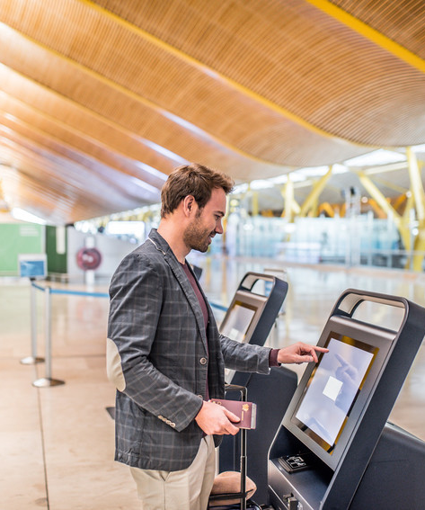
Un des tous premiers secteurs dans l’usage du net
Création de Expedia par Microsoft en 1996
(aujourd’hui 100 Milliards de $ de ventes annuelles)
IATA publie en 2005 le standard du billet électronique
De 2007 à 2014, le tourisme était la première catégorie de dépenses sur Internet
En 2013, 75% des internautes achètent leurs billets sur le net
En 2015, 43% du CA voyages est fait sur le net
3/4 des voyageurs utilisent les outils de comparaison

Slide 3









Chaîne de valeur et relation client
Client
GAFA
intégrateurs (opérateurs de plateformes)
Opérateurs de service
Équipementiers

Slide 4
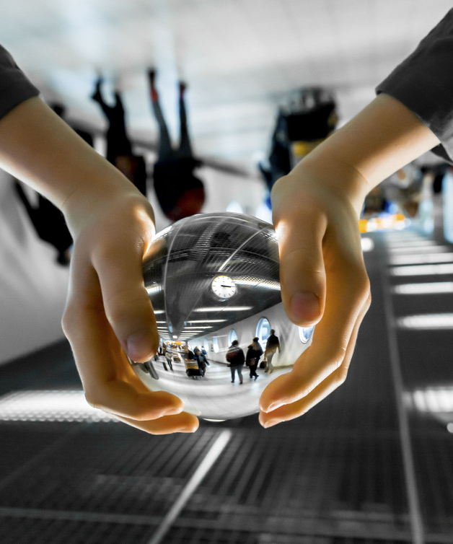
Le modèle économique des plateformes
“The winner takes it all”
Commission de 18 à 25%
Ex Blablacar crée en 2006 leader mondial du covoiturage avec 70 millions de clients en Europe, lui permettant la diversification
Redéfinit le marché et la référence de prix (Booking dans l’hôtelier)
Un modèle intégrateur: Permet de créer de la valeur autour du porte à porte ou du tout intégré (expédia) en simplifiant l’expérience client

Slide 5
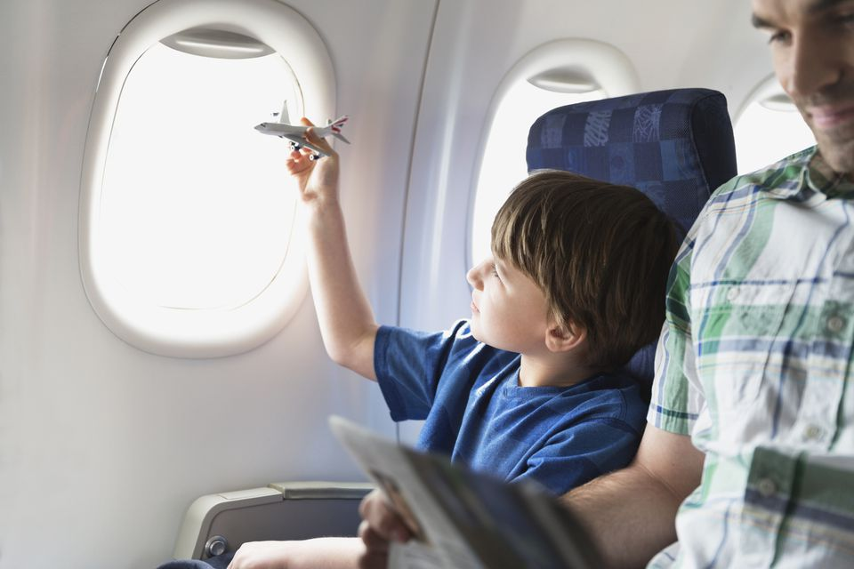


Améliorer l’efficacité des opérations du transporteur

Slide 6
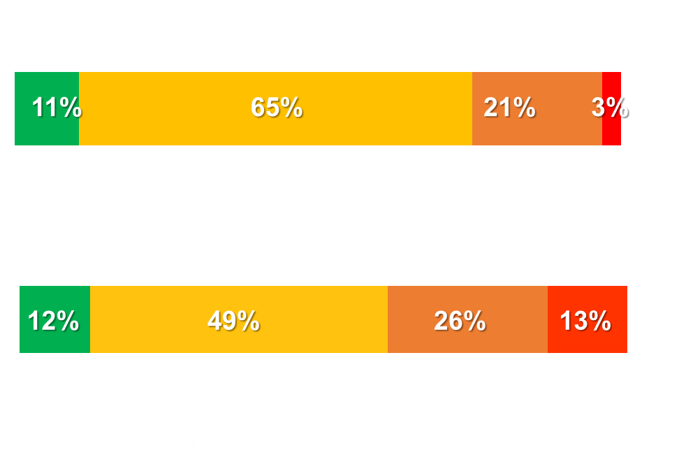
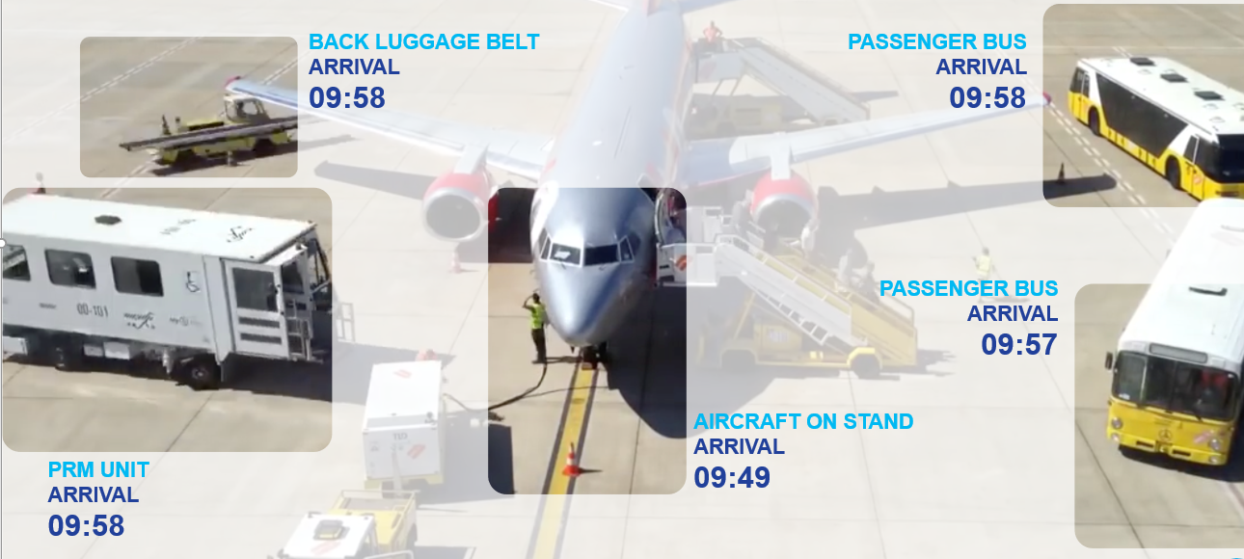
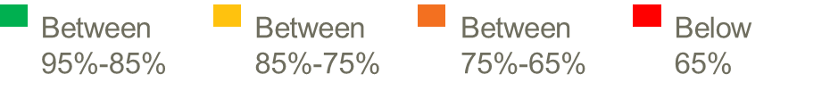
La ponctualité : premier élément de la satisfaction client
Analyse des données pour améliorer la performance
Nombre d’aéroports
Number of airports
Nombre de compagnies aériennes
Entre
Entre
Entre
Au dessous
Notes:
Why should we care?
1 minute delay = ~100$
Flight delays cost $39b yearly to airlines, out of which $420m could directly be saved with turnaround optimization
There are multiple reasons for the delay of an aircraft. We can address this issue by addressing the challenges of industry and to improve the operational excellence. This can possible with âddressing Turnaround time around aircraft and airport.
Better visibility will support proactive management, identify issues before they happen, drive better on-time performance
Turnaround is a key process for the ATI operations fundamentally underpinning a key Airlines and Airports business KPI – On Time Performance
It has become increasingly important as Passengers are increasingly demanding re. OTP, Airports get more congested and the raise of LCCs / Single Aisle Aircraft (with shorter routes / tighter schedules / more “sweating their assets”) have increased the industry demand for more efficient and predictable turnaround operations
Airlines and Airports operators have been working hard at improving turnaround and OTP, a lot of optimization have been made
Optimizations have however tended to focus on specific parts of the process (generally owned by one player) in a kind of a “silo” approach
There is an increased recognition that Turnaround is actually the “meet me” point of many players who need not only to improve the way in which they do work individually but bring a step change in the way they improve through collaboration (and Technology has a key role / lots of potential to make a difference)
It being both i) very important for the Industry, ii) at the cross road of airlines, airport and aircraft operations, and iii) crying out for improvement through collaboration. We hence feel very strongly that SITA is ideally positioned to take a leadership role in that area

Slide 7

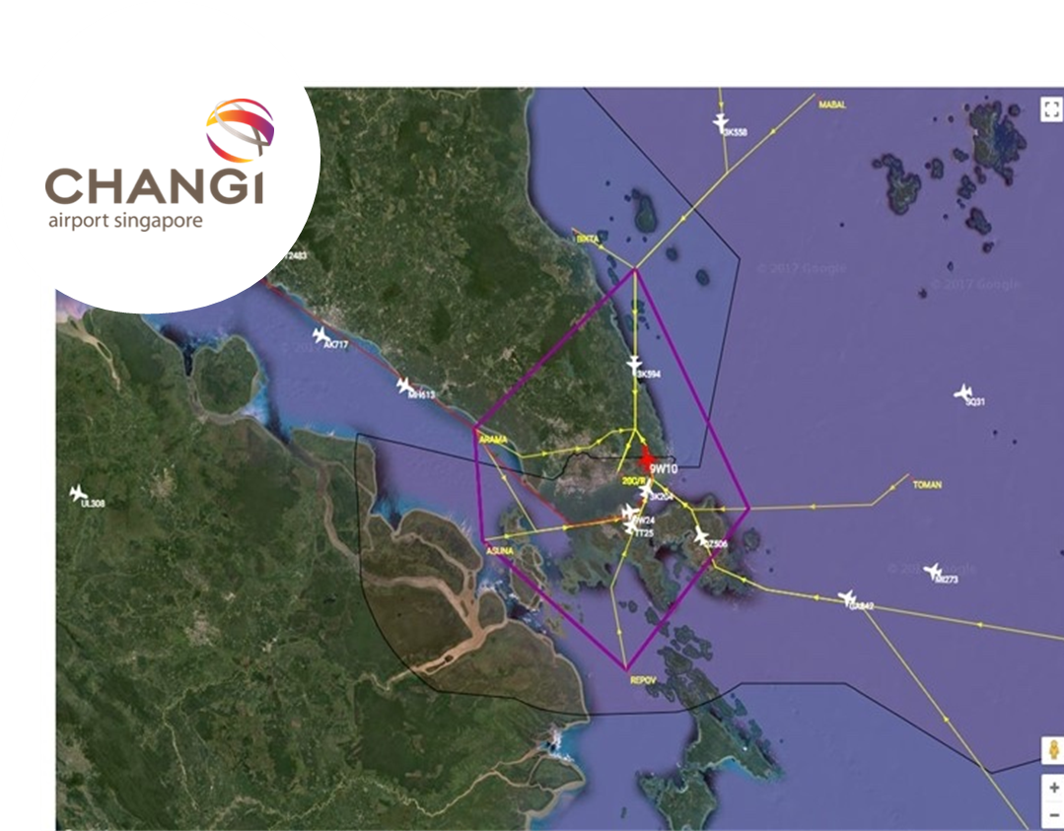
Les bénéfices de la maintenance prédictive
La météo contextualisée
en temps réel
La vegetation
sur les voies
L’Intelligence artificielle pour anticiper
Notes:
E-WAS
Provide pilots with accurate, real-time weather reports focused on key dynamic situations, including turbulence and thunderstorms. Through multi-sourced weather information, pilots can be better prepared for the flight and offer your customers the most efficient and comfortable service whilst protecting On Time Performance and minimizing unnecessary fuel burn.
According to a study by the University of Reading in England, climate change is set to increase the amount of severe turbulence on planes by the period 2050 to 2080
What is the Changi challenge?
Limited visibility on arrivals only 30 to 60 minutes before touchdown
No A-CDM in Asia
High variability due to weather and congestion
How SITA helped
Provide an accurate prediction of within 15 minutes of the flight arrival for around 80% of flights 6 hours before touch down.
Opportunities for resource/ manpower management, and arrival flow control
EG can anticipate an influx of flights therefore the airport will need to be sure they have no people at security or immigration
Data hub:
The current A350 model has a total of close to 6,000 sensors across the entire plane and generates 2.5 Tb of data per day, while the newer model – expected to take to the skies in 2020 – will capture more than triple that amount.
… moreover, to bring value, these need to be corelated to external sources e.g. weathers condition to bring further value.
By 2034 the commercial aircraft fleet will double and out of 43 ‘000 aircraft that will be flying, 85% will be new generation aircraft. They will accommodate an unprecedented number of connectivity technologies but also generate huge volumes of telemetry and data.
Aircraft Data is vital to the improvement of OEM services but it is a challenge (Data is doubling every 2 years)
SITAONAIR was selected by Rolls-Royce
Neutrality
Trusted party
Industry presence & recognition
Expertise on data delivery & management
Végétation: Arbres, herbe… vrai problème le long des voies. Ce système permet d’identifier les endroit ou la végétation pourrait avoir des impacts sur les circulations et d’intervenir avant qu’elle bloque le train… Ce système fonctionne et, à ma connaissance, allie reconnaissance d’image et algorithme.

Slide 8
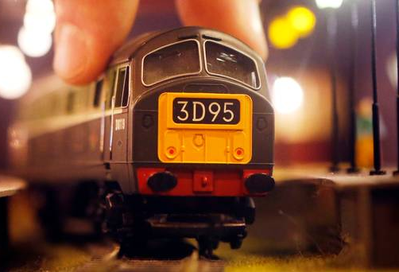
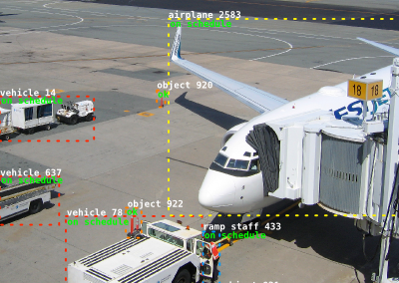
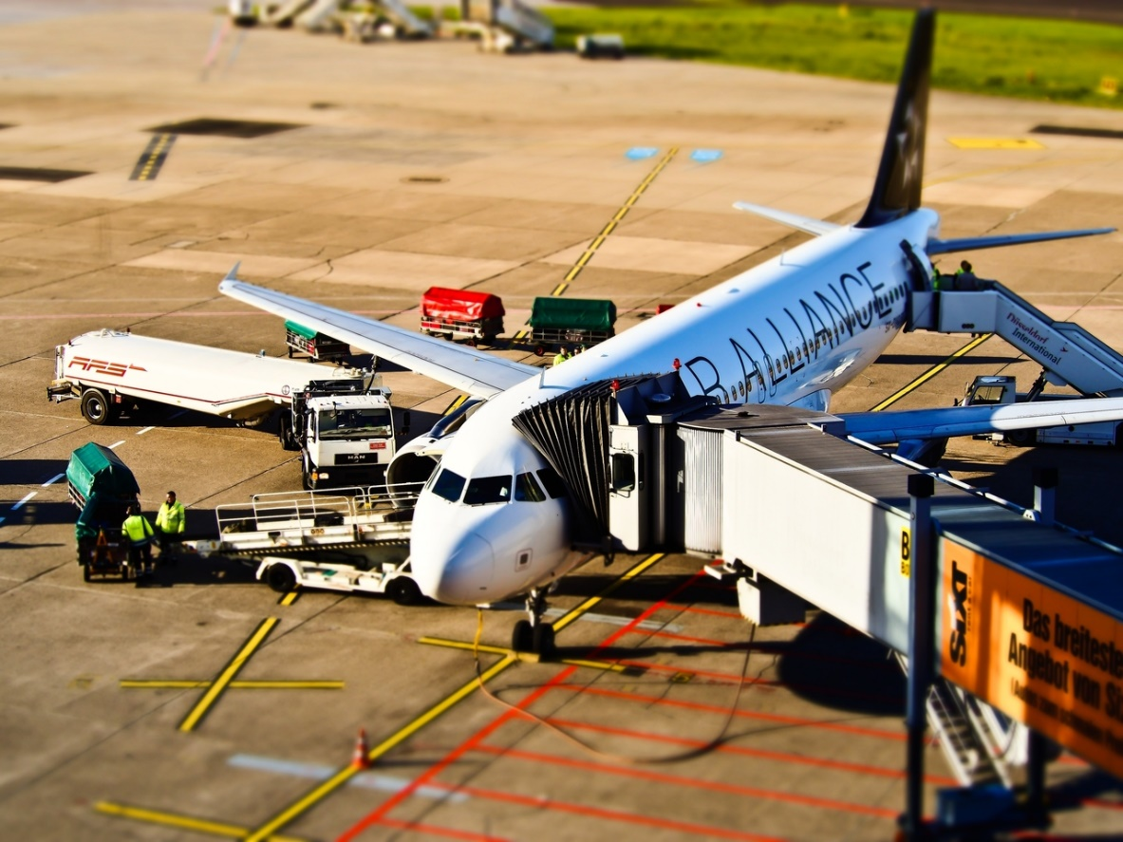
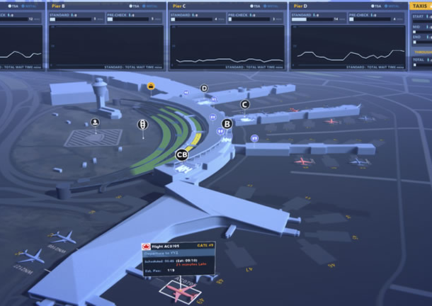
Le retournement de l’avion ou du train
Computer vison
Comment utiliser les nouvelles technologies pour accélérer le retournement?
Une nécessaire coopération entre acteurs
Digital twins
Notes:
Turnaround is key for all transport industry
Barbara to share an example of Trains (door system)
Aviation :Turnaround Solution is the lacking piece in efficient aircraft operations; it could potentially save the industry ~$420M
The turnaround solution could generate ~$0.4B worth of savings for the Aviation industry
It is key to address the challenge of Turnaround, we need to have clear understanding on the underlying issue for the delays and to communicate real time
We have different technologies to adopt and maneuver for fruitful results.
Computer vision: Computer vision is an field that deals with how computers can be made to gain high-level understanding from digital images and videos. It is mainly like installing the cameras at the gate to record the timestamps of images and videos of the vehicles around the aircraft that involves in turnaround activities of aircraft.
Digital Twin: (We didn't start working yet into this area, more like an idea/possible are to explore)
Digital Twin will enable improved aircraft turnaround performance by aggregating data from many sources and pushing the right information to the right frontline staff at the right time. It will be able to anticipate upcoming constraints, model ‘what if’ scenario planning and make recommendations to resource planning. This enhanced situational awareness for both central control room and frontline staff enables a more efficient turnaround process.
Use computer vision to track all stakeholders around the plane for proactive turnaround management

Slide 9
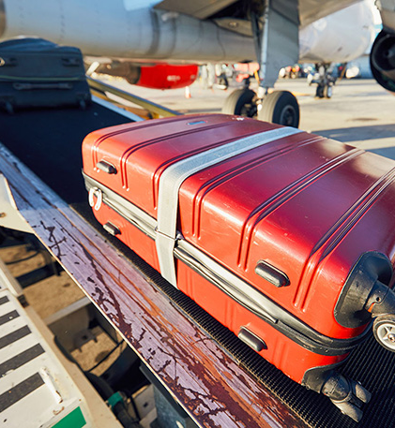
Le suivi des bagages
Le challenge: disposer en temps réel de la position de chaque bagage
4.36 milliards de sacs transportés en 2018. SITA a traité 3.36 milliards de messages de sacs par an
24.8 millions de bagages ont été mal acheminés en 2018, pour un coût de 2.4 milliards de dollars
64% des passagers veulent être informés du statut de leur(s) bagage(s)
Le partage des données entre acteurs multiples nécessite de mettre en place des échanges fortement sécurisés et des règles transparentes
Notes:
Passengers happier when technology smooths their way
We facilitate COLLABORATION across the air transport community
Today’s digital savvy travelers are increasingly demanding a seamless airport experience that is not compartmentalized across airlines, airports, and border agencies.
To deliver this experience in the next few years will require our industry differently and work more collectively. We will need to be better at sharing common information and work together to solve common problems.
Baggage is a good example. On a typical journey, your bag will change hands a number of times – from the time to check it in it will be handled by one or airline, airport, ground handler or customs agencies.
To ensure we deliver that bag to you at the end of the journey, we need to be able to track that bag across the journey (check-in, loading, transfers and arrivals) and share that information with each of these entities (SITA’s BagJourney).
Do you know how many bags were transported in 2018 ? 4.36 billions of bags. SITA has processed 3.36 billion bag message. Based on the reports, we have noticed 24.8 millions bags were misdirected and it cost 2.4 billions dollars
By tracking the bag we reduce the chance your bag will be mishandled, saves the airlines money.
SITA's research reveals that where bags were being tracked when loaded onto the aircraft, the rate of improvement is as high as 66% (where there was no tracking in the previous year) (2019 Baggage IT Insights)
We can also share this information with you as the passenger so you know where you bag is at all times.
One of the standout findings of our report this year is that at every point in the journey, where passengers use technology, the rate of satisfaction is higher. Airlines and airports can see the benefit of their technology investments in making it easy for passengers, every step of the way. Over the years, booking, check-in and bag drop have increasingly become automated and passengers like it. Interestingly, this year the report shows how introducing automated passport controls, in collaboration with government and border agencies, also increases passenger satisfaction.”
Bag collection is a notorious pinch point, but here the positive effect of technology is clear. When passengers use services like real-time notifications, their satisfaction is 8.6% higher, elevating this stage of the journey to second place for satisfaction, just behind check-in.

Slide 10
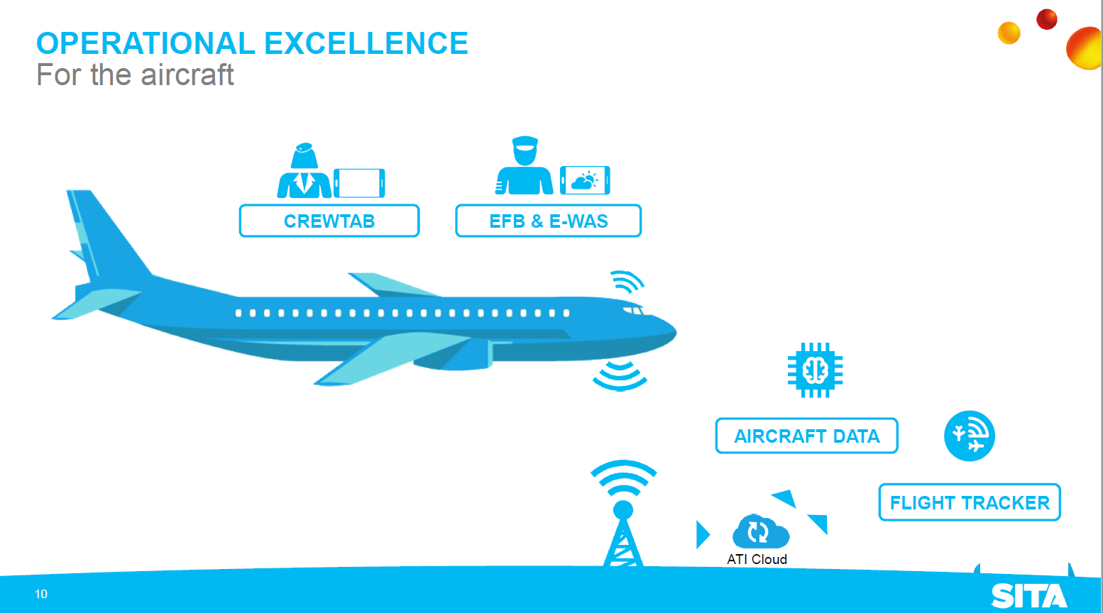
Les performances de l’avion ou du train

Slide 11





La nécessaire collaboration entre acteurs de l’écosysteme
L’exemple de l’aerien
PARTAGE DE
DONNEES
Identité(s)
Bagage(s)
Capteur(s)
Vol(s)
API
API
API
API
PLATEFORMES
DE PARTAGE
A l’aéroport
Pour l’avion
Notes:
Our industry needs are changing. It’s not only about sharing infrastructure (pipe); it’s about sharing data (knowledge)…
There’s an important number to remember:
It is that SITA ‘bridges’ – or transports – as much as 60% of the operational data exchange among the air transport community.
That is not the internal data within say BA or Saudi, but the data exchanged between the actors in the community, such as the airlines, airports, aircraft manufacturers and border agencies.
Sharing and bridging has been in SITA’s DNA since our beginning.
Data has the potential to add value at every touchpoint. Today, we are focused on sharing the network, infrastructure, platforms and technology.
Tomorrow: the sharing of data and knowledge will be of immense importance to our industry’s future. Since we work with everyone in the community, SITA ‘naturally’ has access to large volumes of air transport data – along with experience in unlocking and handling it through Application Programming Interfaces (APIs), as well as airline, airport .
Vision: Air transport needs a common platform at the airport and for the aircraft, making sure everything is open, enabling us to plug and connect to the different data - one platform to serve the airport, one to serve the aircraft, and so on that encompasses identity, baggage, flights, sensors etc…
FYI-
What new technologies will help us collaborate? Blockchain: Think of sharing technology and data, and our community role…. it is as though the blockchain was invented for SITA 😊 Blockchain is about sharing information safely and securely, between industry players in a decentralized way. It provides one truth at a given point that can be used to facilitate workflow and facilitate data exchange. We began exploring blockchain in 2016, and have since conducted research and trials with IAG, British Airways, Heathrow, Geneva and Miami Airports to create a single source of truth around flight data. We continue to explore and develop, adding use cases across baggage, identity management and cargo. Our FlightChain and Aviation Blockchain Sandbox are great examples of how we co-innovate with customers.
And around the aircraft? New generation aircraft feature thousands of sensors, generating terabytes of data each day. By 2034, 85% of the world’s commercial fleet will be new generation aircraft. Each piece of data provides essential feedback on the status of the aircraft, which is vital for Original Equipment Manufacturers (OEMs).
We will enable airlines to collect, control and share this data, while correlating it to external sources, such as weather conditions – through our eAircraft DataHub. This will help monitor engine performance in certain conditions, for example, or evaluate engine performance and maintenance.

Slide 12

Le Superflyer
Rendre le contrôle au passager

Slide 13
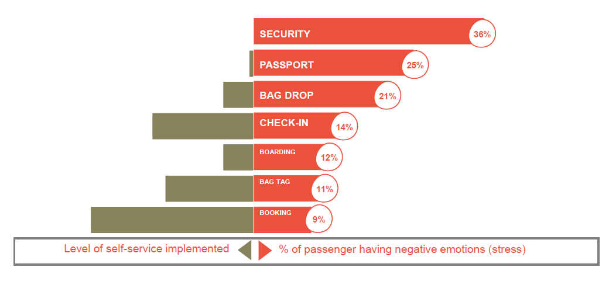
Le niveau de stress du client est inversement proportionnel au niveau d’automatisation du processus

Slide 14
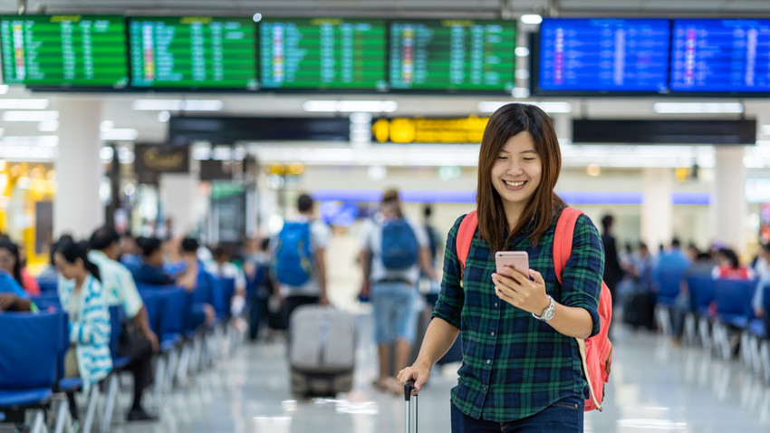
Personalization
La personnalisation de l’experience client
Le futur est 100% mobile
Notes:
Passengers want to be informed at every step of the journey
Comprising a new generation of travelers accustomed to a personalized digital experience
63% of travelers think sharing real time information is a top priority
100% Mobile enabled travel biometrics enrolment, wayfinding, flight information…
100% Self-Service Self-Bag Drop, Mishandled bags, Lost and Founds, …
SMOOTH TRAVEL No queuing at airport, Short Turnaround, managed disruptions …
Passenger centricity a personalized experience – the right data at the right time
Passengers want everything to be under their control. 72% prefer self boarding and 49% prefer self bag drop
One of the standout findings of our report this year is that at every point in the journey, where passengers use technology, the rate of satisfaction is higher. Airlines and airport can see the benefit of their technology investments in making it easy for passengers every step of the way

Slide 15




Le management de l’identité est clé pour améliorer l’expérience client
L’usage de la biométrie à toutes les étapes
75%
63%
43%
59%
Smartphone with fingerprint sensors
by 2020
Airports plan biometric ID management investment by 2020
Airlines plan biometric ID management investment by 2020
Passengers would use biometrics
for ID
Notes:
The end goal is to provide passengers with a frictionless experience as they go through the airport while increasing security. Creating this walk though experience will required smart integration of biometric with next generation access control systems as well with the existing airline and airport systems.
Today sharing biometric data across borders or between airports is limited because of the data privacy related concerns. This issue will be addressed over time as trust framework are developed to facilitate data exchange securely and under the passengers control. So instead of having enroll your biometrics at every airport, or with every country, you can do it once and just travel between airports and between countries using the same biometric credential
We help the air transport community to deliver a SEAMLESS PASSENGER JOURNEY
In the US, SITA’s biometric technology is being used in place of the traditional boarding pass, ID check and a government border check (SITA Smart Path™) for the US Biometric Exit. This is the airline and government check in one step.
Example at Orlando airport with British Airways and the US Customs and Border Protection (CBP)
We gave British Airways’ passengers the option of biometric boarding at the gate, on flights from Orlando to London Gatwick, with almost 100% take up.
Boarding international flights with 240 passengers in around 10 minutes.
Orlando Airport deploying this solution for US Biometric Exit at all its 30 international gates.
Miami Airport is also using our technology so its passengers can have their “face as their passport”.
SITA and MIA also partnered on a number of innovative travel experience solutions, including Mobile Passport Control and MIA Airport Official, the airport’s mobile app.

Slide 16

Rendre le contrôle de ses données au passager
Biométrie
Contrôle des données
Self sovereign identity
Les règles d’éthique relatives au droit des personnes
doivent être renforcées
16
Notes:
The end goal is to provide passengers with a frictionless experience as they go through the airport while increasing security. Creating this walk though experience will required smart integration of biometric with next generation access control systems as well with the existing airline and airport systems.
Today sharing biometric data across borders or between airports is limited because of the data privacy related concerns. This issue will be addressed over time as trust framework are developed to facilitate data exchange securely and under the passengers control. So instead of having enroll your biometrics at every airport, or with every country, you can do it once and just travel between airports and between countries using the same biometric credential
We help the air transport community to deliver a SEAMLESS PASSENGER JOURNEY
In the US, SITA’s biometric technology is being used in place of the traditional boarding pass, ID check and a government border check (SITA Smart Path™) for the US Biometric Exit. This is the airline and government check in one step.
Example at Orlando airport with British Airways and the US Customs and Border Protection (CBP)
We gave British Airways’ passengers the option of biometric boarding at the gate, on flights from Orlando to London Gatwick, with almost 100% take up.
Boarding international flights with 240 passengers in around 10 minutes.
Orlando Airport deploying this solution for US Biometric Exit at all its 30 international gates.
Miami Airport is also using our technology so its passengers can have their “face as their passport”.
SITA and MIA also partnered on a number of innovative travel experience solutions, including Mobile Passport Control and MIA Airport Official, the airport’s mobile app.
Self sovereign identity :
We are now in a world where no one wants to hold personally identifying information if they don’t have to. The implementation of GDPR regulations has brought a keen focus on what personal data is collected, stored, used and most importantly, who holds the responsibility for it.
But we live in a digital world and secure digital identification is a necessity for so many things – not least travel and crossing borders.
Passenger information, identification and government authorizations such as visa approvals are necessary for passenger facilitation, something that is only becoming more of a challenge as we face rising passenger numbers globally. Airlines, like all industry players, are coming to the realization that the only way to handle such sensitive data is to not have it. It is seen as a liability.
Is self-sovereign ID the answer?
Self-sovereign means a lifetime portable identity for any person, organization, or thing that allows the holder to present verifiable credentials in a privacy-protecting way. These credentials can represent things as diverse as a passport, an airline ticket or simply a library card. It essentially puts control of a person’s identity back into their hands.
The world’s industry players have joined together in the Sovrin Foundation, an international non-profit organization with the mission to enable self-sovereign identity online. SITA is one of the Founding Stewards of the Sovrin Foundation and together with global industry leaders is working on a path to give people back control of their identity.
SITA’s unique role in the global air transport industry - its community ownership and neutral position - makes it ideally suited to be the first travel industry Steward for Sovrin, representing the air transport industry.
As digital identities and data privacy rise higher on the agendas of airline and airport CEOs and CIOs, SITA is working with its partners to explore a new path for identity management. It is currently working on three use cases with three partners on the Sovrin Network. The SITA team plans to showcase these to the industry in the next six to eight months and to demonstrate how self-sovereign identity could give control back to passengers.
EXAMPLE:
On the future of digital identity we are working with Etihad to add biometrics and self-sovereign identity to the cabin crew checking process. This makes it simpler and more secure at the point of entry into the airport. Self-sovereign Identity will also make it easier for airline & airport staff to prove credentials or training certifications which will be especially beneficial when crew change from one airline to another – they will now be able to take their certifications with them in a way that can be digitally verified across the industry.

Slide 17

Merci pour votre attention

