Slide 1
Metropolitan Challenges for London
Sources of Economic Growth, Change and Competitiveness
Ian Gordon
LSE London research centre,
London School of Economics
(I.R.Gordon@lse.ac.uk)
Mission d’étude 2019 ,
Après le Brexit, recoudre le territoire ?,
City University, London, April 9th 2019

Slide 2
Outline of Presentation
The context:
  London’s economic region; and the long term evolution of the London economy
The character of the London Economy
  What’s distinctive about it, in a UK context
  Particular sources of strength/weakness
The turnaround in performance since 1980s
  Shifts in employment, population and productivity
  Explanations for these

Slide 3
Administrative and Functional Versions of ‘London’

Slide 4
The Context to Recent Developments
Long Term Change in the city’s role (since late 19th century)
The role of Decentralisation and Deindustrialisation since 1960s
The current extent of the London FUR

Slide 5
London’s Role in Three Major Eras (1)
The Imperial City (late 19th century)
  No large factories – artisan workshops + services
  Linked to elite consumption and trade from the Empire etc.
  Competitive, outward looking and with low security for businesses/workers
  Unstable/casual jobs → low social cohesion

Slide 6
London’s Role in Three Major Eras (2)
2. The Fordist National Capital (mid 20th)
Became factory centre for market-oriented mass production
Plus bureaucratised services (state and private)
More UK-oriented – but with a strong share of the growing sectors of the economy
Centre for the more dynamic (southern) half of the national economy (cf old industrial regions)
More job stability ( including working class ‘career’ opportunities) and social cohesion

Slide 7
London’s Role in Three Major Eras (3)
3. Post-Industrial ‘Global city’ (1980s on)
Partly continuation & partly reversal of earlier trends
Disappearance of manufacturing and goods-handling particularly from core areas
Impacts of deregulation (Thatcher), privatisation, emphasis on flexibility + internationalisation & gentrification of inner areas
New context adding value to traditional metropolitan economic strengths (scale, diversity, flexibility, originality, international connections)
Growing cost differences: squeezing out routinisable activities → emphasis on quality competition
In some ways a return to late 19th century model – more inequality and similar challenges to security and social cohesion

Slide 8
Deindustrialisation and Decentralisation
Greater London Employment (000s)
Outside GL: in Outer Metropolitan ring
Manufacturing declined more slowly (-c. 230k = 33%)
Business services grew faster from low base
Total employment grew (+ c. 670k = 36%)
Across wider region – implies near zero change in employment, but very big sectoral and spatial shifts

Slide 9
The Changing Significance of the FUR/Mega Region
Range of London economy has long extended beyond GL
  with discontinuous development, because of the Green Belt
Originally the hinterland just provided labour to London
  directly by commuters; or indirectly in dispersed back offices etc.
Then in last 30 years: shifts from simply dependent (or separable) economy → integral part of a regionalised London economy
  Some key metro/capital/global city functions now outside the core (inc. international HQs, business service, and knowledge ‘clusters’)
  Distinct strengths and sources of agglonmeration economies - polycentric

Slide 10
The Character and Strengths of the (Greater) London Economy (1)
Its post-industrialism:
  all non-manufacturing sectors (plus publishing) are over-represented in London
  very diverse range of specialist services
Its skills base:
  Proportion of graduates in the workforce (31%) is well above rest of UK (18%); 44% among 25-30 yr.olds
  Many come from other regions (and abroad)
  but advance faster on London ‘escalator’ , often via job mobility in flexible labour market

Slide 11
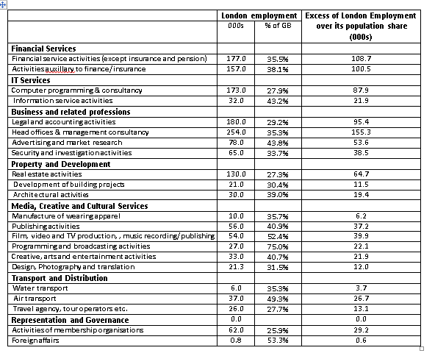
London Specialisms with > 25% of GB jobs (2015)

Slide 12
Character and Strengths (2)
International Orientation
  In terms of markets – with substantial ‘global’ sector
    not just serving UK firms: cf. New York, Tokyo – or Paris
    But national markets (outside region) still much more important – and UK macroeconomy still crucial – see Table
  Historic / language links feeding technical and market information
    interpreted and recycled from London
  And increasingly cosmopolitan population / labour-force

Slide 13
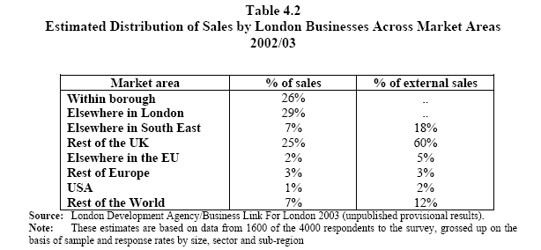

Slide 14
London’s Diversity
36% of G. London population born abroad
56 countries of origin with more than 10 thousand residents
Largest are:
  India 299,000
  Poland 133,000
  Ireland 124,000
  Bangladesh 110,000
  Pakistan 105,000
Generally seen as a major asset / attraction by businesses and residents

Slide 15
Change since the 1980s – I: growth
Within past thirty years:
  Population : from decline to growth in Greater London since late 1980s
    Via direct/indirect effects of immigration
  Employment: from decline via apparent stability to growth
    with much greater volatility – boom/bust/boom/…
  Via growth in non-financial business services
    major role of ‘global’ sector in short term fluctuations – but not disproportionately in trend growth (even in FBS)
  Productivity/earnings: sharp widening of gap relative to UK 1979-90
    market liberalisation period (cause / effect of inequality?)
    none in past decade – flat productivity as in UK
  Sub-regional divisions in performance:
    Inner/outer reduced – but post 2007 growth heavily in Centre
    East/west divide highlighted

Slide 16
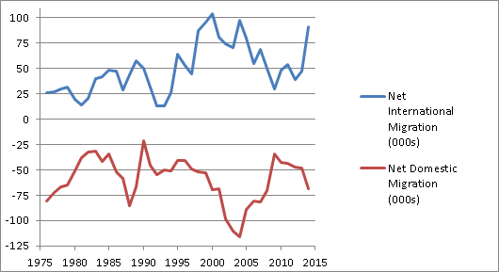
London Net Migration 1975-2015

Slide 17
Shifting London Employment Trends 1971-2017

Slide 18
Shifts in Sectoral Balance
1971-2018

Slide 19
More Volatile Employment Trends

Slide 20
London earnings for full-time workers
as ratio of the GB average 1971-2018
Source: New Earnings Survey/Annual Survey of Hours and Earnings

Slide 21
Change since the 1980s – II: Inequality and unemployment
Income inequality in GL growing faster than in UK, mostly in 80s
Despite boost to growth – unemployment in London worsened absolutely / relatively over this period
And, became much more heavily concentrated in core – especially ‘crescent’ of inner east London (Tottenham-Docklands-Brixton)
  traditionally high UE areas
Not correlated with overall London pop. or empl. trends – and only minimally with low skill job trends
Deterioration concentrated in periods of general / regional slack in demand (less than full employment) – and cumulative then

Slide 22
Accounting for the Changes (1)
Broad shifts in growth and inequality:
  consistent with ideas about global cities and flexible city economies
  but uneven timing etc. suggests more specific causes
Indirect effects of globalisation / flexibilisation via UK labour market & financial market deregulation – on growth & inequality
  And with ‘global city’ / dot.com myths + weightlessness → speculation / volatility
Old trends with continuing effects of: sectoral shifts (on employment change); residential segregation, unequal Labour Market competition (on UE concentration)
Impacts of national recessions: on level of UE and its concentration
  via marginalisation and exclusion processes from which recovery is slow
Plus: asylum seeking and other waves of ‘new migrants’ from poor countries

Slide 23
Accounting for the Changes (2)
In summary:
The ‘new economy’ is affecting London
  Generally positive
  But → increasing inequality and volatility
Key changes mediated by national policies
  cf. globalcity-isation
National economy also still crucial – both for general demand and employment pressure
  London is not an offshore island
Old established processes / constraints still key factors in recent changes

Slide 24
London since the Financial Crisis
Expected to do relatively badly in employment terms, since:
  Been much more cyclically sensitive in recent boom/busts
  Crisis started in City-type financial services
But actually shown more resilience than other UK regions:
  Partly lack of manufacturing (worse hit than expected)
  Partly bail-out – implicit subsidy to banks of up to £120bn?
  Plus impact of massive QE
  But done conspicuously better in activities with a majority of graduate-type jobs:
    Including public sector (health and education) & Head Offices
  With employment gains since 2007 all in central area
In short run, at least, small public sector should make least vulnerable to current round of major public expenditure ‘cuts’

Slide 25
Six Major Growth Clusters in Central London post-2007
Finance; banks, other monetary intermediation and auxiliary activities (except for insurance or pensions) + Finance-related IT;
Business administration: head offices, employment agencies and cleaning services;
Property Development/Services; construction, architecture, real estate agencies and real estate management;
Digital Content; advertising, radio and TV broadcasting services, [computer consultancy, programming and repairs];
Public Services; hospitals, primary/tertiary/misc education, and general public administration (not all in public sector);
Tourism; hotels and restaurants.

Slide 26
Employment Changes:
June 2007-June 2018
 | London |  | UK
 | 000s | % | %
Manufacturing | -26 | -19% | -10%
Construction | 43 | 26% | 2%
Other Production | 4 | 16% | 17%
Distribution | 12 | 2% | -1%
Transport | -7 | -3% | 9%
Hotels/Catering | 95 | 32% | 21%
Arts, Recreation | 34 | 29% | 16%
Other Private Services | -7 | -5% | -9%
Finance | 154 | 52% | 26%
Information Services | 30 | 9% | -8%
Real Estate | 38 | 49% | 26%
Professional / Technical | 175 | 35% | 31%
Private admin. services | 95 | 20% | 13%
Education | 75 | 26% | 9%
Health | 185 | 53% | 20%
Public Administration | -2 | -1% | -17%
TOTAL | 897 | 21% | 8%

Slide 27
What Difference Has (London) Policy Made ?
Over to Richard Brown

