Slide 1
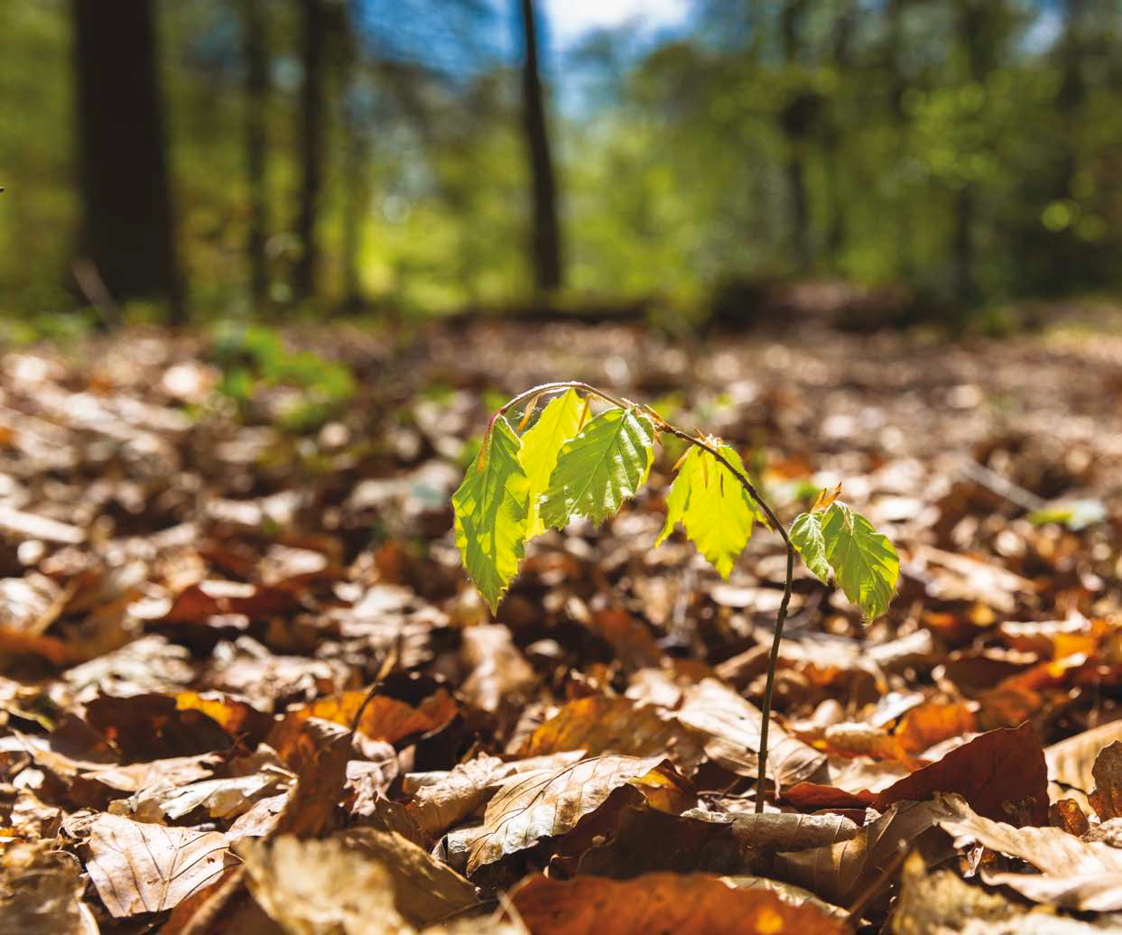

Nature restoration in European cities: Implementing the EU Nature Restoration Regulation
European Union

Slide 2


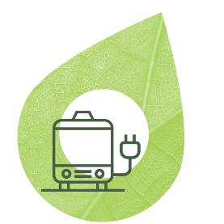








CLIMATE
PACT AND CLIMATE
LAW
PROMOTING
CLEAN
ENERGY
INVESTING IN
SMARTER, MORE
SUSTAINABLE
TRANSPORT
PROTECTING
AND RESTORING NATURE
STRIVING
FOR GREENER
INDUSTRY
The European
Green Deal
FROM FARM
TO FORK
ELIMINATING
POLLUTION
LEADING THE
GREEN CHANGE
GLOBALLY
ENSURING
A JUST TRANSITION
FOR ALL
MAKING
HOMES ENERGY EFFICIENT
FINANCING
GREEN
PROJECTS
Notes:
The Biodiversity angle is a core part of the Green Deal

Slide 3
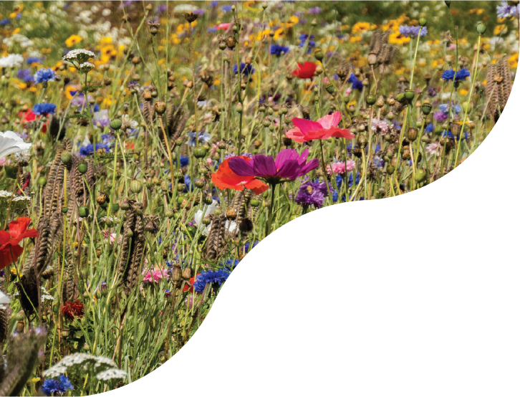







EU Biodiversity Strategy for 2030
Ensure that by 2030, Europe’s biodiversity will be on a path to recovery for the benefit of people, the planet, the climate and our economy
Enable Transformative Change
Protect Nature
EU For An Ambitious Global Agenda
Restore Nature
Notes:
The Biodiversity Strategy for 2030 set out a comprehensive package of commitments and actions to put Europe's biodiversity back on the path to recovery by 2030. One key pillar of the Strategy is that the Commission would come forward with a proposal for legally binding EU nature restoration targets to fill the gaps in the existing regulatory framework and promote the restoration of degraded and carbon-rich ecosystems. That is what has now be proposed.

Slide 4

EU Biodiversity Strategy - key points:
Continuing ecosystem degradation and biodiversity loss across the EU →
  Protection is not enough
  Voluntary targets of the 2020 EU Biodiversity Strategy: not met
  → a reinforced approach is needed
Conclusion: The Commission to come forward with a proposal for legally binding targets for nature restoration – including Urban ecosystems
Cities with at least 20,000 inhabitants have an ambitious Urban Nature Plan

Slide 5
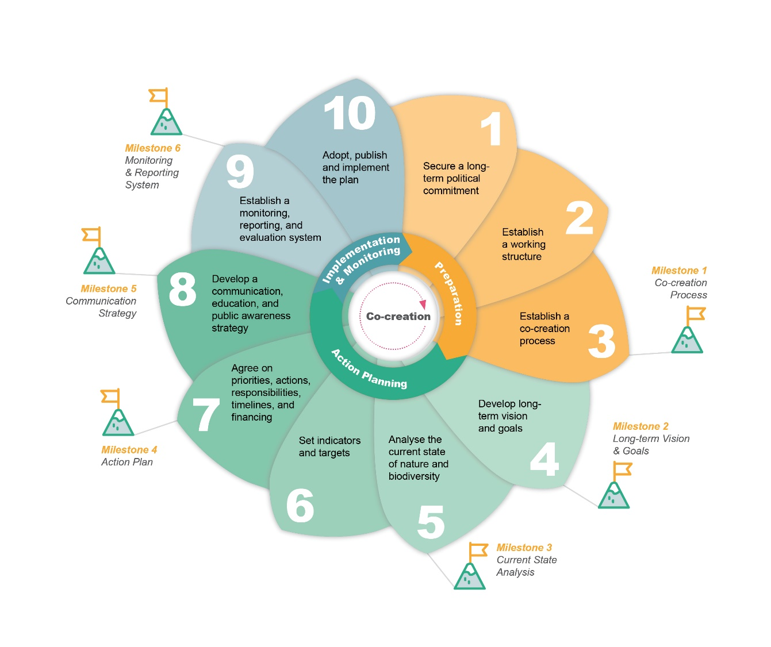
Urban nature plans

Slide 6
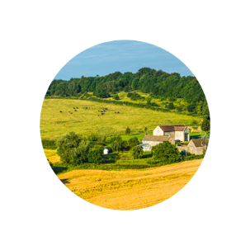



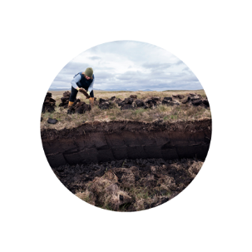

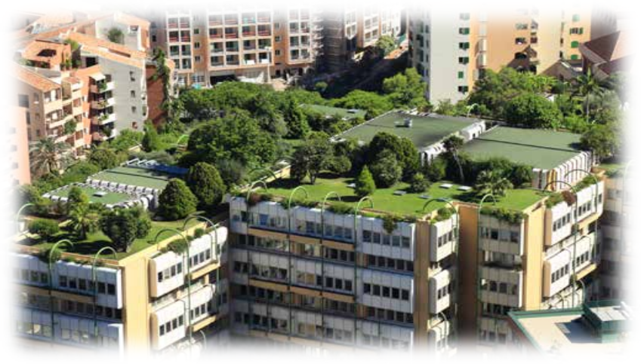

Overarching objective
By 2030 → restoration measures will cover 20% of EU’s land and sea
By 2050 → measures in place for ALL ecosystems in need of restoration
Restoration targets
Habitats Directive
Marine Habitats
Urban ecosystems
Rivers
Pollinators
Agro-ecosystems
Forests
Notes:
The proposal contains these overarching restoration objectives coupled with a set of binding targets for specific ecosystems, to ensure a broad coverage of ecosystems to be restored, resilient and adequately protected.

Slide 7
Urban ecosystem targets
Until 2030: no net loss of total national levels of urban green space and tree canopy cover in 'urban ecosystem areas'
  exemption from national target for urban ecosystem areas with more than 45% green space and more than 10% tree canopy cover
After 2030: increasing trend of:
  overall national level of urban green space
  urban tree canopy cover, in each urban ecosystem area
  …until satisfactory levels are achieved (no exemptions)
Notes:
The proposal aims to ensure a steady increase in urban green space and tree canopy cover in densely populated areas from now to 2050. This can be achieved by ‘greening’ urban planning processes over time, restoring degraded industrial land, increasing green roofs, tree lining streets and creating micro parks and allotments, even by greening car parks.

Slide 8




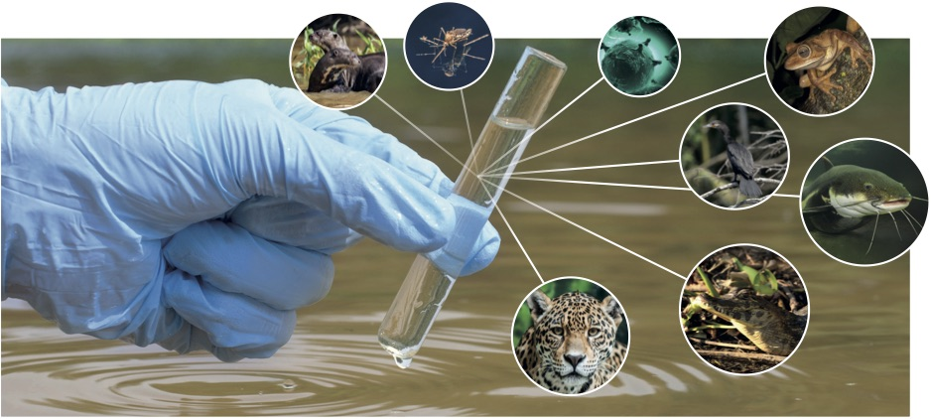
Nature Restoration Regulation
Implementation framework – Monitoring and Reporting
  Member States to monitor and report on implementation of restoration measures and results achieved
  Commission and European Environment Agency
→ assess progress in implementation and achievement of targets and obligations
Notes:
Based on reporting by Member States, the Commission will check on progress in restoration, i.e. the restoration measures put into place by a Member State aiming to achieve good condition. This information will be verifiable.
Based on the monitoring and reporting by the Member States, the Commission will also check progress in achieving good ecosystem condition, i.e.: (a) For those ecosystems whose condition is described by Favourable Conservation Status of the Habitats Directive; and (b) for those ecosystems for which good condition is not yet defined, evidence of an increase in specific indicators will be used to verify progress.

Slide 9
Implementation framework
  National Restoration Plans (NRP)
    Preparation: - quantify & map areas in need of restoration
    - identify synergies with climate change & other plans and strategies
    Content: - quantify and describe restoration measures
    - non-deterioration measures & timing for implementation
    - financing and support to affected stakeholders
    Process: - public/stakeholder participation
    - submit to Commission after 2 years, Commission makes observations
      Monitoring and Reporting
    Member States to report on implementation of NRP, on putting in place restoration measures and results achieved
Notes:
Member States will have the flexibility and the obligation to plan which restoration measures they will put in place where. They will have to describe this in their National Restoration Plan, which they have to submit 2 years after then entry into force of the Regulation
National Restoration Plans. The National Restoration Plans will be instrumental in planning and prioritising activities, as well as in channelling and optimising financial and other resources from EU and other Member States’ sources.
The National Restoration Plans would include the following components:
A framework to map and monitor the condition of targeted ecosystems, as well how to effectively monitor and report on progress towards the targets. Progress would be described in terms of (i) restoration measures undertaken and (ii) description of ecosystem condition.
Plans for specific restoration measures, and for where to prioritise restoration (e.g. links with protected areas), including addressing potential trade-offs taking climate change projections into account.
Plans for how to gain EU, national, and public/private financing, and where and how to best deploy this financing.
Public participation: How stakeholders (e.g. farmers, foresters, fishermen) would be given opportunities to participate in the preparation of National Restoration Plans and various restoration activities.

Slide 10
NRR term | Dataset and link | Latest available | Update frequency | Type of data | Release date | Best baseline?
1.Local Administrative Units | Local Administrative Units boundaries | 2023 | Yearly | Vector polygons | Q4 2024 | 2024 data set available in 2025 (TBC when)
2.Local Administrative Units: cities, towns and suburbs | Local Administrative Units “Degree of Urbanization” classification | 2023 | Yearly | Tabular | Q4 2024 | 2024 data set available in 2025 (TBC when)
3.Urban centres and urban clusters | Urban centres and urban clusters | 2021 | Every 10 years | Raster Resolution 1000 m | Q4 2024 | This is the final dataset that must be used for NRR implementation
4.Urban green spaces | CLC+ Backbone note new notation: CLCplus Backbone | 2021 | Every two years | Raster Resolution 10 m | Q2 2024 | 2023 reference year will be published Q2 2025 (this will be the final dataset for NRR)
5.Tree canopy cover | High Resolution Layer Tree Cover Density product | 2018 | Annual | Raster Resolution 10 m | Q2 2025 | 2021 avalable Q2 2025 2022 & 2023: avalable Q3 2025. 2024: available between Q4 2025 – Q2 2026 (this will be the final dataset for NRR)

Slide 11
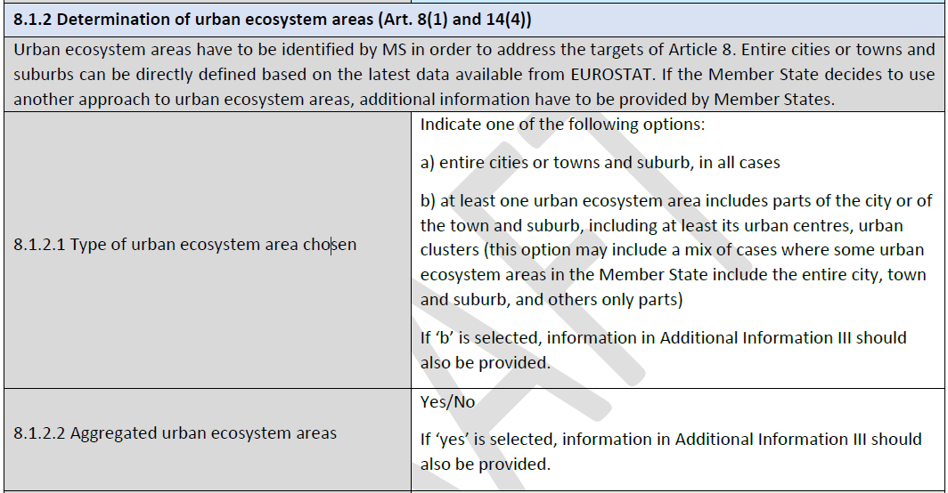
Urban Ecosystem Areas

Slide 12
Supplementary Data?
Improve or complement the information already included in the official datasets
i.e. allow an increase of data quality in terms of:
  Precision: In the case of urban green or urban trees data identified with a higher spatial resolution
  Accuracy (reliability): Accuracy refers to how close a measurement is to the true value. It measures the correctness and reliability of the spatial data in relation to the real-world values.
Be consistent over time: available in 2024 (baseline), 2030 and be maintained for the future monitoring
Be consistent over space: the data should be maintained to cover over time the area for which they are used, during all stages of the regulation implementation.
In all cases, supplementary data should be derived from systematic monitoring in which the methodology can be clearly described
Supplementary data needs to be reported at national level

Slide 13
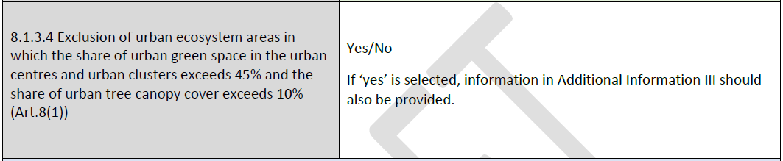
Exclusions?

Slide 14
After 2030
Increasing trends after 2030
No exemptions
Revision of the National Restoration Plans

Slide 15
References
A portal of reference documents on the Nature Restoration Regulation, hosted on the EEA website: Nature Restoration Regulation Reference Portal | Biodiversity Information System for Europe
An explanatory brochure on the nature restoration regulation: The nature restoration regulation - Publications Office of the EU

Slide 16
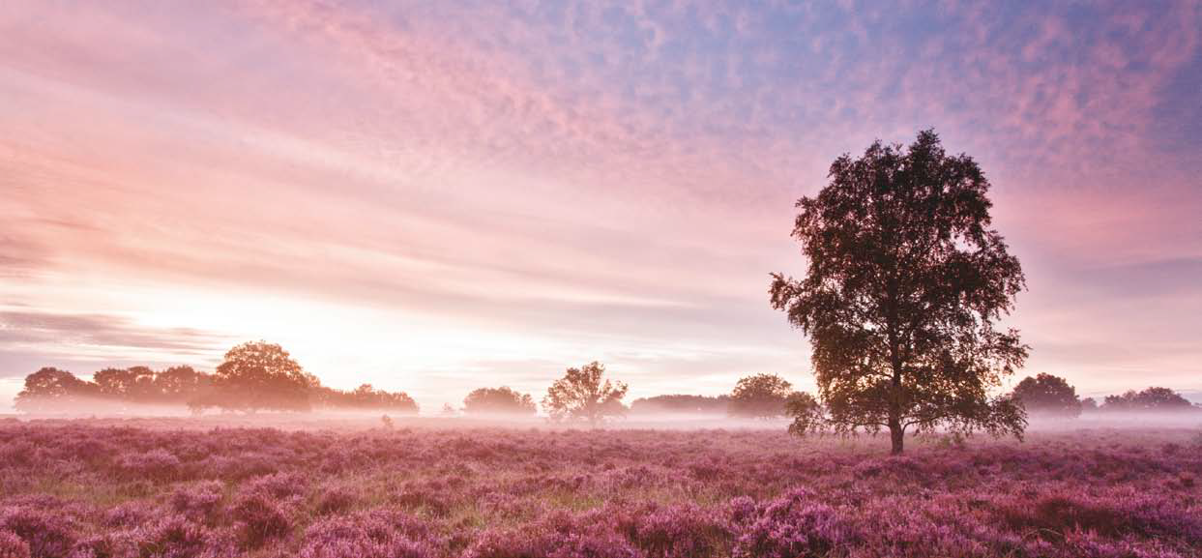
Thank you for your attention!
Notes:
To finish off: Sunrise with fog over heather landscape, Kampina Nature Reserve, The Netherlands.

