Slide 1
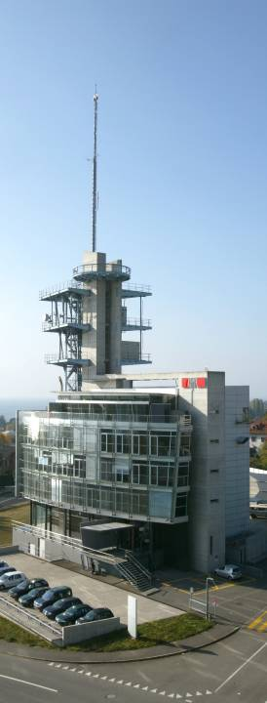
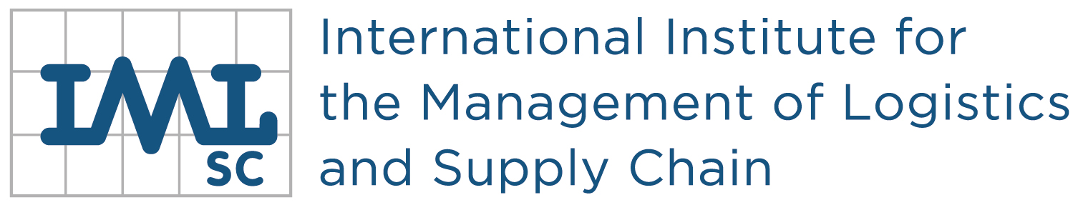



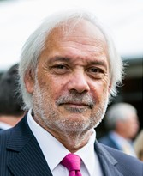

Lausanne - Paris
Prof. Ph. Wieser
President of IML
WELCOME
2020

Slide 2



IML (International Institute for the Management of Logistics and Supply Chain / EPFL)
History
Founded in 1990
Ecole Polytechnique Fédérale de Lausanne
Swiss federal Institute of Technology
Ecole Nationale des Ponts ParisTech
More 40 (international) COMPANIES
More 20 ACADEMICAL MEMBERS

Slide 3


IML (International Institute for the Management of Logistics and Supply Chain / EPFL)
History
2019
>1’200 graduates
75 nationalities
5 continents
1990
Headquarter
1993
1st Executive Master, Lausanne
1994
1st Executive Master, Paris
1995
Executive Master, Lausanne and Paris
(2 sessions/year, english-french)
In 1998, IML received the Award of Excellence from the
Institute of Transport Management (ITM) in Birmingham
2011
1st Executive Master, Casablanca
2014
New program «part time», Paris
2016
CAS in Healthcare Supply Chain Management
2019
New program «part time», Lausanne

Slide 4

IML (International Institute for the Management of Logistics and Supply Chain / EPFL)
Structure & Organization
Membership
Steering Committee
General Assembly
Headquarter
Prof. Ph. Wieser
Elaine Moran
Elaine Moran
Prof. Ph. Wieser
Executive Master
Lausanne
F. Bonnafous
Prof. M. Nakhla
Executive Master
Paris
Teaching Committee

Slide 5



















IML (International Institute for the Management of Logistics and Supply Chain / EPFL)
Examples of some academic members of IML (Membership)
European Logistics
Association

Slide 6


































IML (International Institute for the Management of Logistics and Supply Chain / EPFL)
Examples of some industrial members of IML (Membership)

Slide 7



IML (International Institute for the Management of Logistics / EPFL)
Activities
Postgraduate program
Executive Master
(MAS, CAS)
Continuing education
Lausanne/Paris
Casablanca
Taylor made program
Auditing
Transfert of Technology
PhD
Research
2019
50th Edition
>1’200 graduates
75 nationalities
Industrial partnership

Slide 8
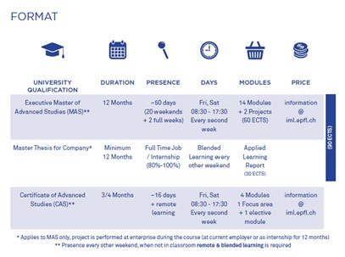

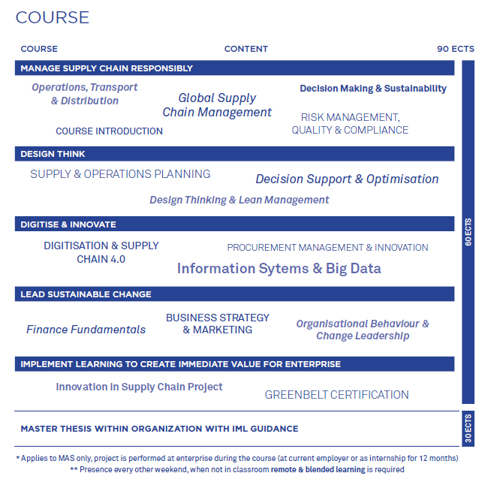
IML (International Institute for the Management of Logistics and Supply Chain / EPFL)
Activities
Education (MAS & CAS)
New program «part time», Lausanne
Innovation & Digital Supply Chain
2019

Slide 9
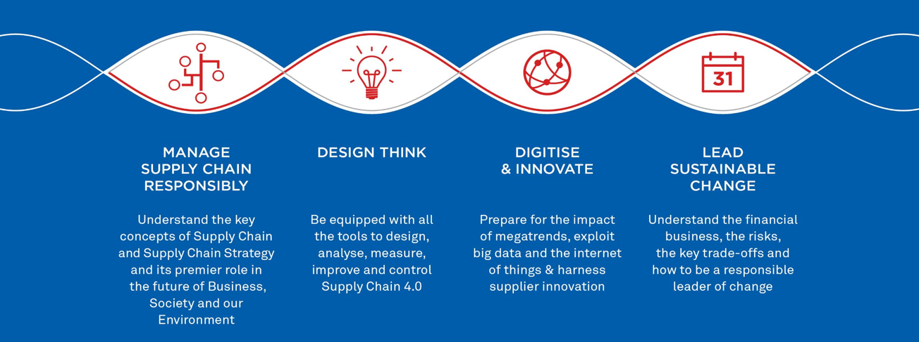
IML (International Institute for the Management of Logistics and Supply Chain / EPFL)
Activities
Education (MAS & CAS)
New CAS programs
4 new CAS programs

Slide 10
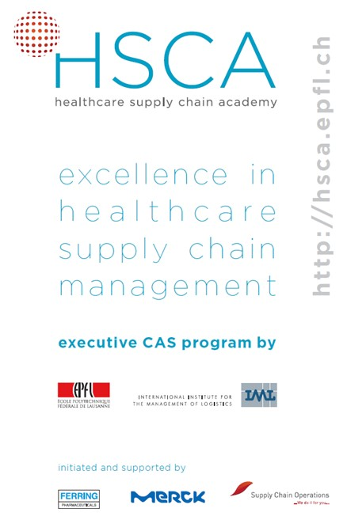
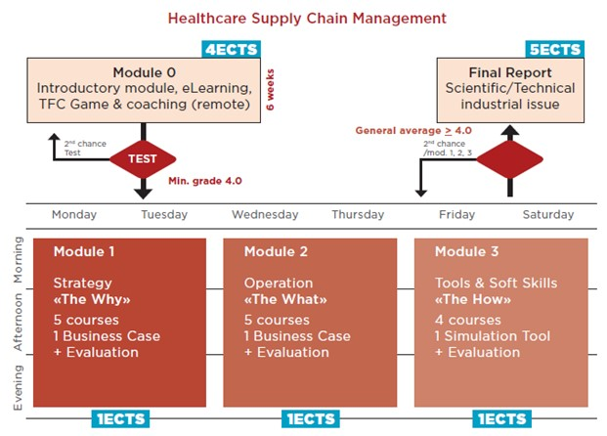
IML (International Institute for the Management of Logistics and Supply Chain / EPFL)
Activities
NEW Education Program CAS : HSCM

Slide 11
IML (International Institute for the Management of Logistics and Supply Chain / EPFL)
Students IML: repartition of nationalities (2019)
2019
>1’200 graduates
75 nationalities
5 continents
See IML ALUMNI Website http://www.iml-alumni.org/

Slide 12

IML (International Institute for the Management of Logistics and Supply Chain / EPFL)
Activities
Education (MAS & CAS)
Teachers from worldwide
80 Teachers
+10 nationalities

Slide 13









IML (International Institute for the Management of Logistics and Supply Chain / EPFL)
Activities
Education, Taylor made Program

Slide 14
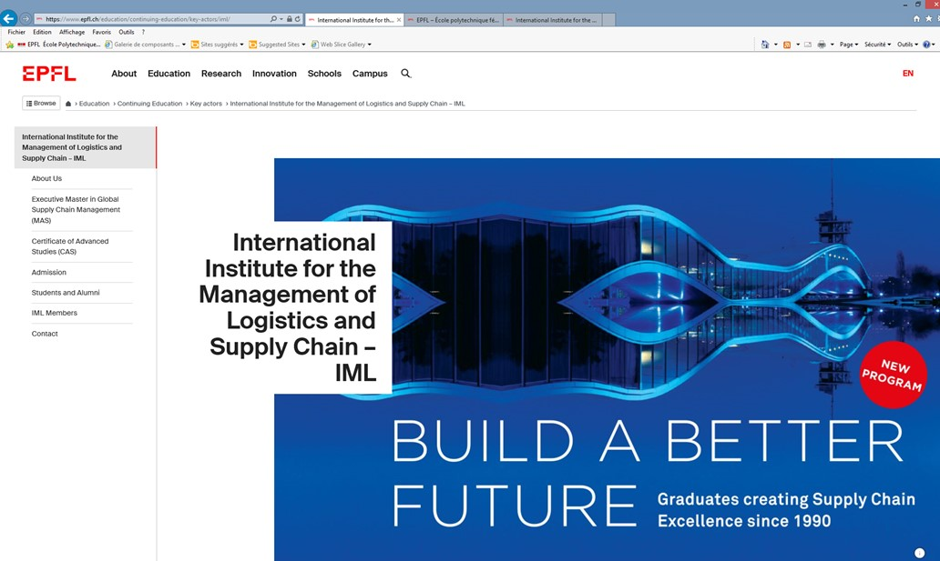
IML (International Institute for the Management of Logistics and Supply Chain / EPFL)
Our Web Site

Slide 15
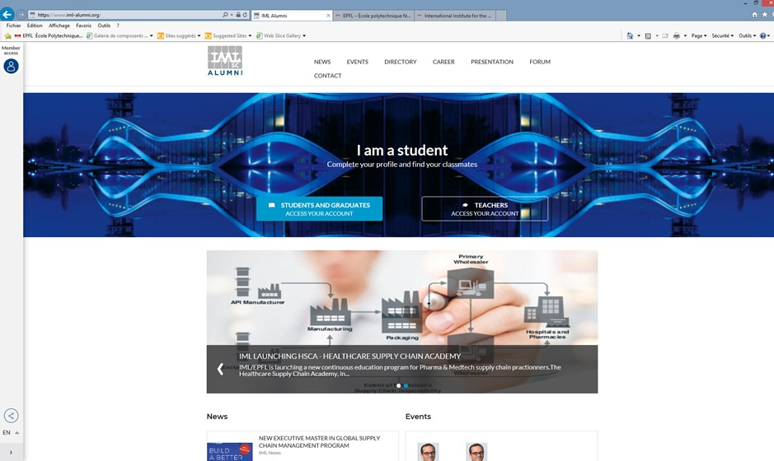
IML (International Institute for the Management of Logistics and Supply Chain / EPFL)
Web Site: ALUMNI IML
http://iml-alumni.org/

Slide 16

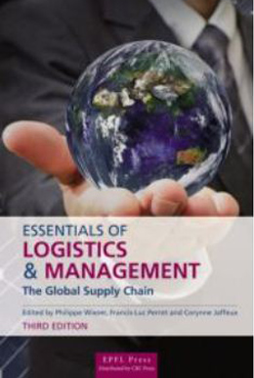
IML (International Institute for the Management of Logistics and Supply Chain / EPFL)
Handbook

Slide 17
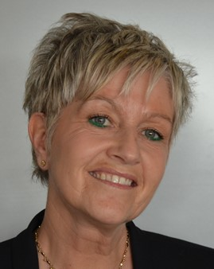
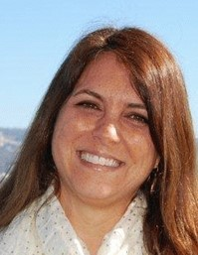
IML (International Institute for the Management of Logistics and Supply Chain / EPFL)
Main staff
E. Moran
IML Executive Director
IML Program Director
Ch. Wahl
Assistant
Reprography, administration
Permit, accommodation, …
Accounting
C. Martinucci
Alumni
Admin support

Slide 18
Thank you
for your attention
2020

