Slide 1
Climate change: The scientific basis for climate targets
Philippe Ciais
Laboratoire des Sciences du Climat et de l’Environnement

Slide 2
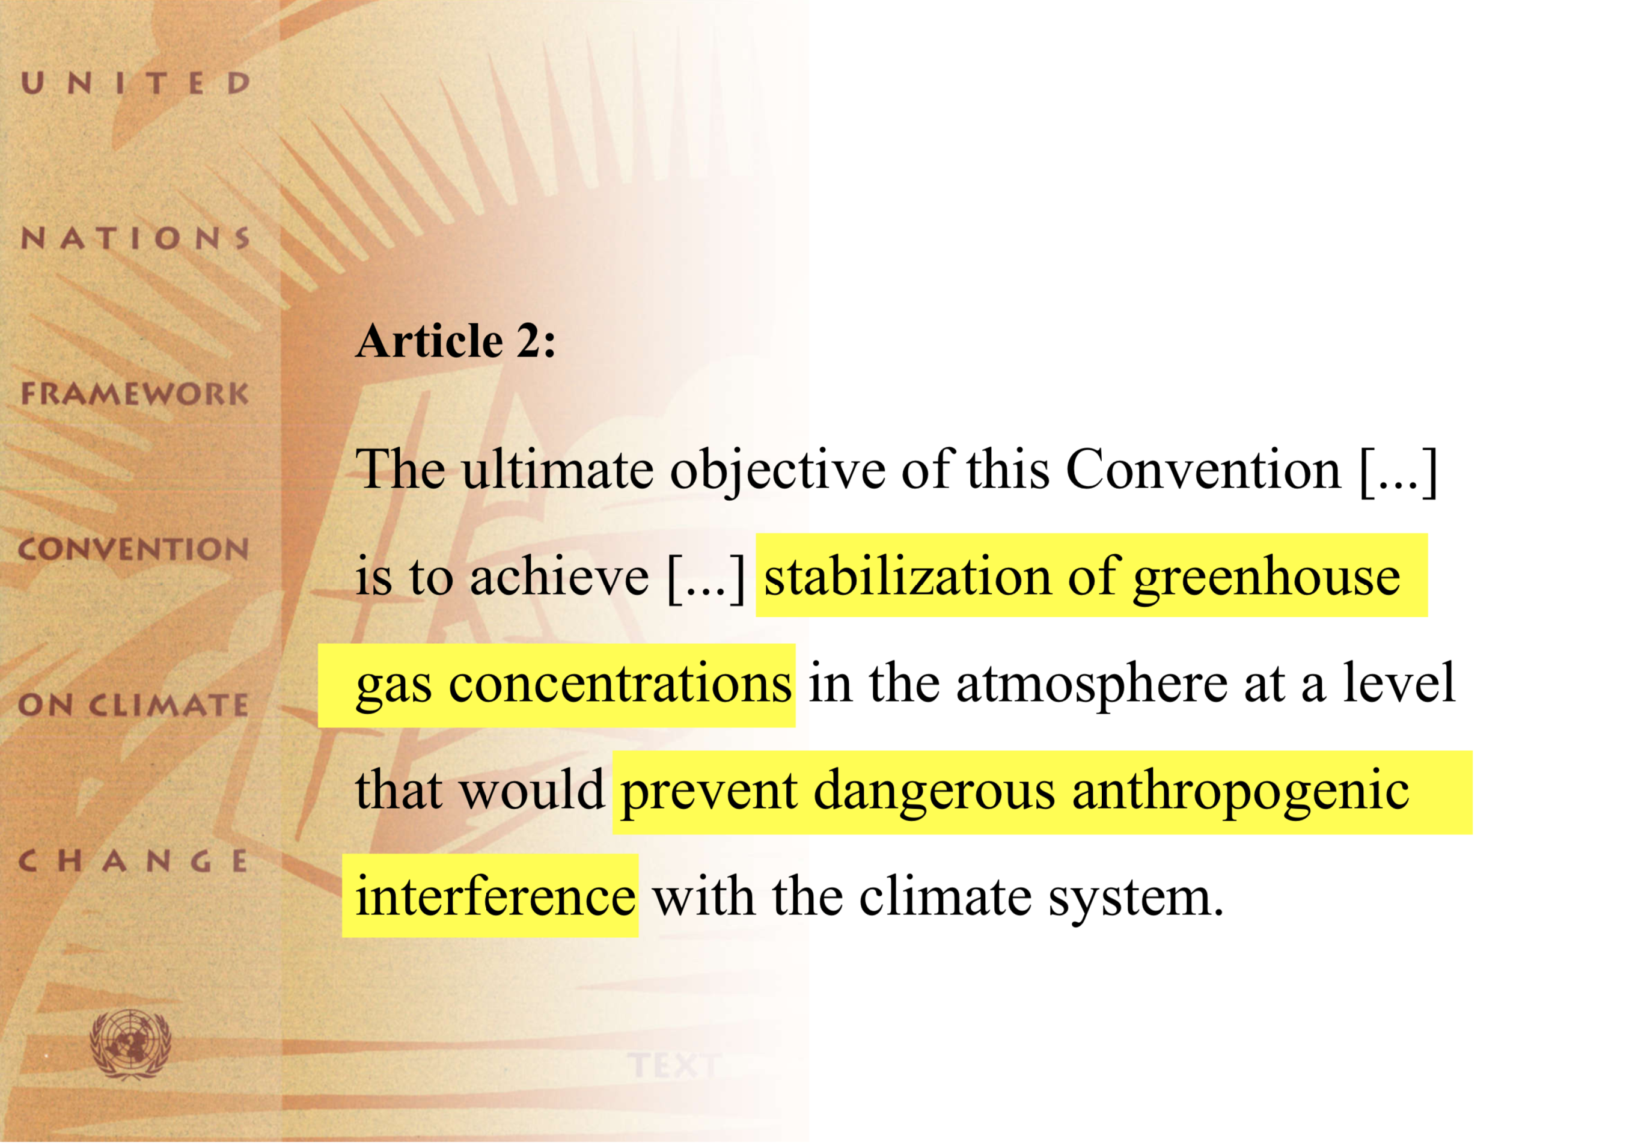
Rio Earth Summit, 1992

Slide 3
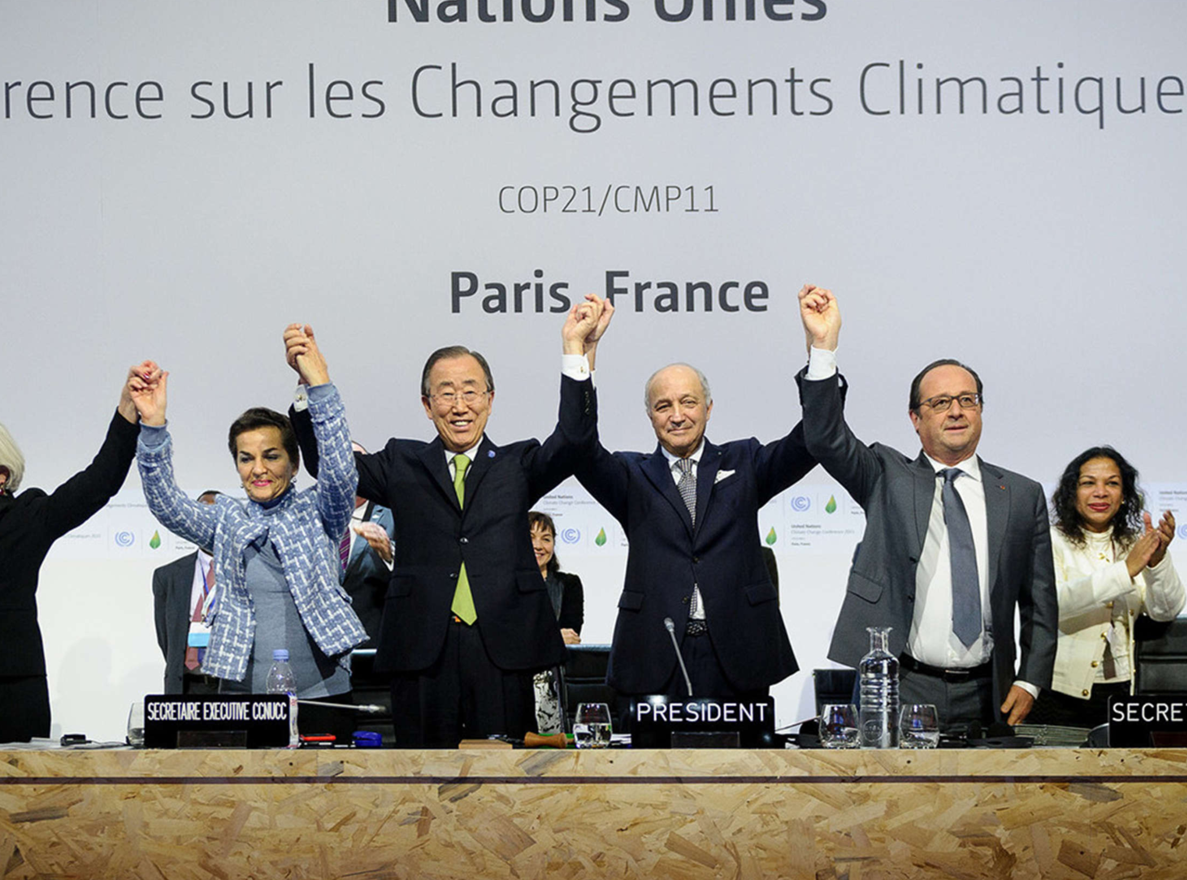

Slide 5
Finding the scientific consensus
Bringing the consensus to policymakers
Defining and quantifying climate targets
Challenges for the future

Slide 6
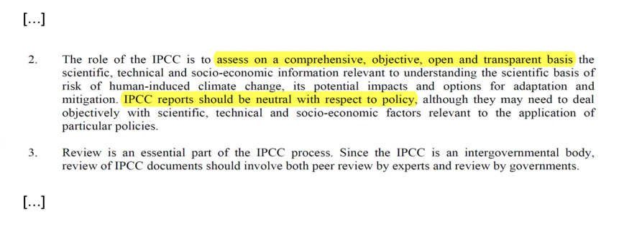
Principles governing IPCC work

Slide 10
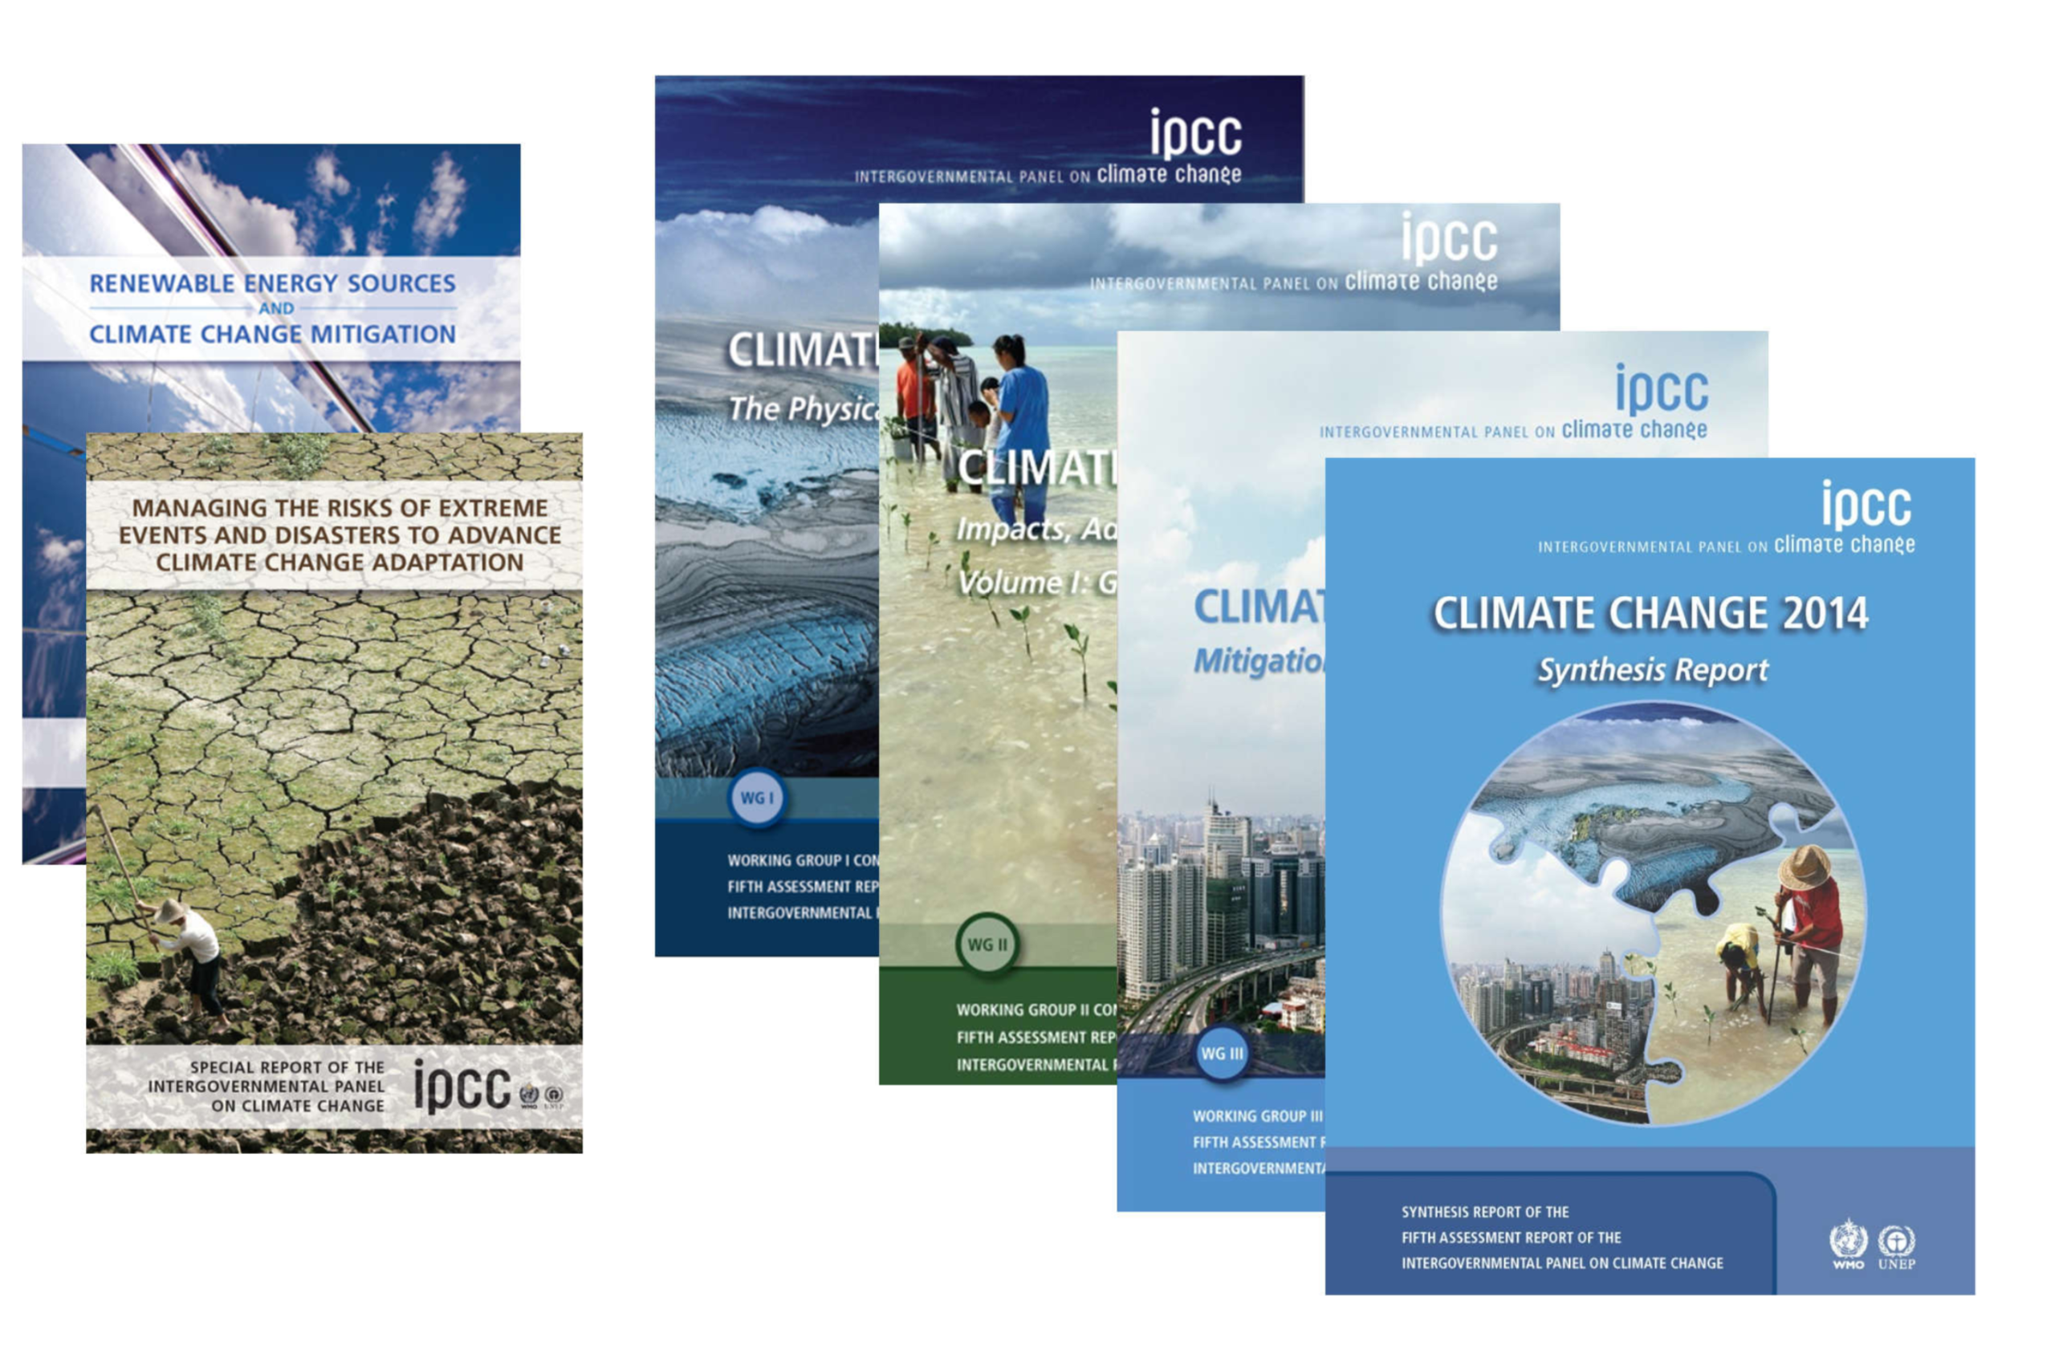
IPCC 5th Assessment Cycle (2008-2014):

Slide 11
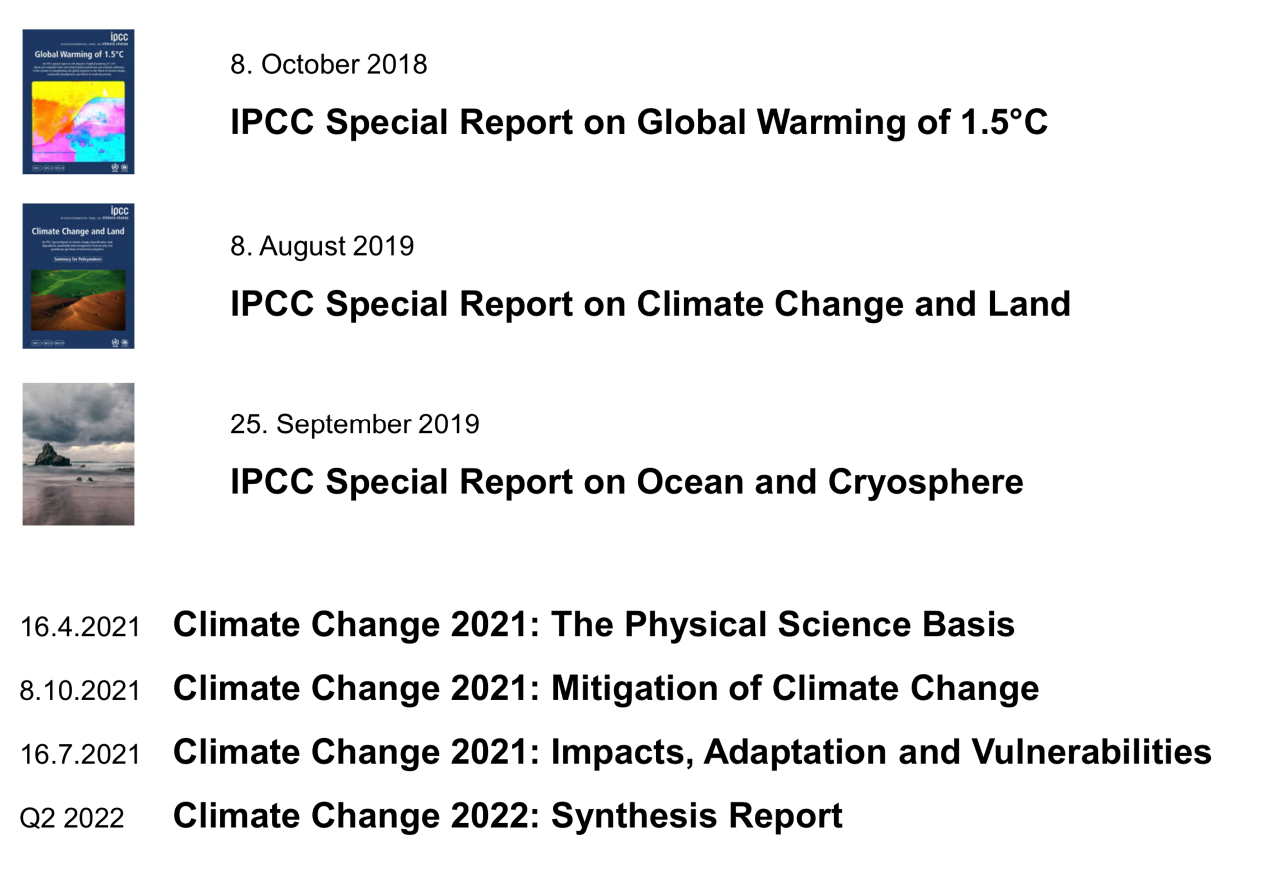
IPCC 6th Assessment Cycle (2015-2022):

Slide 12
Finding the scientific consensus
Bringing the consensus to policymakers
Defining and quantifying climate targets
Challenges for the future

Slide 14
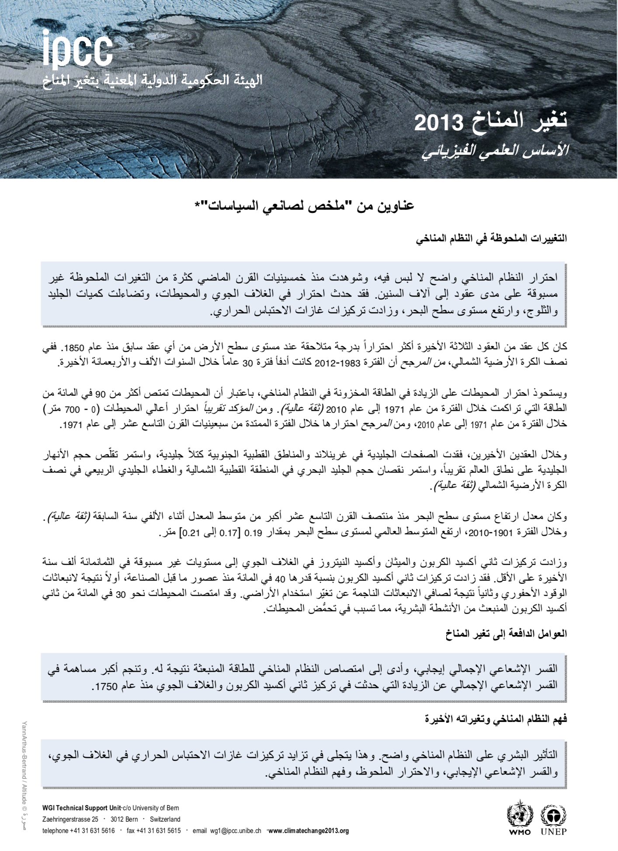
IPCC headline statements

Slide 16
Are IPCC summaries understandable ?

Slide 18
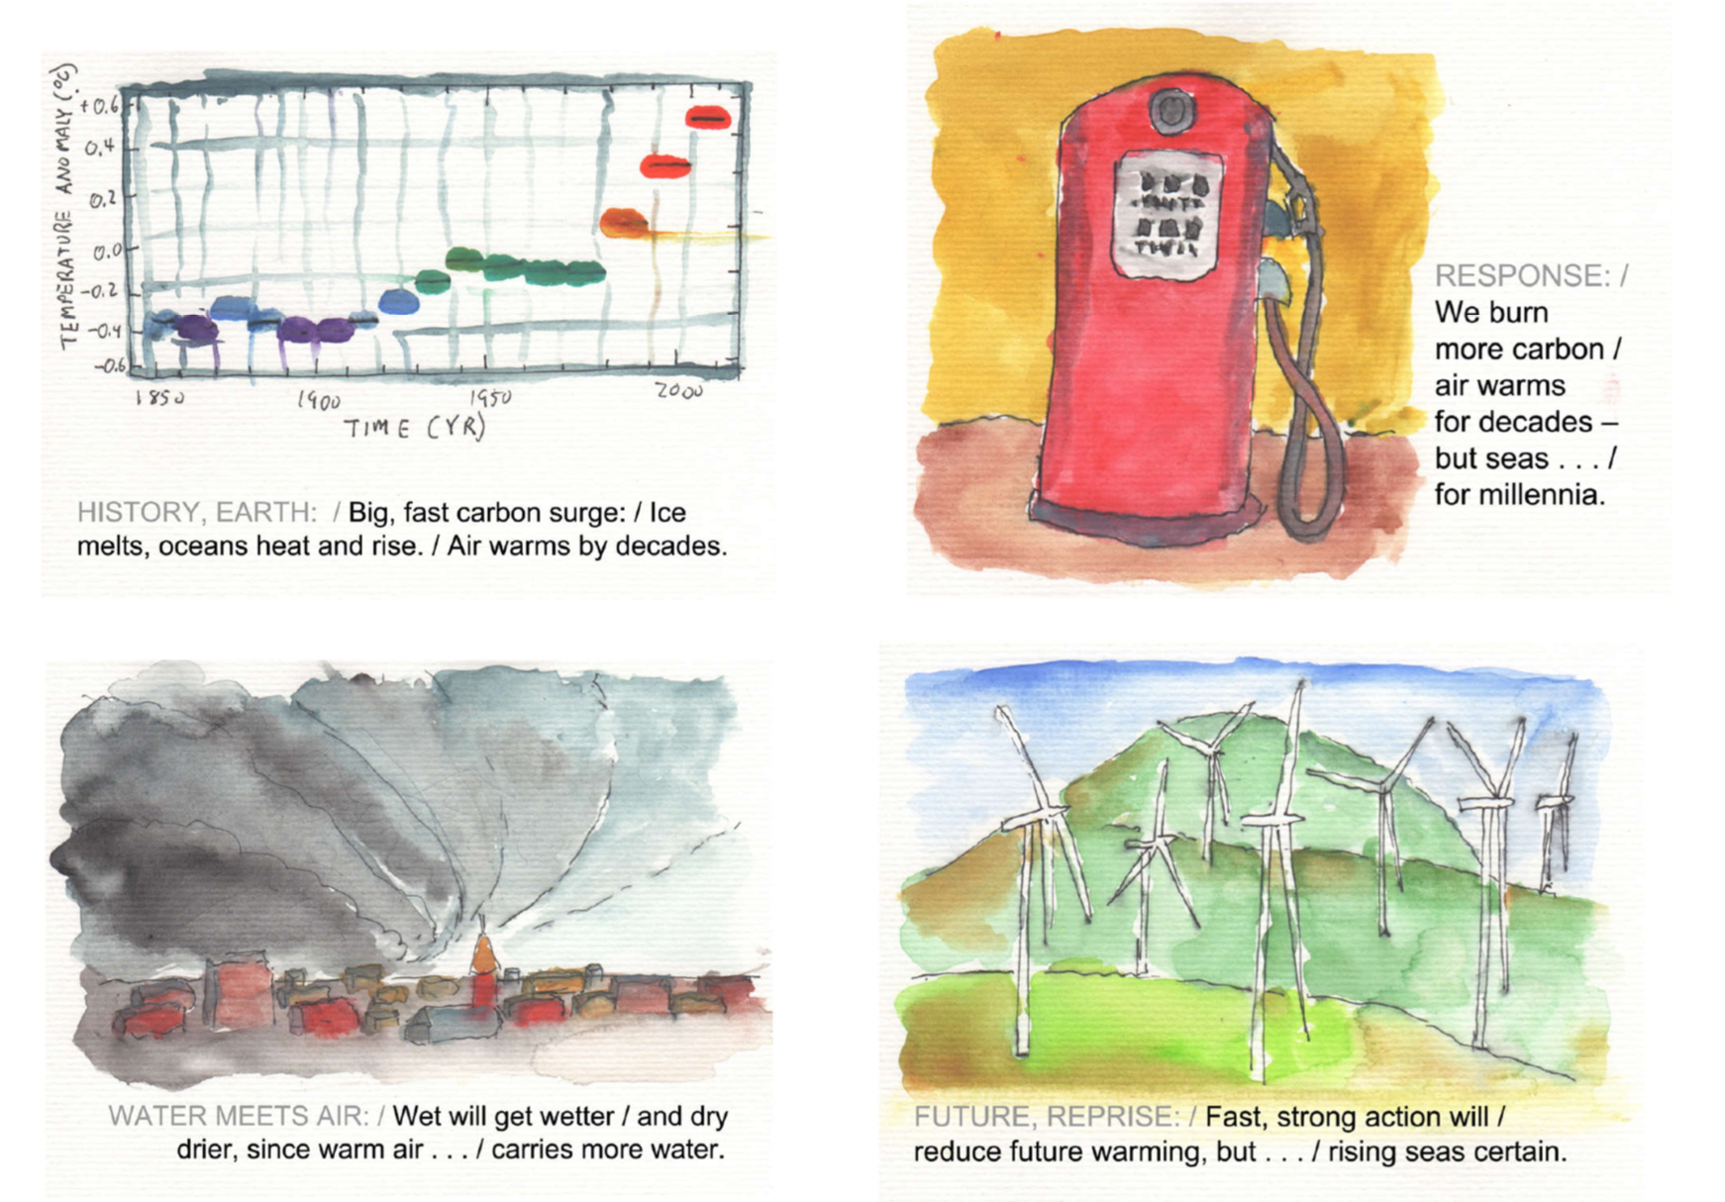

Slide 19
Finding the scientific consensus
Bringing the consensus to policymakers
Defining and quantifying climate targets
Challenges for the future

Slide 20
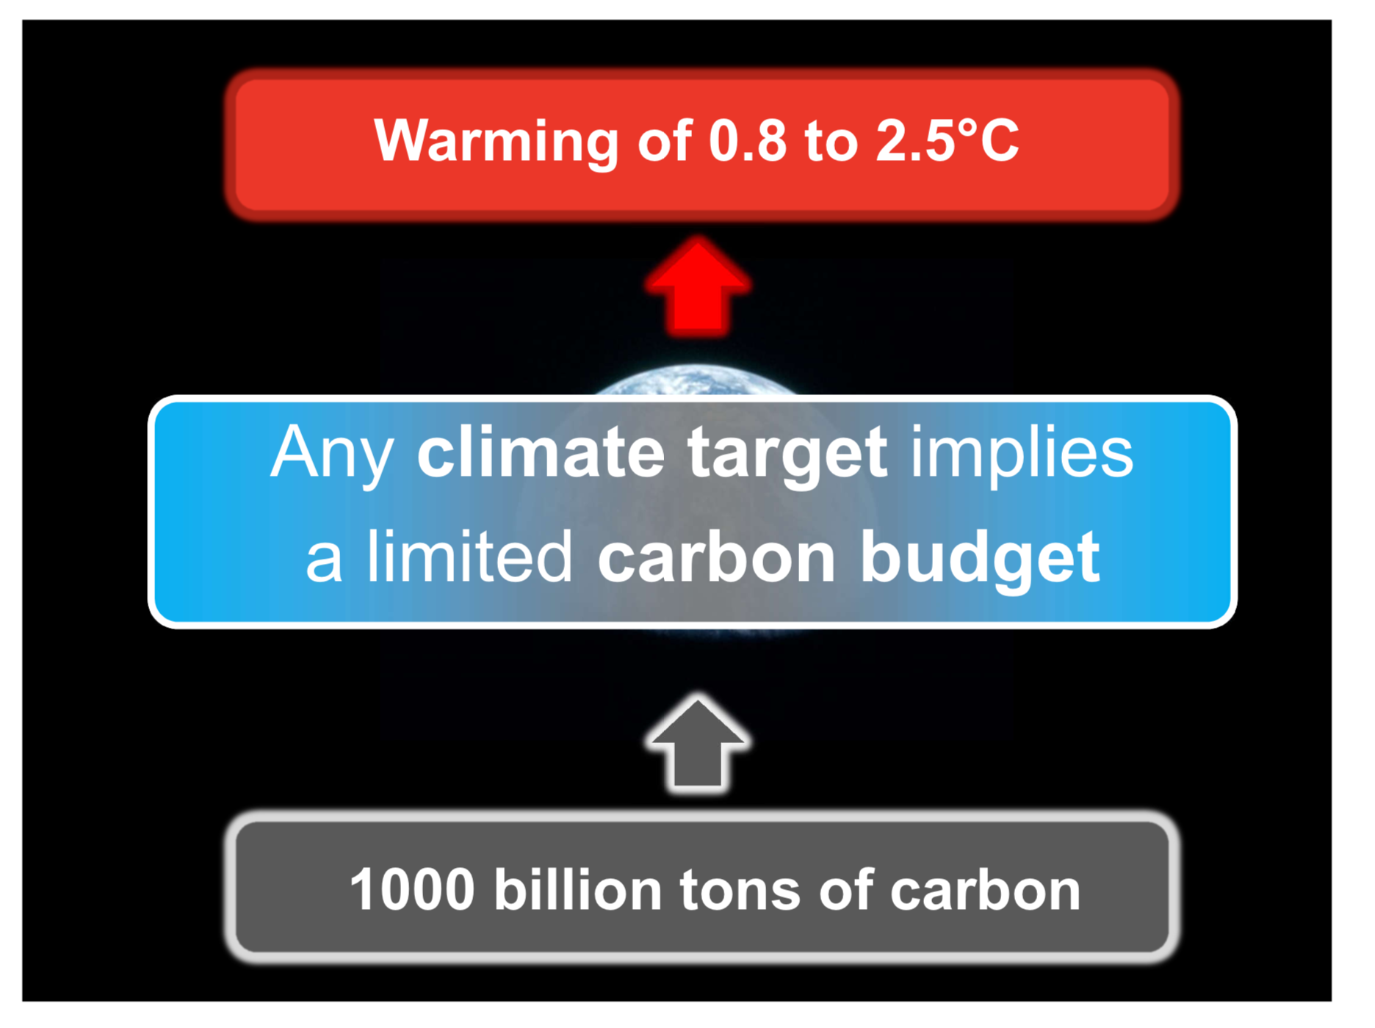

Slide 21
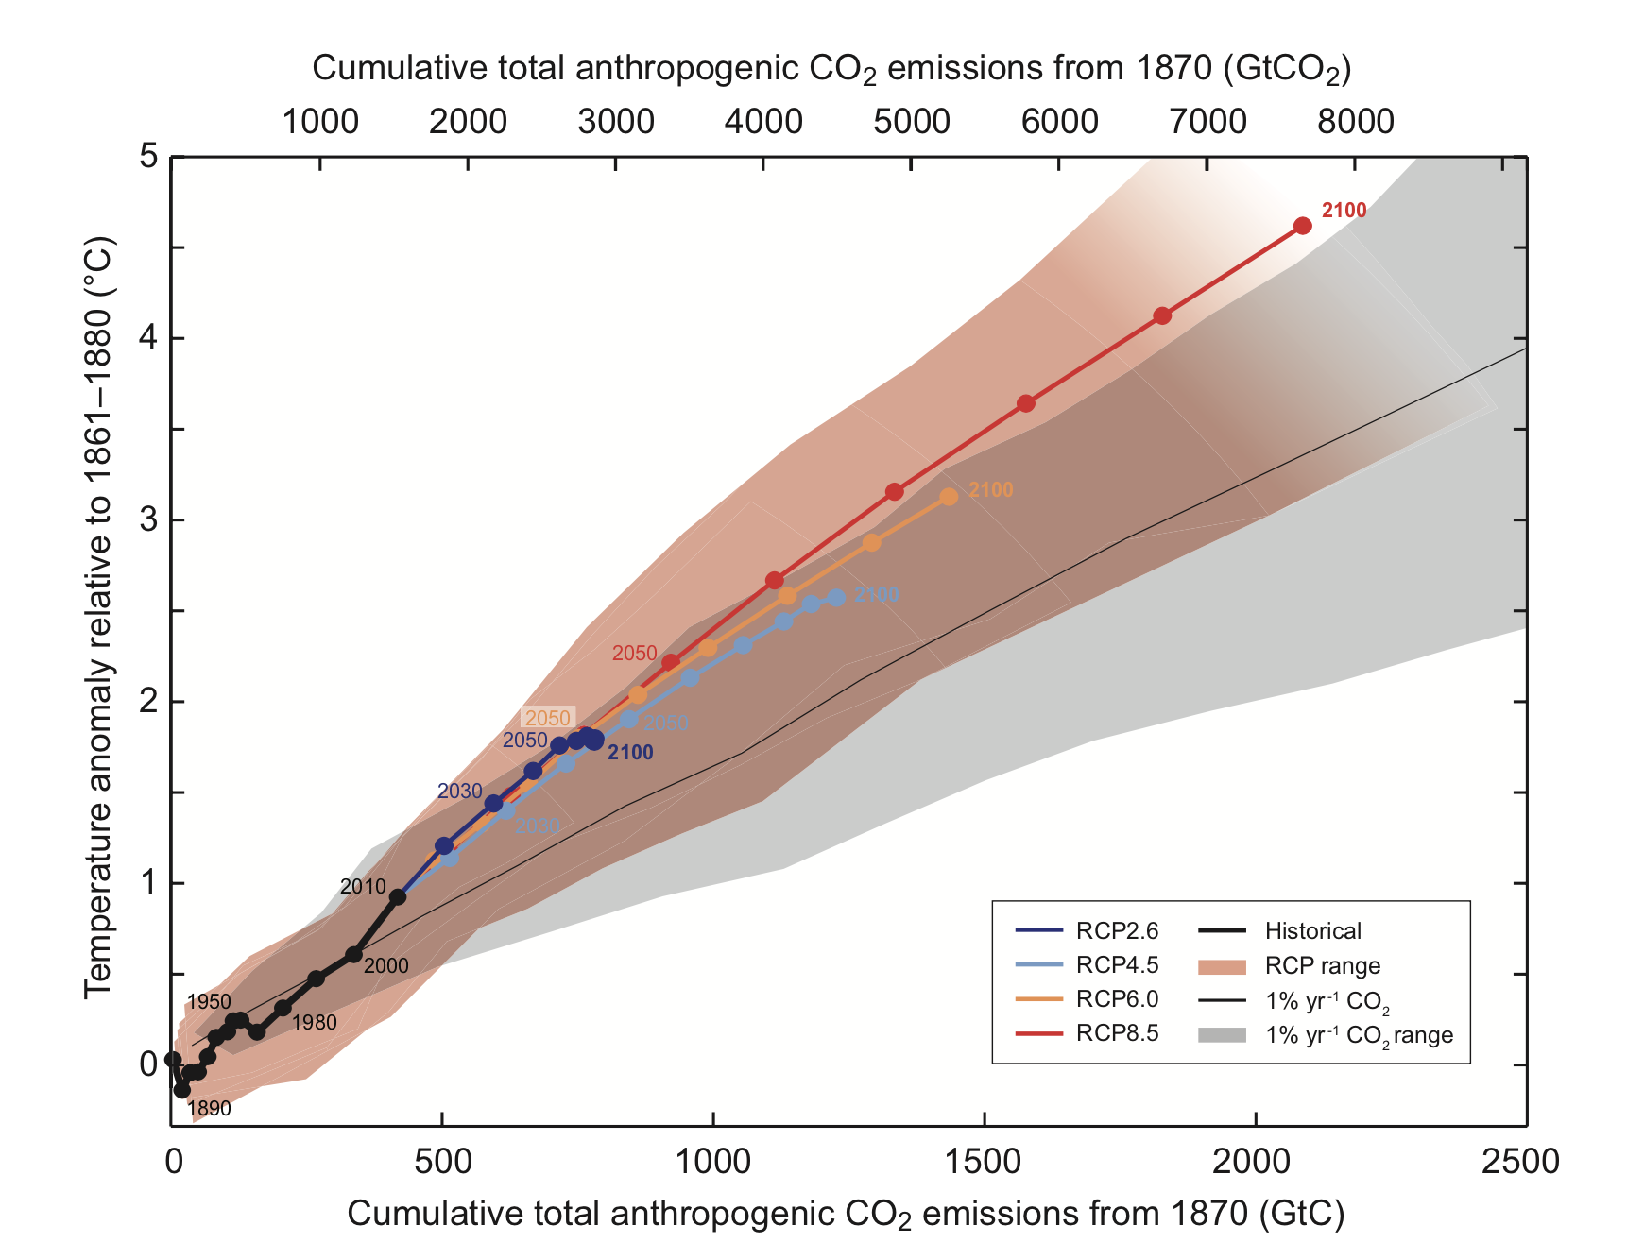
Climate targets and carbon budgets
2°C
Temperature anomaly since 1860
2° ≈ 1000 Billion tons of carbon
Cumulative carbon emissions (Billions tons C)
Past carbon already emitted

Slide 22
IPCC Special Report on 1.5° : Each 0.5° counts

Slide 23
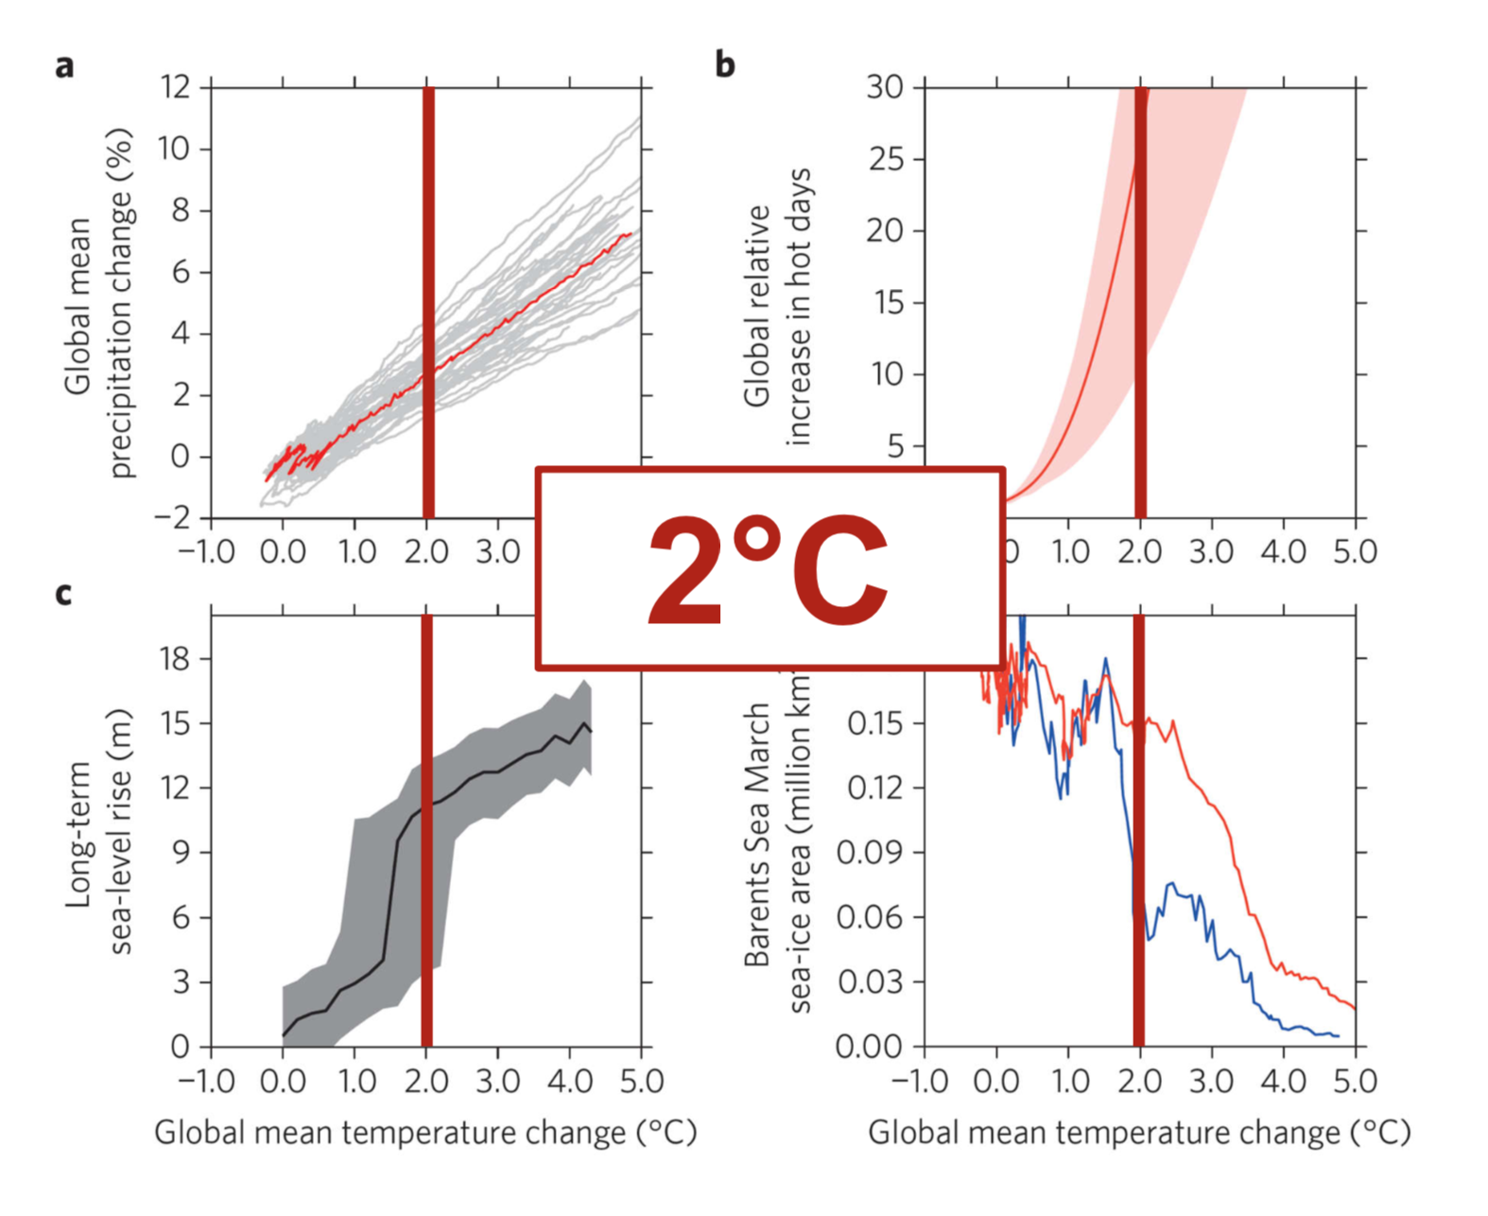
IPCC Special Report on 1.5° : Each 0.5° counts
23

Slide 24
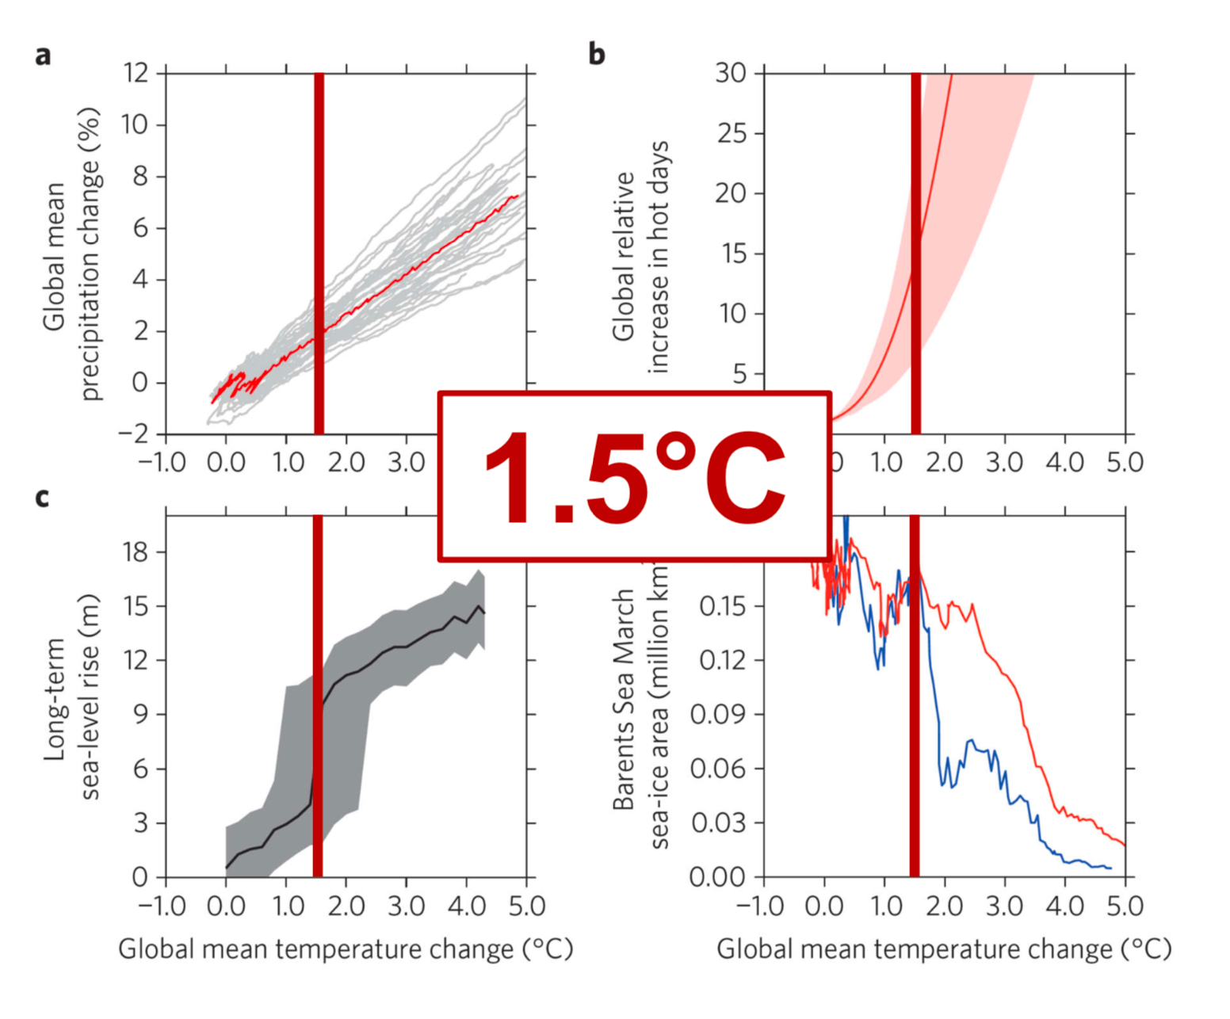
IPCC Special Report on 1.5° : Each 0.5° counts

Slide 25
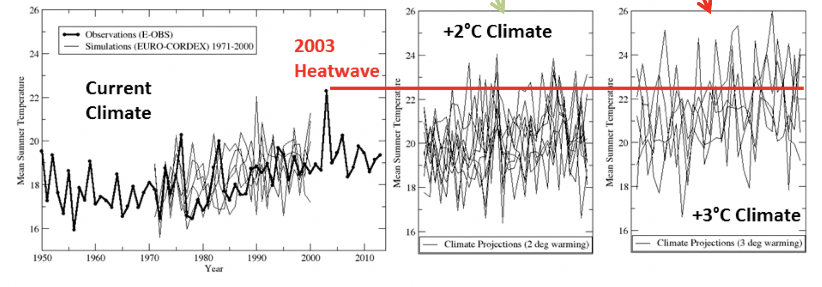
1° makes a big difference for summer heatwaves

Slide 26
Finding the scientific consensus
Bringing the consensus to policymakers
Defining and quantifying climate targets
Challenges for the future

Slide 27
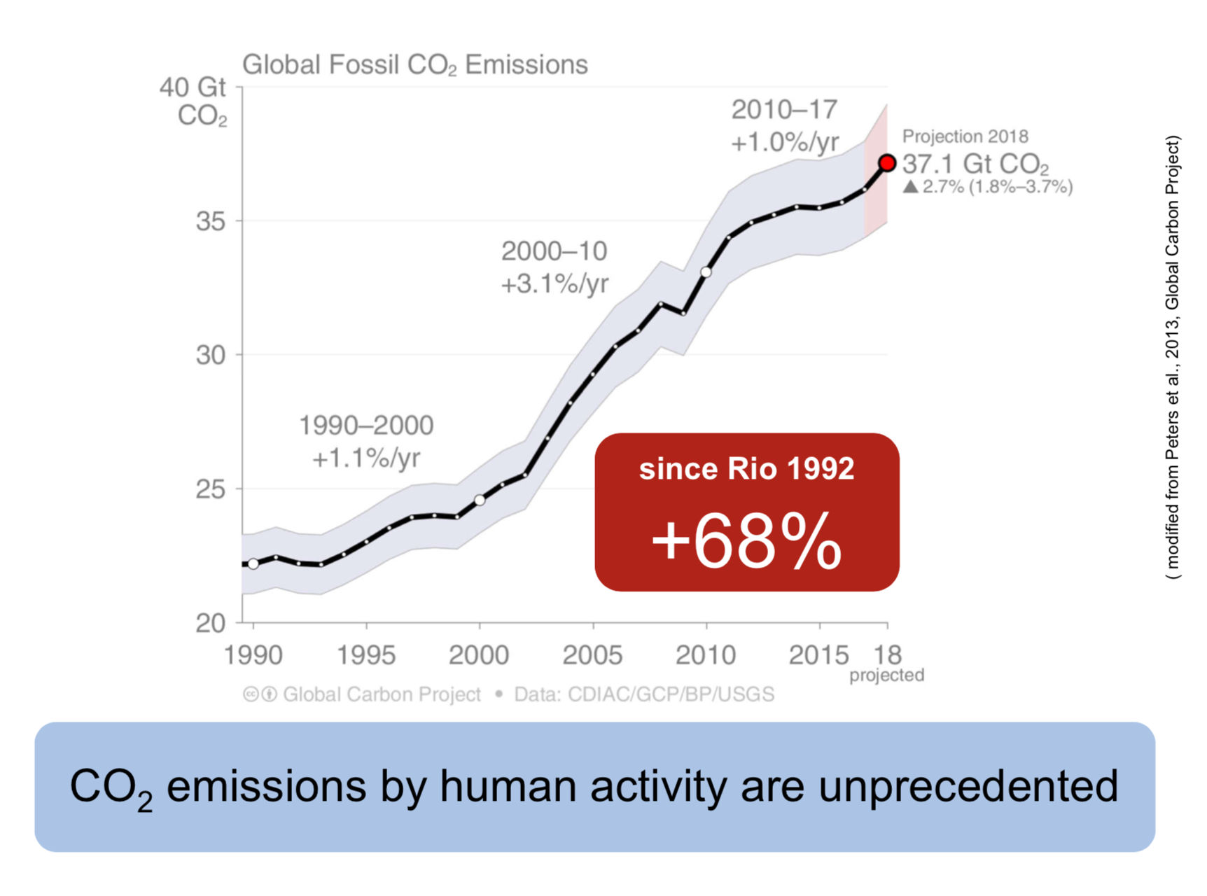

Slide 28
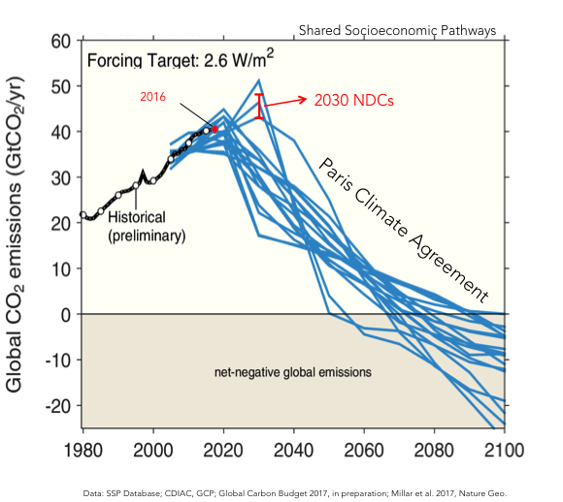
Emission pathways in the Paris agreement
The 2°C goal of the Paris Agreement requires a reversal of the trend of CO₂ emissions in the short term, and large and sustained reductions in the long term

Slide 29
Conclusions – take home
A climate target is a political choice based on international consensus.
Every 0.5°C matters: Warming of 2°C instead of 1.5°C makes a large difference in terms of impacts and risks.
The Paris targets require urgent mitigation because the carbon budget is rapidly exhausted.
The Paris targets require international cooperation, massive investments in decarbonized energy supply, demand side efforts, leverage of financial systems and local action
It is not only a necessity, but also an opportunity

