Slide 1
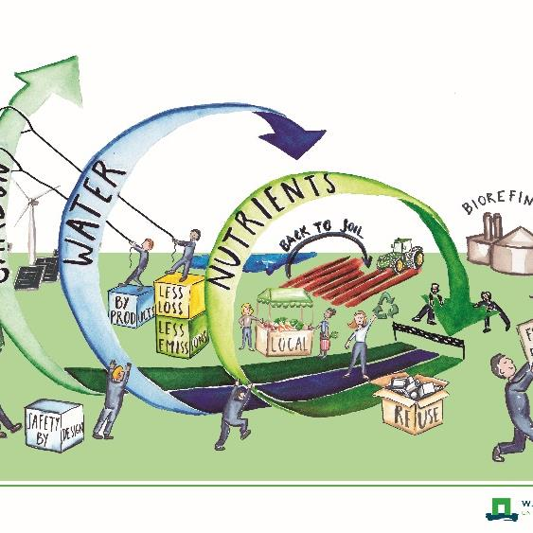
Towards Circulair and Climate Neutral Society
Saskia Visser
Input by: colleagues fro Wageningen-UR & TerraEnvision

Slide 2
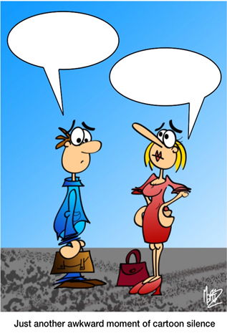
My talk
Introduction to (agriculture in) the Netherlands
Circular agriculture
Transition
First steps towards (Examples)
Perspectives for action: Transition management
(Some Soil slides)
This Photo by Unknown Author is licensed under CC BY-NC-ND

Slide 3
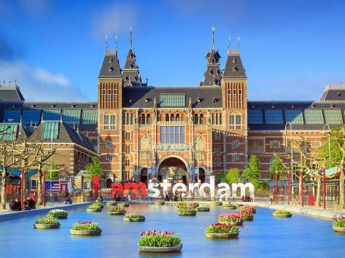
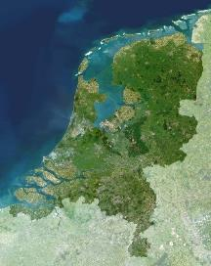
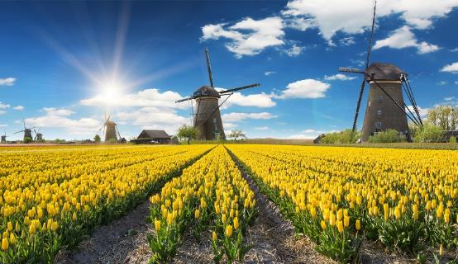
The Netherlands
https://youtu.be/eUjWdS-z5AA
Notes:
18.M people
France is about 13 times bigger than Netherlands. Netherlands is

Slide 4
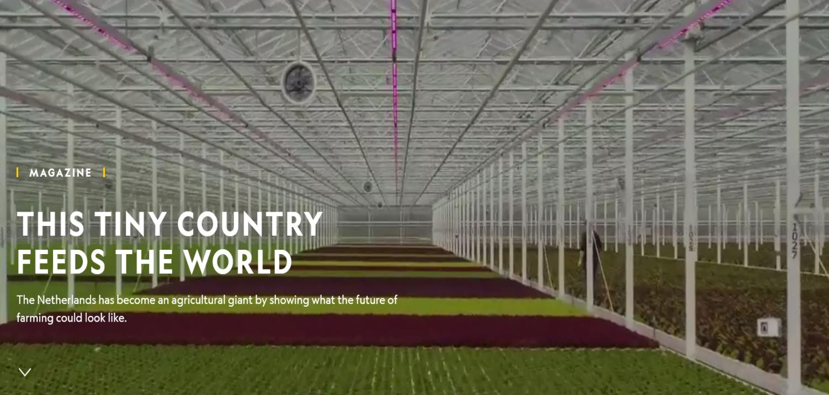

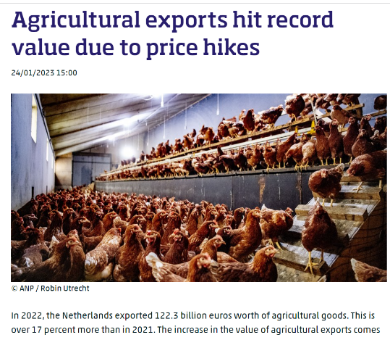
Dutch Agriculture
Notes:
Dutch agricultural exports worth €94.5 billion in 2019
NL is one of the world’s leading developers and manufacturers of food-processing machinery;
The Dutch agri-food sector strives for a sustainable source of healthy, safe food, produced with respect for nature and the environment.
Dutch agricultural entrepreneurs use efficient and sustainable production systems and processes, and can therefore increase productivity by five times higher than the European average.

Slide 5
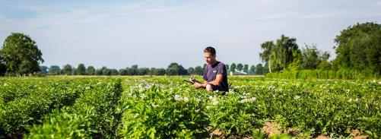
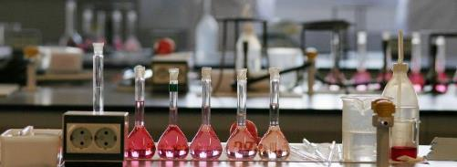
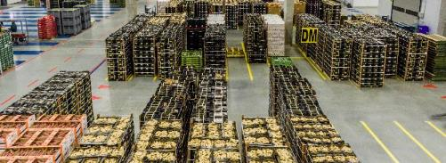
Some figures
The Netherlands is the second largest exporter of agri-food products, worldwide
12 R&D centres of the world’s top-40 food & beverages companies
are located in the Netherlands.
World largest auction for flowers and plant is located in Aalsmeer, the Netherlands

Slide 6
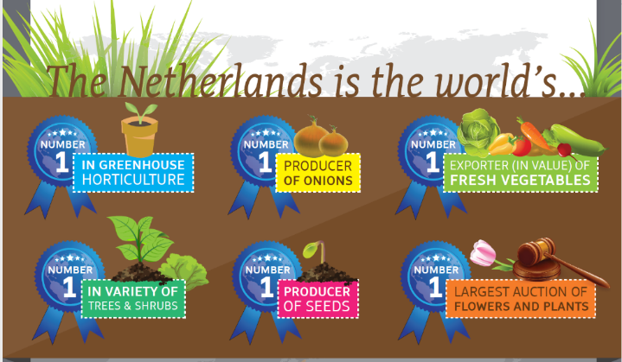
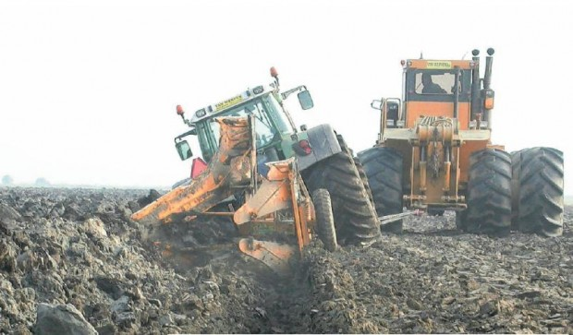
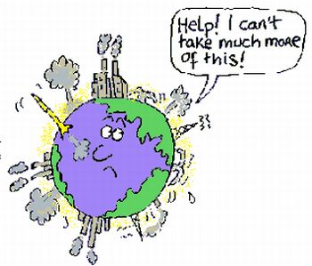
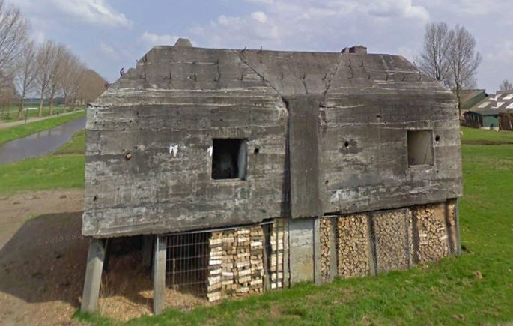
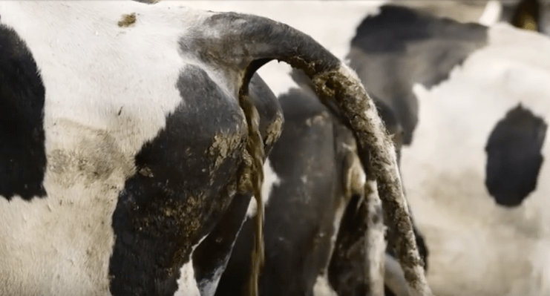

Slide 7
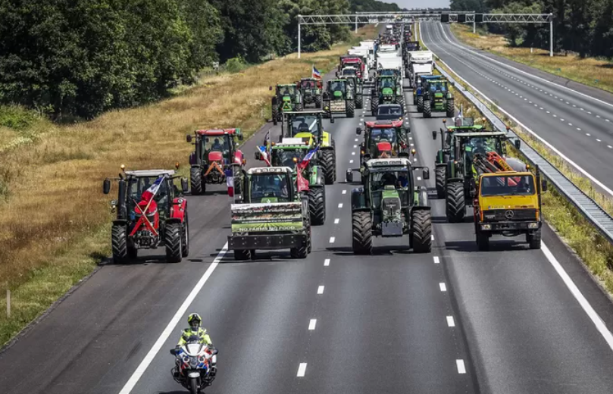
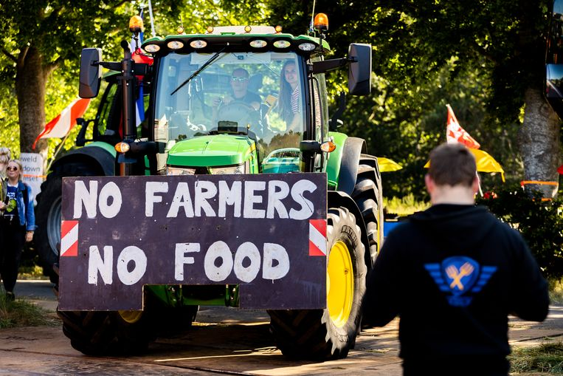
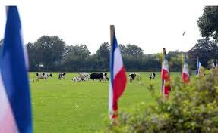
The Nitrogen crisis
Farmers protest

Slide 8
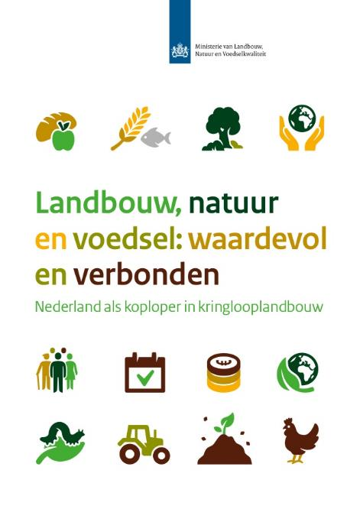
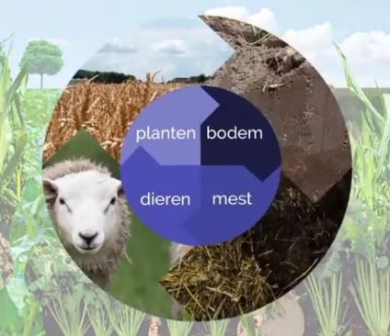
Strategy: Circular agriculture
A form of sustainable nature inclusive agriculture in which the cycle of substances is closed. This means that all substances that disappear from an area as a result of agriculture are also returned to that area.
Notes:
The vision builds on the transition to circular agriculture. It entails a paradigm shift from
growth in production volumes and cost price reductions towards optimisation in resource
use and food production in harmony with nature. The transition to circular agriculture
will stimulate new economic activities and types of businesses. It is an inclusive vision:
circular agriculture needs to offer new prospects not only for frontrunners but for all
types of agricultural activities and for all farmers and growers, including family businesses

Slide 9


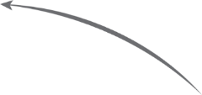
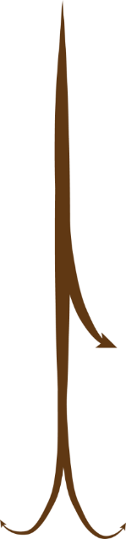







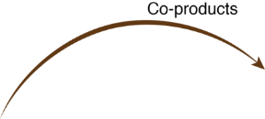
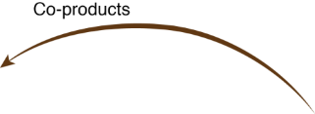





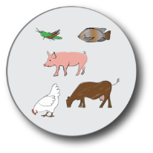
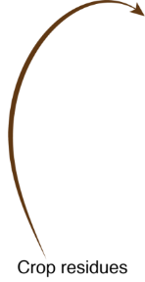


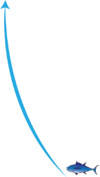
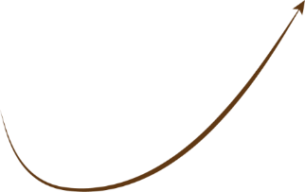
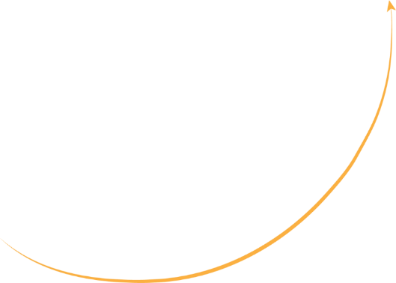
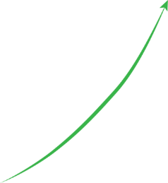


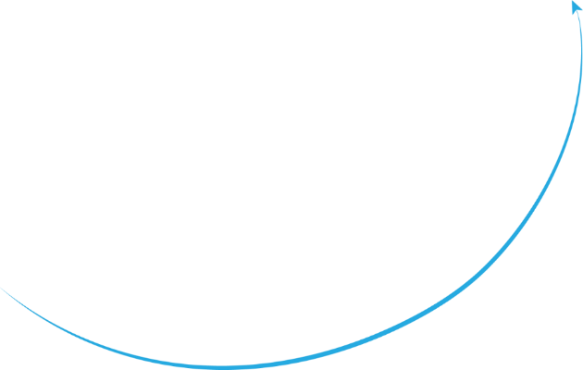
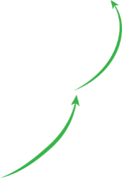




De Boer, De Olde & Van Zanten, 2018
9
Notes:
Biomassa is de basis van de productie van ons voedsel, maar vormt ook de basis van de productie van bio-energie en bio-materialen, zoals kleding, bio-plastics of papier. Biomassa wordt geproduceerd op zowel land als in zee.
Hoe kunnen we het land en de zee nu zo optimaal mogelijk benutten om de mens te voorzien van voedsel en andere bio-materialen?
Dit betekent dat we akkerland en de zee zullen moeten benutten om direct voedsel voor de mens te produceren. Tijdens de productie van dit voedsel worden er eveneens reststromen geproduceerd, zoals gewasresten, co-producten van industriële verwerking, voedselafval en human excreta. Deze reststromen, mits onvermijdbaar, moeten we weer hergebruiken in het voedselsysteem, als voeding voor de bodem of het dier.
De rol van het dier in zo’n circulair voedselsysteem is dan ook om reststromen die de mens niet kan of wil eten om te zetten in hoogwaardig voedsel, mest en andere ecosysteemdiensten.
Naast voedsel, willen we echter ook bio-energie en bio-materialen produceren uit biomassa. Uiteindelijk is zonne- of wind energie mogelijk het best, maar voorlopig is bio-energie nog noodzakelijk.
Het optimaal benutten van biomassa voor deze diverse toepassingen brengt allemaal vragen met zich mee?
Welke rotaties zijn effectief voor zowel de mens, de bodem en het dier? Wat is het biomassa potentieel van de oceaan? En benutten we het potentieel van de oceaan niet effectiever wanneer we zeewier en filterfeeders gaan eten? Welke biomassa zijn het meest geschikt voor het dier, en welke voor het produceren van bio-energie of bio-materialen?
Hoe garanderen we de veiligheid van ons voedsel, wanneer we bijvoorbeeld voedselafval aan ons vee willen voeren en menselijke excreta willen teruggeven aan het land?
We want to provide answers to al these questions; and I now provide you wit some examples of our research

Slide 10

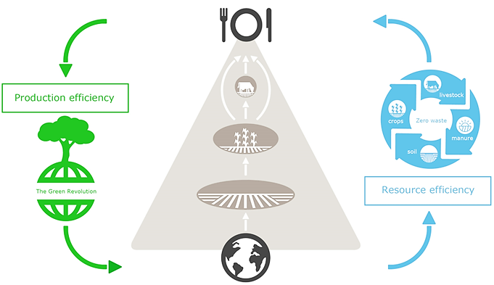


Circular Economy in AgriFood: Connected Circularity
P, N
Connects Agriculture, Nature and Food
Smart use of all produced biomass: as product and revolving resources in a connected circularity
Adding value to residual biomass as revolving resource (Co-products)
Explicit on role of animals in food systems
Choices on land-use within the circular systems
Has consequences for the human diets
Notes:
It focuses on topsoil regeneration, increasing biodiversity, improving the water cycle, enhancing ecosystem services, supporting biosequestration, increasing resilience to climate change, and strengthening the health and vitality of farm soil. Practices include, recycling as much farm waste as possible, and adding composted material from sources outside the farm.

Slide 11
Transition Processes & Management
Optimising
Business
as usual
Stabilization
Increase
sense of
urgency
Institutio-
nalization
Reduce
dependencies
Chaos
Emergence
Reduce
relevance
Acceleration
Experiment
Phase out
Visser et al., 2019 after Loorbach et al, 2018
Notes:
Drivers for transition; technological, biological;
Environment driven; climate change, building with nature concepts
Society driven:
Economy driven: carbon credits?
My believe taht this only works if there is no other partner present, think about mobile phones, an innovation,
Pesticides destroying our biodiversity, enough fertiliser already, why do we still add fossil based fertilisers?
Farmers have invested in their farm, have high loans, that need to be paid back, So they are in a lock in situation, how do we get that out?
Destabilise the current system,

Slide 12
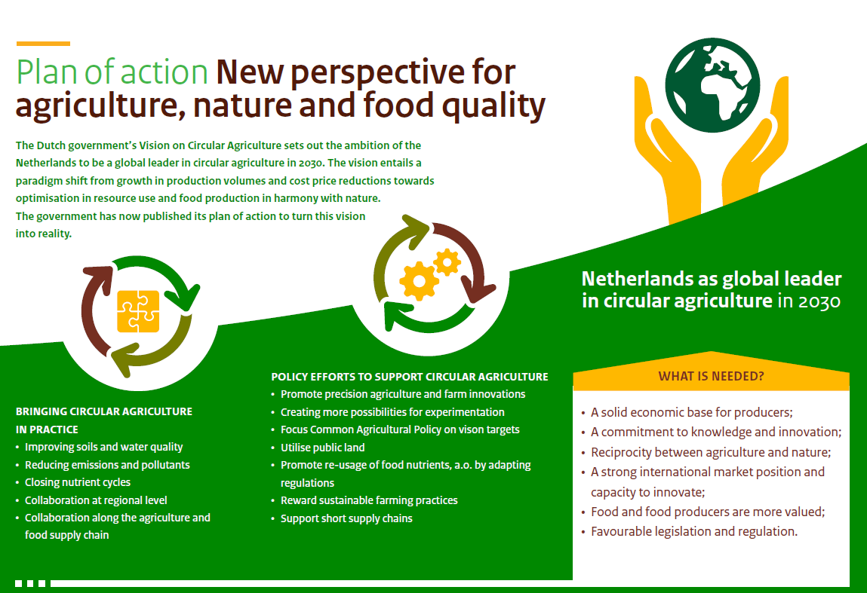


From Explorative Concepts to Viable Practice
Notes:
In 2019, 1 year after presentation the vision on circular agriculture our minister presented the strategy which addresses teh realization of circular agriculture. Teh strategy focusses on bringing circular agriculture in pratices and provides policy efforts to support CA. This mean that we will require a solid economic base for producers, a commitment to knowledge an innovation high appreciation for food and food producers, favourable legislation, and of courcse a good balance between agriculture and nature

Slide 13
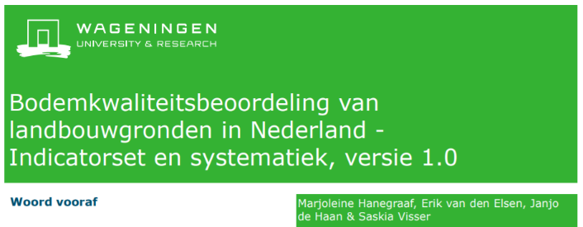
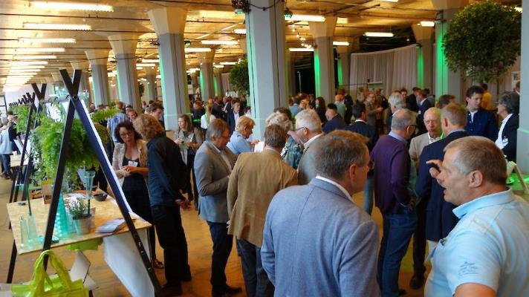
Dutch ambitions: circular agriculture
(related to soil & nutrients)
Soil Health indicators
By 2030:
Use of fossil-based fertilisers and pesticides is significantly reduced/abandoned
Nutrients in both animal and human excreta are more efficiently used in the production circle
No more discharge of nutrients to surface water.
All agricultural soils are sustainably managed, with attention for (soil)biodiversity.
Farmers have a good income
BODEMTOP
Annual gathering of all Soil Stakeholders
Notes:
But this future of circular agriculture is more than just a dream, we have set clear ambitions and a pathway till 2030.
The first milestone has been reached; In the Netherlands we now have an official soil quality indicator set including target values for these indicators related to soil type and agricultural use.
But we need more than just stating how we measure teh status of teh soil, we should provided perspective to farmers on how to sustainably manage their soils, reaching teh target values

Slide 14
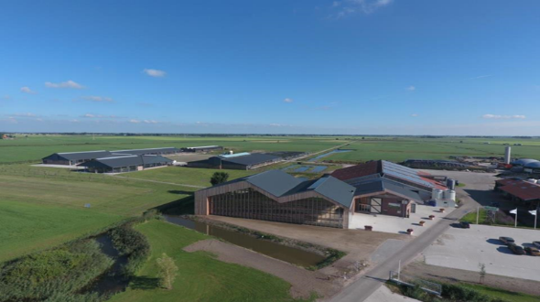
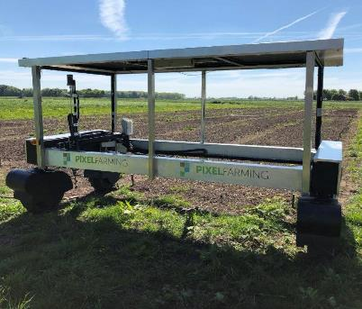

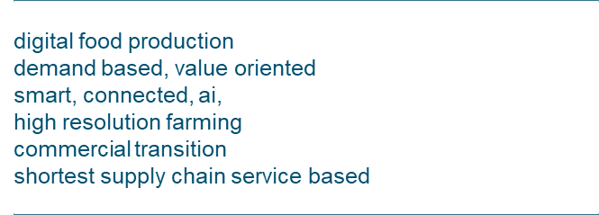
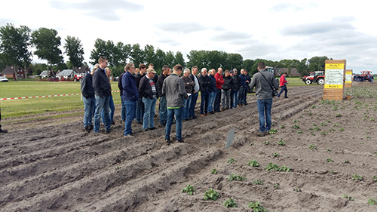
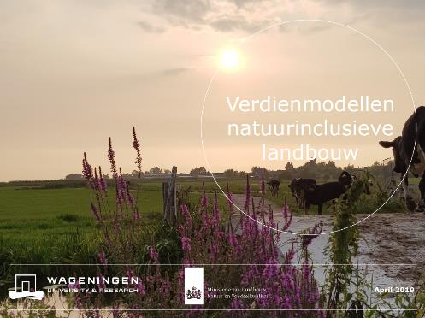
WUR activities in Circular Agriculture
Test farms
Innovation
Educate professsionals
Farmer income
Notes:
Trijntje: toolontwikkeling met boeren bodemverbetering
POP: Bodem-APK (begeleiden boeren bodemverbetering)
PPS-functionele agro biodiversiteit + boeren netwerk

Slide 15
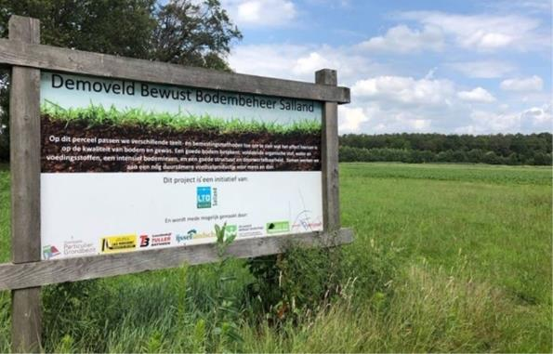
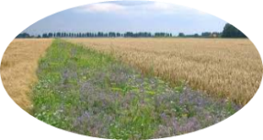
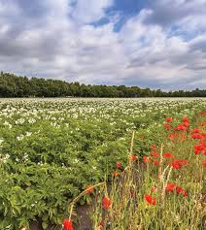
Open cultivation in Circular agriculture
Optimal use of arable land
Strips and New crops
Double purpose crops and rotations
Organic precision fertilization
Robust crops with healthy plants
Nature-inclusive cropping systems
Technology
Notes:
When we start thinking about the open cultivation, and look back at the vision of Imke de Boer we can set some boundary conditions
Optimale benutting akkergronden
Stroken en wissel teelten
Dubbeldoel gewassen en teelten
Organische precisie bemesting
Robuuste teelten met gezonde planten
Natuur-inclusieve teelten

Slide 16
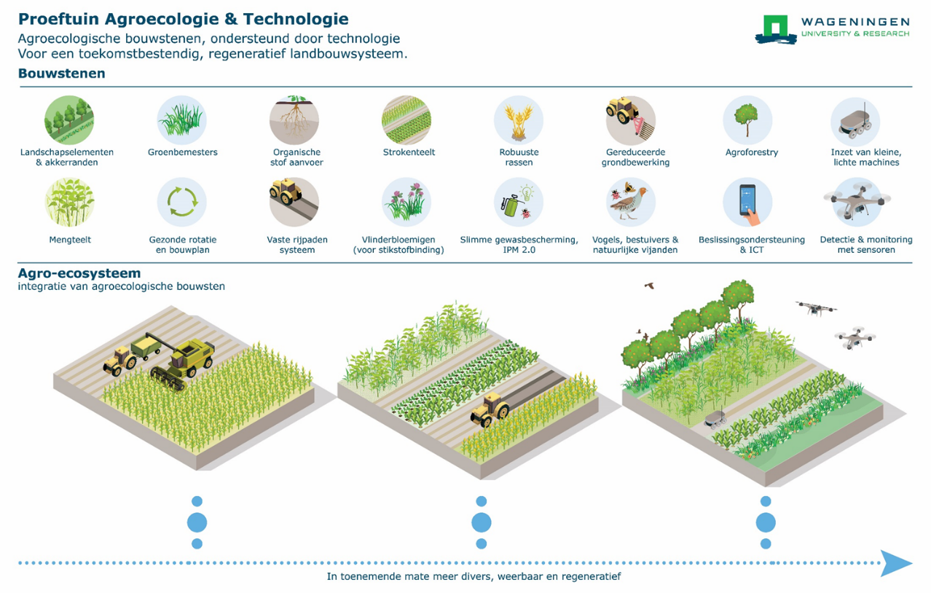
Notes:
Building blocks...
3 trials..
Optimale benutting akkergronden
Stroken en wissel teelten
Dubbeldoel gewassen en teelten
Organische precisie bemesting
Robuuste teelten met gezonde planten
Natuur-inclusieve teelten

Slide 17
Performance characterized by
Land Equivalent Ratio = sum of the relative yields
Y_{i}: yield crop i in intercrop
M_{i}: yield crop i in sole crop
Intercrop system
LER
Wheat/maize
1.21-1.58
Wheat/soybean
1.23-1.26
Faba bean/maize
1.13-1.34
LER = land area that would be needed as sole crops to produce the same yield as a unit area of intercrop
Fang Gou, 2016

Slide 18
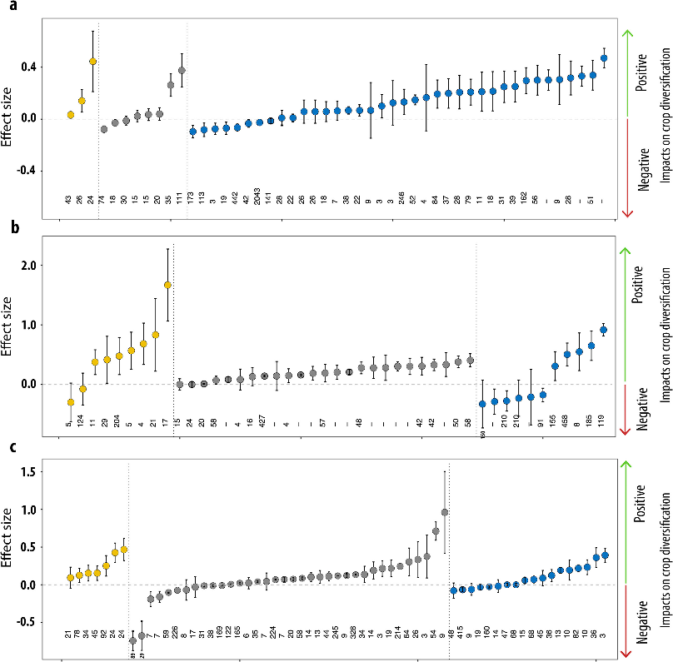

Crop Diversity works!
Biodiversity
Soil quality
Production
Croprotations
Agroforestry
Beillouin et al 2019, DOI 10.1016/J.DIB.2019.103898
Mixed cropping
Notes:
Higher resource use efficiency • Higher Land Equivalent Ratio • Lower pest and disease pressure • More biodiversity • Higher C sequestration • Better soil quality • Better weed suppression • Less erosion
But with current technology economic less efficient (labour) And .... Much more complex to manage

Slide 19


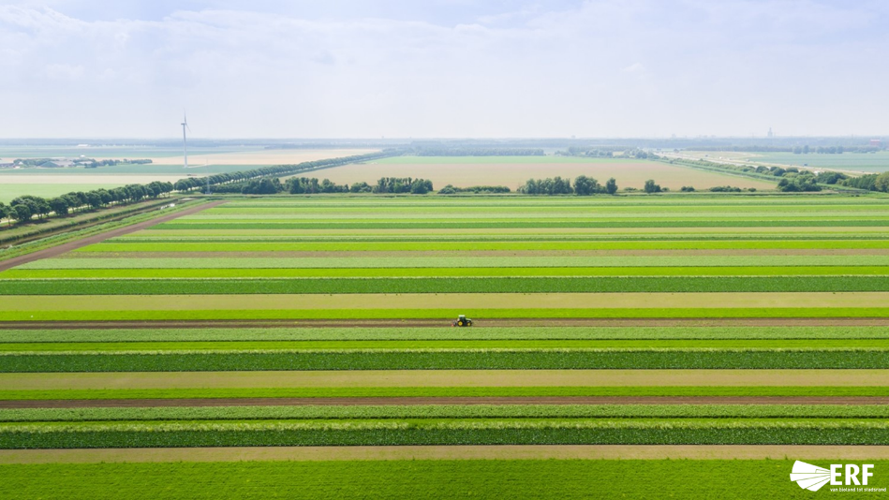



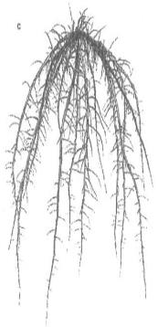
Open cultivation in Circular Agriculture
Wheat – Maize strips
Grey Wacktail Lapwing Meadow pipet Oister catcher Skylark
Demonstration area (444ha)
Reference area (454ha)
Strip cultivation
Notes:
This is what such a strip cropping system looks like. I personally think it really looks great, and apparently I am not the only one. After only 2 years of strip cropping you see an amazing return of many meadow birds, like the skylark, meadow pipet and lapwing
The reason they return is because their feed has also returned. Compared to a natural field you see a much larger diversity of insects in the strips and the mixed strips (with nature). One of teh questions I often get when show this, do these insects not cause many problems with your crop quality. And overall teh question is not, because their natural enemy is present to avoid the opportunity of the insects to grow into a pest..
Obviously I now show you the many positive examples, strip cropping results in a reduced use of pesticides, less fossil based fertilizer and a return of nature to the agricultural field. Yet it also has still many challenges, Labour costs are higher, hence we need a faster development into these robotics, we need to invest in the seed sector such that we can find crop strips that strengthen each other such a in a symbiose and we need to find know more about biological pest control. Yet the first results are promising and We already see adoption of this systems in Germany.
Skylark= veldleeuwerik
Oistercatcher= scholekster
Graspieper: meadowpipet
Kievit= lapwing
Gele kwikstaast; grey wacktail
;
Juvenile birds; need insects

Slide 20


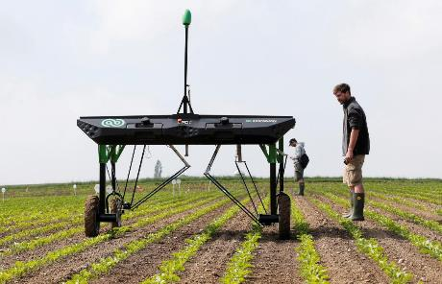
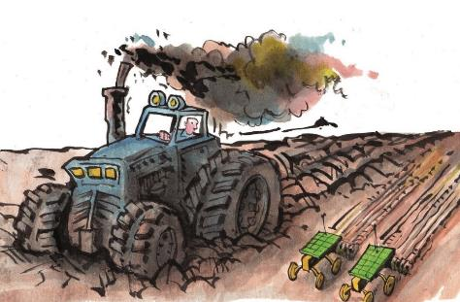


Developments in Technology
Notes:
Controlled traffic, GPS systemsand the use of caterpillar tracks made strip cropping practicly feasible
https://www.youtube.com/watch?v=IKZfjtPquzs

Slide 21









Livestock in circular agriculture
Kernebeek, 2018
Notes:
This implies that humans can use land more efficiently if they would accept austere diets. Diets resulting from our analysis consisted of a limited variety of products because we used proxies for the five major groups of crop production, and for monogastric and ruminant production. We think, however, that including a wider variety of plant-based or terrestrial domestic animal-based products would not have affected our conclusions. Products from fisheries were not considered, as these systems do not use land.

Slide 22


Climate research Livestock
Four focus areas :
Demonstration en monitoring of CH₄ emissions from stables and outside manure storages (reference points)
Pilot- en demonstration projects of reducing techniques
Development of farm monitoring with sensors
Entheric methane emission: measuring variation between animals
On Farm research:
21 locations in NL
Dairy
Goats
Veal calves
Pigs
Annemarie Groenestein- 2019

Slide 23

Circle of Nutrients:
5R-Strategy for optimizing the nutrient balance
Reduce nutrient inputs, where possible
Reuse nutrients from organic residues (inc. manures)
Recover nutrients from biomass waste streams
Reduce nutrients losses to surface water
Redefine systems, where needed
Notes:
Reduce inputs: by law; Psoil high, less allowed, and precisions fertilisation
Reuse; reduce fossil based fertiliser, make use of organic compost, green fertilisers, Sewage organische compost, groen bemesters, slib kan dat ook? (Vellinga)
Reduce losses to surface water, hydrological (drainage buizen) deep into soil, chemical, geen runoff
Ander systeem

Slide 24



SYSTEMIC
Systemic large-scale eco-innovation to advance circular economy and mineral recovery from organic waste in Europe
Notes:
Organic waste from agriculture, manure, sewage sludge.
We use existing Animal Dung as a starting point
The objective is to recover and reuse nutrients and organic matter from biowaste and, where possible, to resuse these nutrients in the region of the AD plant in order to minimize transportation
demonstration plants
Performance of nutrient recovery technologies
Business case development
Environmental Impact Assessment and LCA
Policy advise

Slide 25







Demonstration plant Groot Zevert Digestion (NL)
Notes:
Farm mest, biogas (campina) na vergisting (fermentation) mest/digestaat naar decanter (centrifuge) separation water and solid material
DAF is liquid.
Dikke fractie is org C en Nutrienten P stripper
Nu mest naar Eiffel om mest weg te werken.
P removal, solved in water, additional acid till Ph5, p solution, high concetrates, filtration, addition Ca and Mg, precipate zuur ases benadering
90% is water, DAF dissolved Air Floatation, drijven fijne deeltjes, next membraam filtratie, water scheiding, drukken water weg.
Dunne fractie, N&K , small part , atlease 50% clean water, manure for
Nitraat richtlijn alle N from anmal manure remains animal manure. We want this changed. JRC what are the requirements for teh NK filtrate, to be considered as fertiliser.

Slide 26

Technical Innovation at demonstration plants
Feedstocks
Pig manure
Poultry litter
Sewage sludge
Energy crops
Agro-industrial residues
Innovative Technologies
Reverse Osmosis (RO)
Evaporation
N-stripping
P-stripping
End Products
Biogas
NK concentrates
(NH₄)₂SO₄ fertiliser
Struvite & Ca phosphate
Organic fertilisers and soil improvers
Organic fibres
Downloads: (www.systemicproject.eu)
Technical Factsheets of demoplants
Newsletter of demoplants
Notes:
Calcium en magnesium fosfaat. Kristallijn/ caPZ beter in kunstmest.
New producte
Organic fibers..papier

Slide 27


Conclusions
It’s difficult to produce the precise quantities of animal-sourced food in the EAT-LANCET diet.
In the EAT-LANCET diet, poultry was preferred from a health perspective, but from a circularity perspective pork and (dairy) beef are better suited to upcycle low opportunity cost biomass into animal sourced food.
Including co-products from refined grains increased the scope for poultry. But also increased land use.
GHG emissions and land use were lower in circular scenarios compared to the EAT-LANCET reference scenario.

Slide 28



DID you know....?
EU farmers have higher trust on peers. Farmers build digital relationships with other farmers to form CoP. Change their practice based on information by digital farmer influencers and validated by their peers
(SoilCARE 2021)
Potential of biomass streams from food processing, retail and catering, used for BSF production yields could replace typically 50 to 75 kton soy-beans.
(Vellinga et al. 2021)
Crushed feathers (chicken waste) improve resilience of sugar beets against soil pathogens
(Postma et al. 2021)

Slide 29




Transition recommendations; beyond the pioneers
Income for environmental services +
Income from Milk+
Income
Cost -
196 pioneering farmers have adopted the circular principles, and proof it is possible to be a sustainable producer and earn a good income.
(Hoes and van Lauwere, 2020)
Living labs are key in transition processes in practice. Social learning is the main function of experiments; yet there is a poor exchange of ideas and solutions between the experimental areas. Also, the exchange of experiences to the non-experimental areas has not (yet) started.
(Bouwma, 2021)
Many interventions have long-term busines effects. Difficult to compensate for increased labor. Few circular business options will “Sell Themselves”. Circular innovations therefore require more policy management than ordinary innovations. A number of business options require regulatory changes
Hoes & de Lauwere; 2020, 2021
Hoes et al. 2021
Notes:
Leeuwarder Courant:
In Drogeham injecteren Dictus en Douwe Hoeksma met tegenzin de mest

Slide 30
Transition management: actions
Increasing sense of urgency and pressure for change
Optimising
Business
as usual
Stabilization
Corrective
barriers
Break existing structures
Institutiona-
lization
Reduce
dependencies
Chaos
Formalise direction
Mobilise
means
Challenge the
existing order
Emergence
Steering break down, adjustment and phasing out.
Reduce
relevance
Acceleration
Experiment
Phase out
Connect and
Structure
Experimental space
including scaling
Visser et al., 2019 after Loorbach et al, 2018

Slide 31





Circular agriculture adds profits to climate and nature
Circular & Mitigation
Better use of residual flows for feed
Better use of manure for fertilization
Smarter use of fields and meadows
Capture carbon in soil and vegetation
Notes:
By applying circular agriculture we can add true profit for cliamet and nature. Nature I just showed you some examples. Our climate calculations show that emissions from agriculture can be further reduced that required for teh paris agreement. Significantly reducing emissions from manure (because of teh way we manage it), food and crops

Slide 32
Funding mechnism
Public Private Collaborations
Society
Government
Knowledge
institutions
Business
commity

Slide 33

Finding Answers Together
Notes:
Eight agricultural sector leaders have announced Farming for Generations, a global collaboration to support dairy farmers to adopt regenerative agricultural practices that preserve and renew our planet’s resources, respect animal welfare and ensure the long-term economic viability of farms for the next generation.
Farming for Generations, which will run over the next three years, will initially work with 25 dairy farms in the EU, USA and Russia, to identify best practice solutions and innovations across different farming models, farm sizes and geographies in order to gather cross-sector insights, refine best practices and develop new approaches. This number will increase to 2500 farms after two years.
recent European Parliamentary Research Service report therefore concluded that “resilience and sustainability are keywords for the future of the sector”. It said this will be achieved with innovation as a way to reconcile the need for farmers to earn a decent living, consumer demand for affordable and quality dairy products, and environmental and animal health requirements.
However, this is a complex challenge which requires the support of the whole food chain.
With that in mind, Farming for Generations, spearheaded by global food industry leader Danone, draws on the expertise of leaders from the whole agricultural value chain.
This includes animal health and welfare companies MSD Animal Health, Neogen and FutureCow; animal nutrition and health company DSM; crop nutrition leader Yara; crop science company Corteva Agriscience; and artificial intelligence agri-food start-up Connecterra.
Netherlands-based Wageningen University and Research, renowned for its food and food production research, will also be a research and advisory partner.
Furthermore, farmers will be involved in each step of the way, ensuring that practices are viable and suited to local customs and geographic specificities.

Slide 34


What is your relationship with the Soil?
Soil has many functions
Good soil management is beneficial for everyone
" Little bit of action perspective for smart soil management”
Notes:
Voedsel productie, buffer en water filter, opslag plaats voor nutrienten en organisch materiaal
Geschik bodem beheer is nuttig voor ieder EU land

Slide 35





We are not Kind for our soils
Manure vs Soil biodiversity
Subsidence vs climate
Soil compaction
Foto margot de Cleen
Foto Margot de Cleen
Notes:
Oplossingen vaak lokaal aangepakt

Slide 36

You don't know what you're missing until she's not there...
Foto margot de Cleen

Slide 37










Vulnerabilities
Flood
Flooding
Soil erosion
Dieren
Heat stress
Nature fire
Rheden
Velp
Arnhem

Slide 38




System features landscape > city
A'
A
Soil moisture
grondwater
hangwater
Superficial runoff
Soil storage GHG (summer)
< 100 mm/d
> 700 mm/d

Slide 39










Strategy > measures
Handelings-perspectief
eliminate
store
hold
Always sufficient soil moisture
Combat moisture deficiency

Slide 40

All soils / land perform all functions…
…but different parts of the land(scape) are better at delivering different functions

