Slide 1
Meeting with L’Institut des Hautes Études d’Aménagement des Territoires
Baden-Württemberg’s Mobility Strategy
Elke Zimmer
State Secretary of Transport Baden-Württemberg
Stuttgart, 29th June 2023
Notes:
Mobility Strategies & Innovations Roundtable: Exchange of experiences and best practices

Slide 2
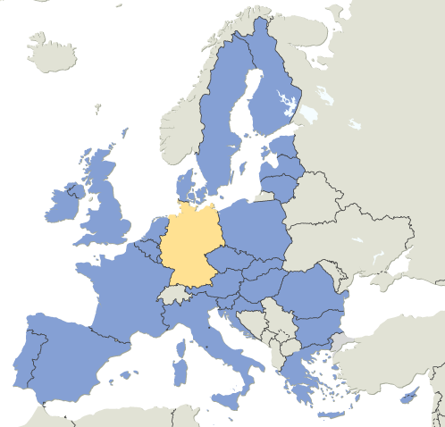



MINISTRY OF TRANSPORT
Locating Baden-Württemberg
Population
11.1 million
Total land area
35.748 km²

Slide 3
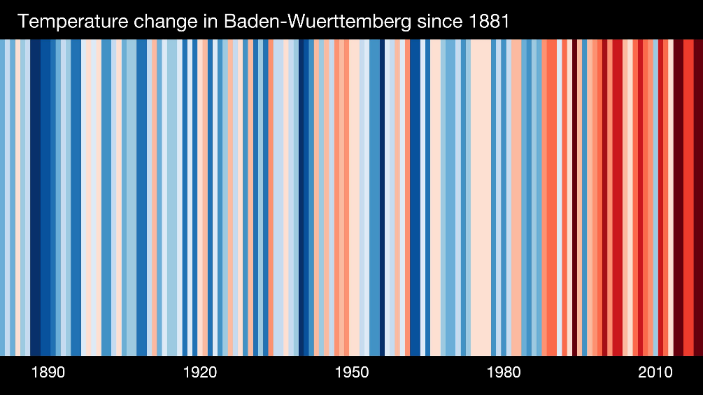
Climate protection requires a profound
transition of our mobility system
Climate goals for Baden-Württemberg:
  2040: all sectors climate neutral
  2030:
  -65 % CO₂ in all sectors
  -55 % CO₂ in the transport sector (compared to 1990)
Temperature change in Baden-Württemberg since 1881
Source: wetter.de © Ed Hawkins (University of Reading)

Slide 4
Transport emissions 2010-2030
Evidence
Target

Slide 5
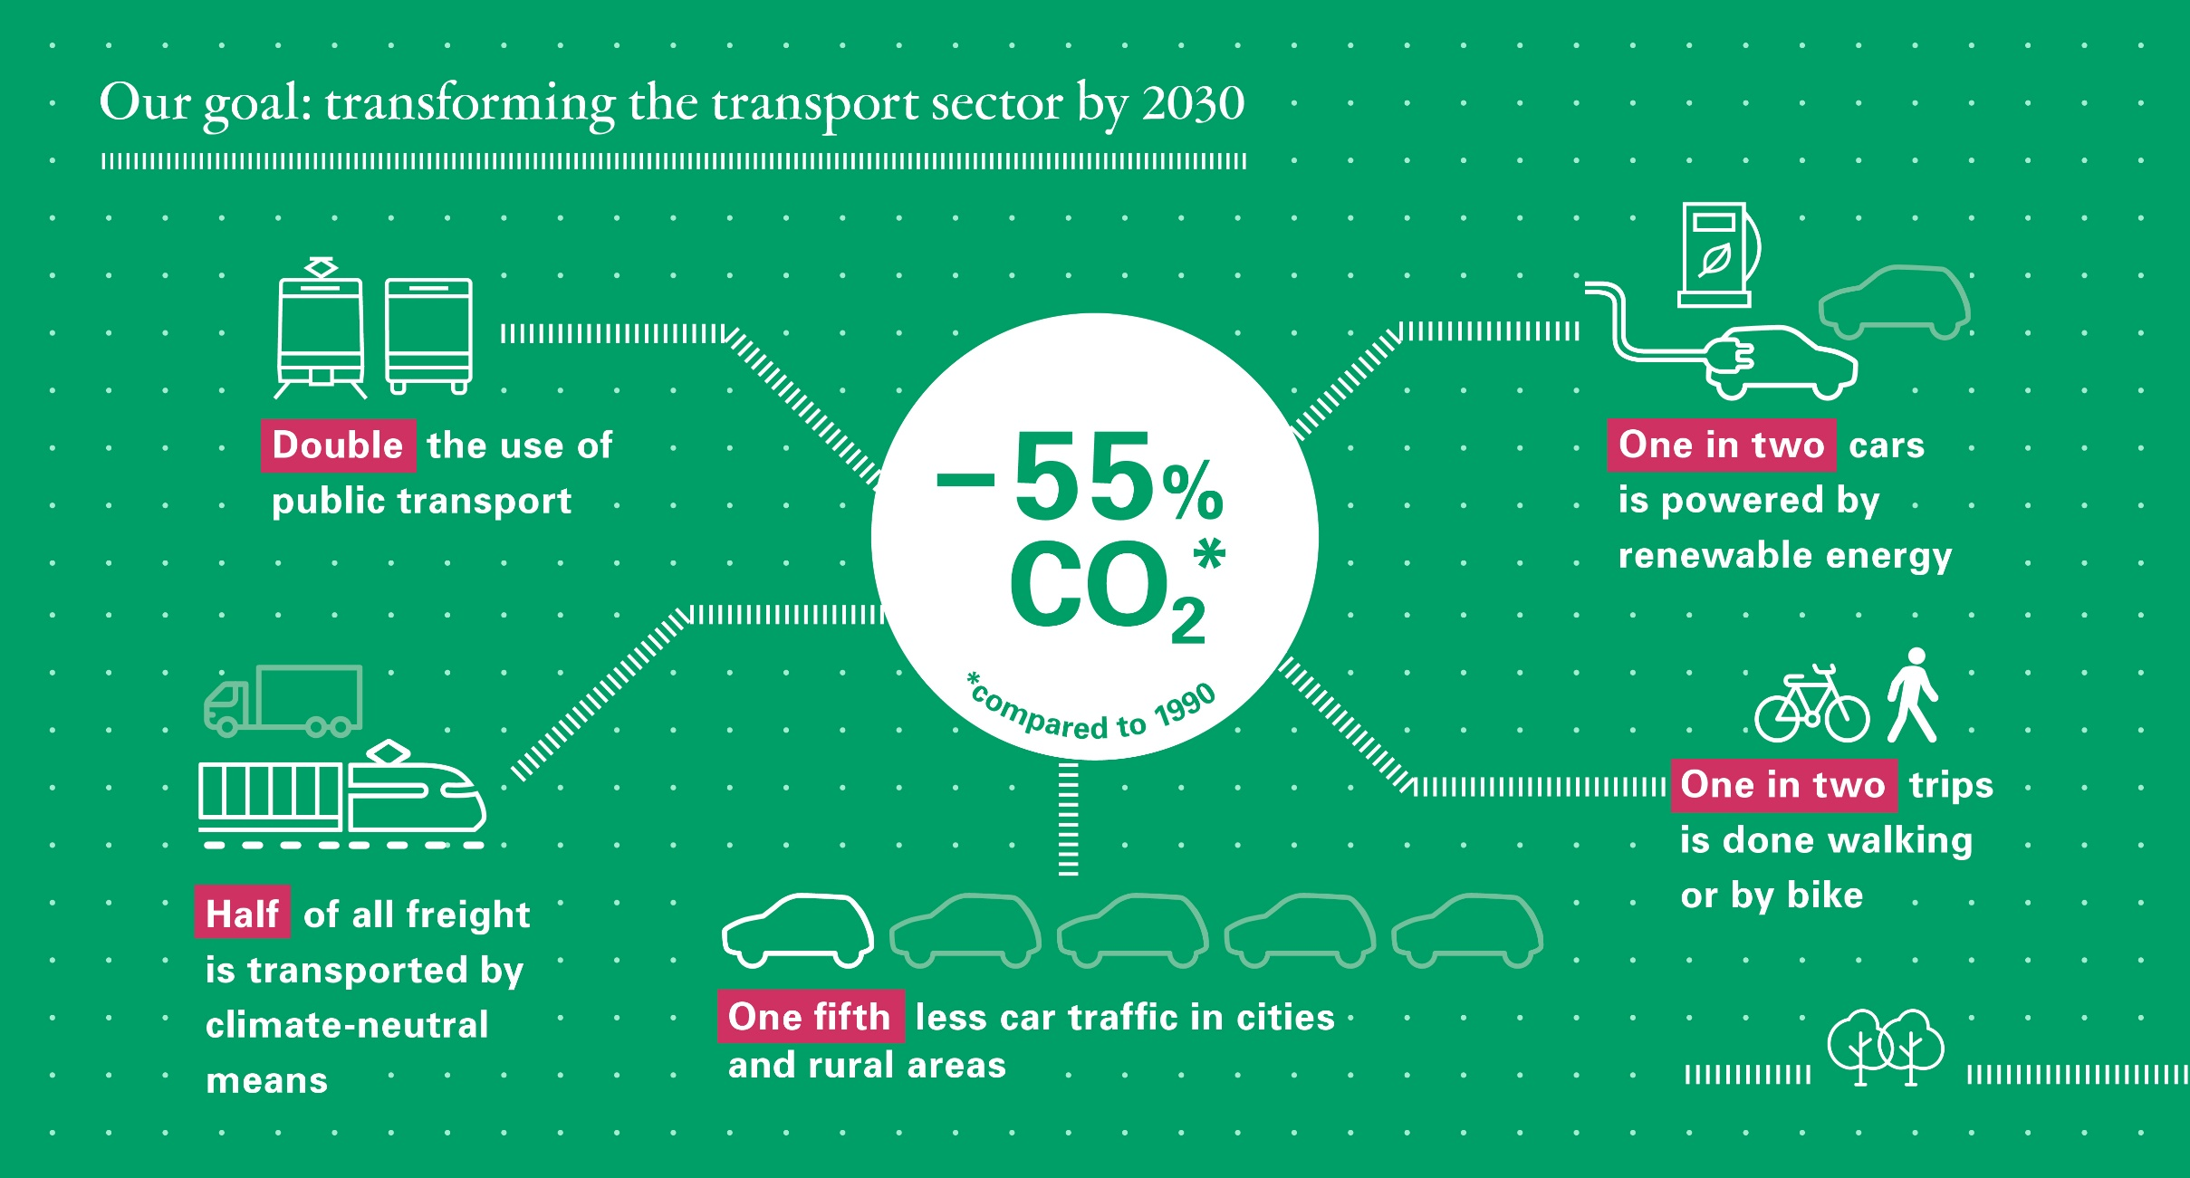
Notes:
Five (new) key targets for 2030

Slide 6
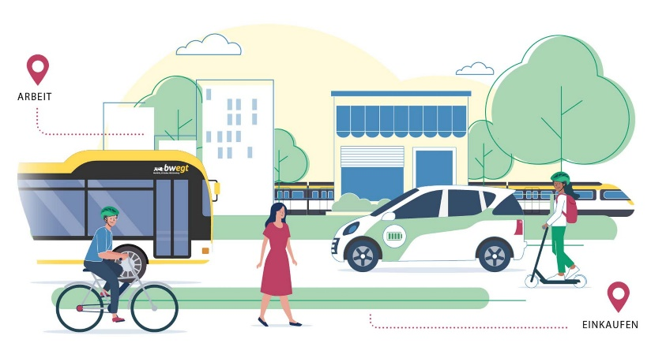
Mobility and Climate Concept (MCC) for the State of Baden-Württemberg
approx. 30 core measures to realise the five key targets
e.g.
  speed lines for busses
  data platform for mobility data
  corporate mobility management
a State Mobility Act
  Will be the legal basis for implementing
  MCCat all levels

Slide 7
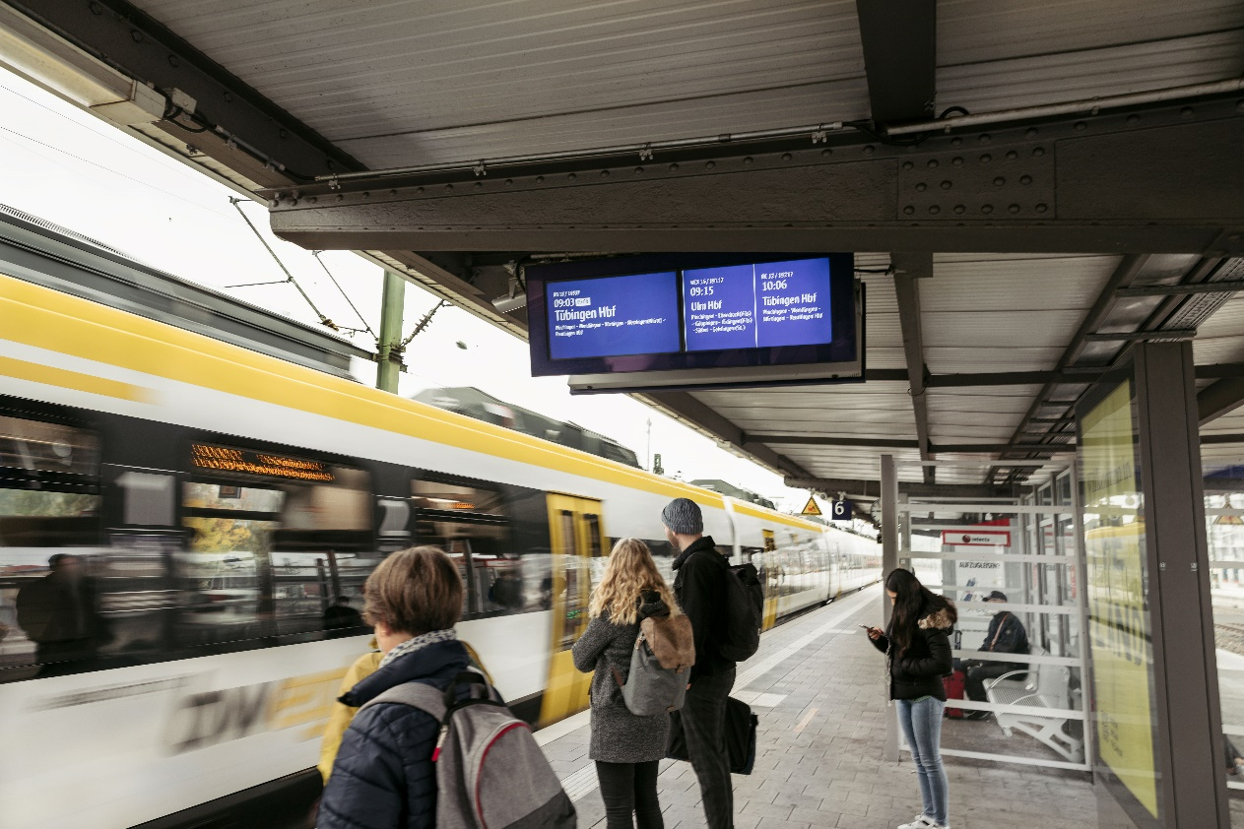
Doubling public transport
  Target:
  Doubling number
  of passengers
  in public busses and trains
  by 2030
  compared to 2010.

Slide 8
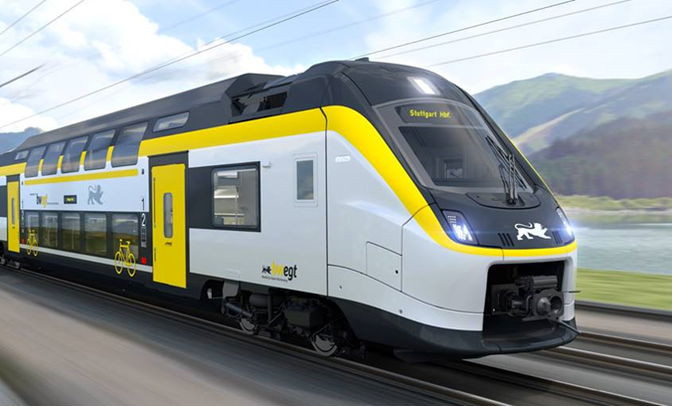
Regional Rail Transport
state is responsible for ordering
regional rail transport
we increased regional rail transport by up to
80 Mio. kilometers per year (+ 19 %)
last year: the state ordered 130 new double-deck trains
investment volume: over 2 billion euros
2022: fastest regional trains speed up to 200 km/h

Slide 9
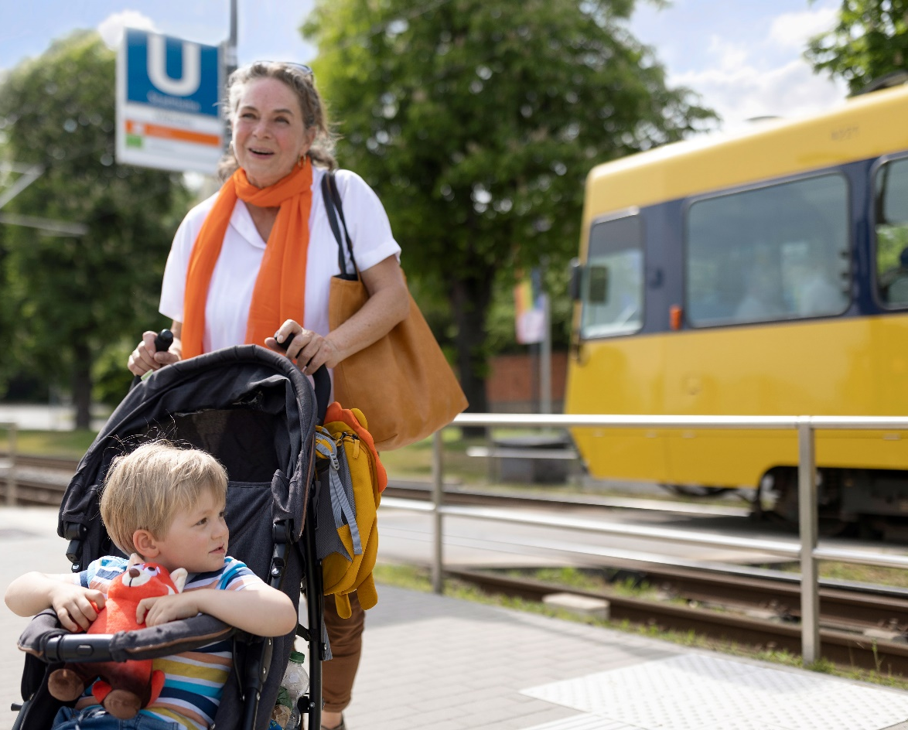
Guaranteed Mobility by Local Public Transport
  Connecting all localities to public transport
  from 5 a.m. to midnight by 2030
  urban areas: minimum of every 15 minutes
  rural areas: every 30 minutes
    On-demand services
    in areas and times with low demand

Slide 10

Current Challenges
  old rail infrastructure
  rail network modernization
  and expansion
  are causing additional restrictions
  lack of reliability and speed of trains
  shortage of skilled labour
  financing
Source: Pixabay

Slide 11
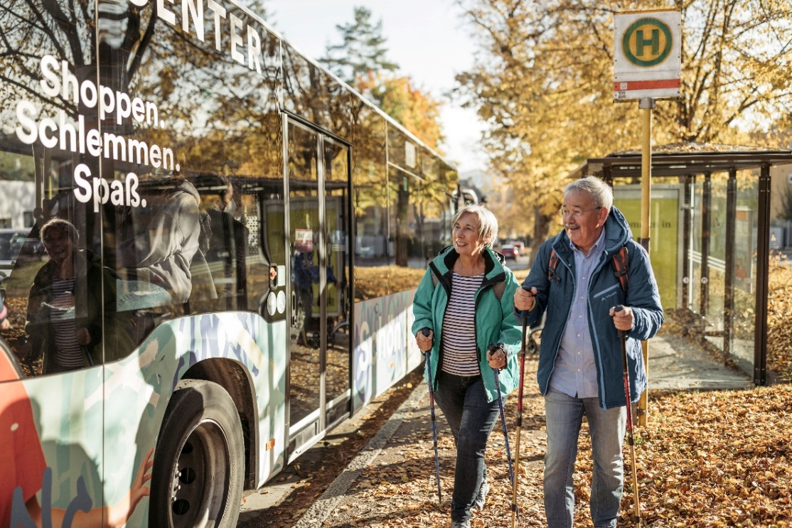
Mobility Pass
New financing tool for municipalities
4 different charging modes
  road-users
  employers
  residents
  car-owners
In return: a personal public transport credit for season ticket
Revenue only for improving local public transport system
The Mobility Pass is an offer to municipalities and the model can be chosen freely!

Slide 12
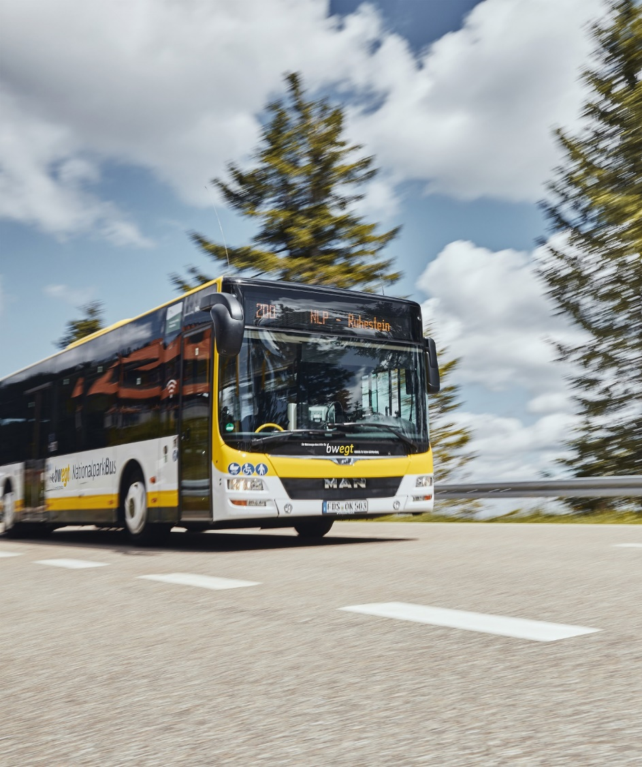
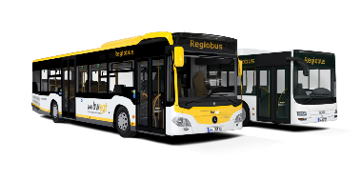
Expansion of public transport in rural areas
BW Funding Programme: Regiobuslinien
Objective: Developing a ‚Regiobus‘-network
Connecting cities without railway access
Filling gaps within the railway network in Baden-Württemberg
Fast and direct bus connections.
currently 46 Regiobuslinien
operating on a combined net lengths of 1.183 kilometres
Notes:
To support the expansion of the local public transport, Baden-Württemberg released in 2015 an own funding programme for the so called „Regiobuslinien“. Regiobuslinien are rapid and direct operating bus routes, that are connecting cities which are lacking an own railway access. Within the programme we are funding 50% of the operating expenses. By this, the Regiobuslinien contribute a lot in filling the existing gaps within the railway network in Baden-Württemberg. The programme is a great success, the demand demand is constantly increasing. By the end of 2022 there are 46 Regiobuslinien, which are operating on a combined net lengths of 1.183 kilometres. In total we spend around 100 million since 2015.

Slide 13
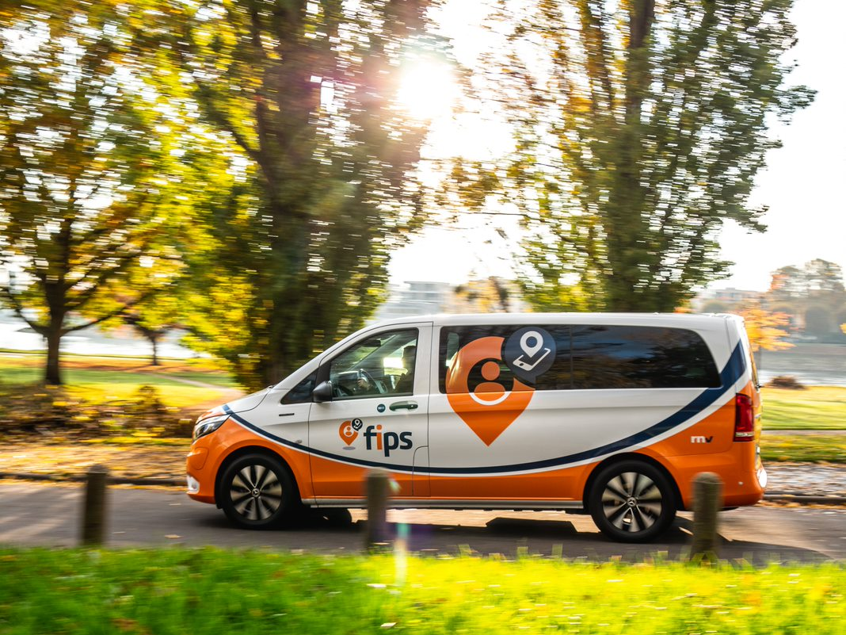
Expansion of public transport in rural areas
BW Funding Programme: On-Demand Shuttles
Objective: Area-wide connection of rural regions
Connecting rural areas to rail and ‚Regiobus‘-lines
Supporting local public transport as part of a mobility guarantee
Since 2021: Funding of area-related, digitalised On-Demand-systems
Source: Rhein-Neckar-Verkehr GmbH
Notes:
To support the expansion of the local public transport in rural areas, Baden-Württemberg released own funding programmes for on-demand-vehicles to support local public transport. On-demand vehicles are connecting rural areas with little public transport supply as part of a mobility guarantee on working days from 5 a.m to midnight (weekend from 7 a.m.). Vehicles can be booked via app or phone call. On-Demand offers area-wide connection in rural areas with rails or ‚Regiobus‘-lines. Since 2021 funding programms support the construction of on-demand. Until 2024, 5% of the land area of BW will be covered by On-Demand-systems.

Slide 14

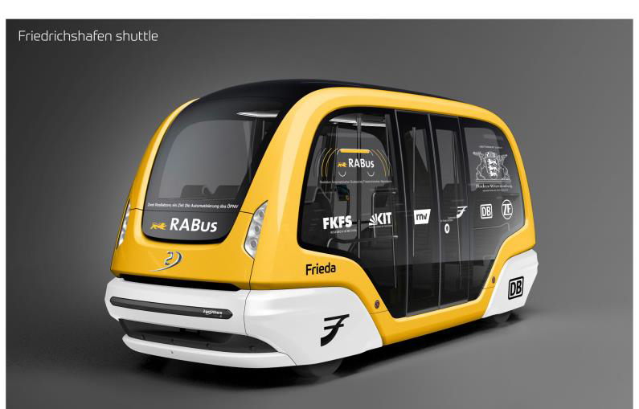
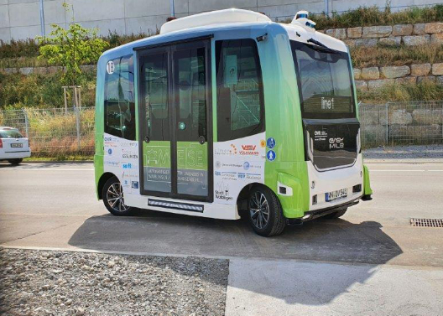
Projects for autonomous driving in public transport
RABus: Prototype automated bus operation in urban and rural areas. 2 testing sites supporting research:
  Mannheim: Development of a new residential quarter; driverless operation in mixed traffic
  Friedrichshafen: Inner-city and intercity operation at reasonable speed (>40km/h)
  Start of operation in 2024
AMEISE:
Automated bus in the Ameisenberg industrial park in Waiblingen near Stuttgart: Transport of students and people with disabilities in an autonomous minibus

Slide 15

Climate-neutral transportation of
every second tonne of freight
  main objective: Shift as much traffic as possible to climate friendly and efficient modes of transport: rail and waterways
    a great share of railway lines are already electrified (compared to trucks)
  fostering shift to climate-neutral trucks
  (i.e. electric, hydrogen, ReFuels)
  suitable charging and refueling infrastructure
  extending truck tolls to state and municipal roads

Slide 16

Freight Transport Concept 2020
12 fields of action to make freight transport
more sustainable, efficient, safe
e.g.: Center of Excellence
  support for companies
  who want to shift transport
  from road to rail
  consulting and networking

Slide 17
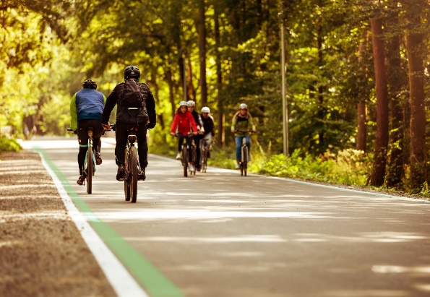
Every second trip
by bike
  Aim: double the share
  of cycling to 20 % by 2030
  Cycling strategy adopted in 2016: RadSTRATEGIE
  completion of the state-wide cycling network RadNETZ
  with target-standards
  for safety and comfort by 2030
  20 fast cycling routes

Slide 18
RadNETZ
8.000 km bikeways state-wide
connects 700 municipalities
by 2030

Slide 19
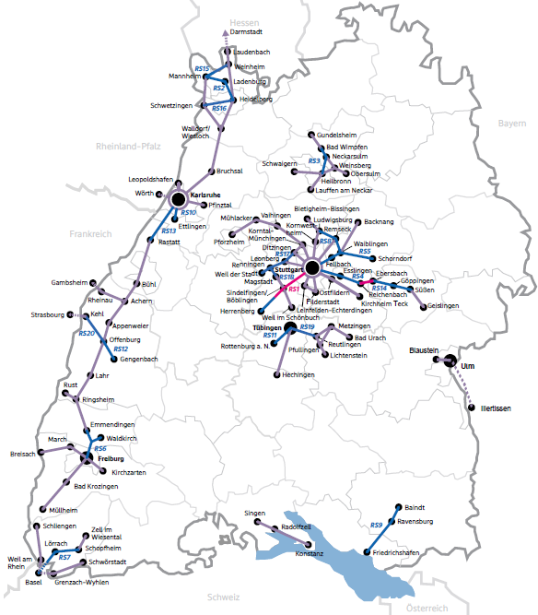
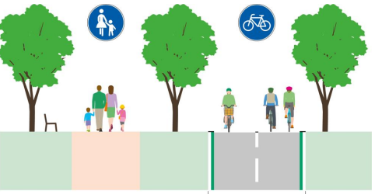


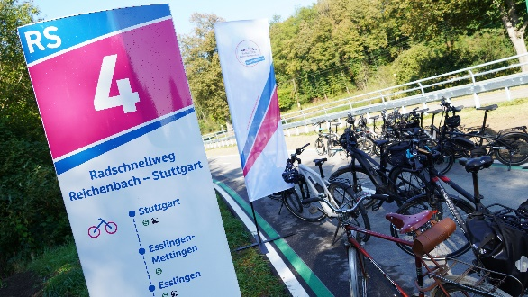

Bike highways in Baden-Württemberg
Fast and direct cycling routes
especially for commuters
over long distances.
since 2018 feasibility studies
for 63 routes
2023: 21 projects in planning
by 2030: realisation of at least
20 fast cycling routes
RS 1 Stuttgart – Sindelfingen/Böblingen - Herrenberg
Cross section of fast cycling route (4m width, seperation of traffic types)
Opening of RS 4 Stuttgart - Reichenbach – Ebersbach along Fils

Slide 20
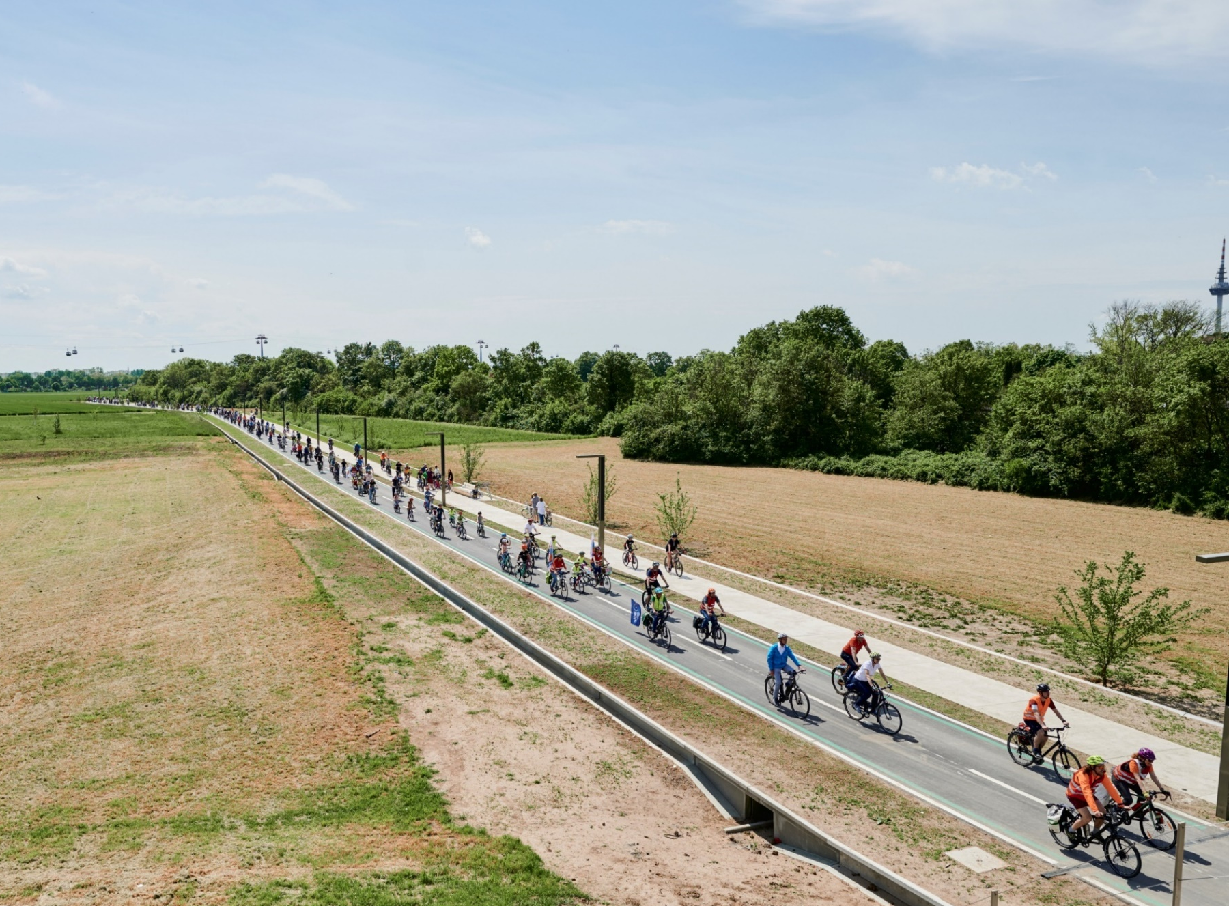
New bike highway
opened in May 2023
at
The German National
Garden Show
in Mannheim

Slide 21
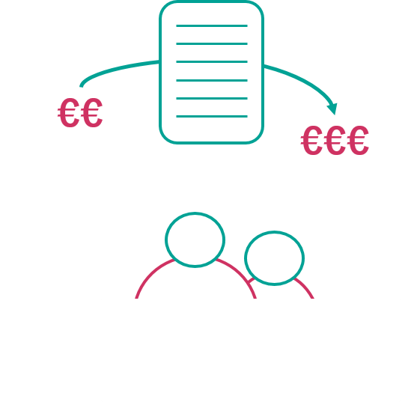
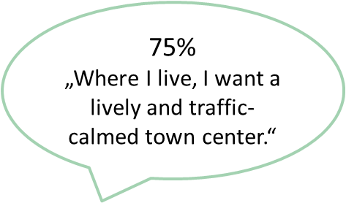
Supporting municipalities
Funding Sustainable Mobility Staff
  35 Coordinators for Mobility and Climate Protection on the district level
  German Mobility Award 2022 for Baden-Württemberg (category knowledge transfer)
Sustainable Urban Mobility Plans (SUMP) aka „Climate Mobility Plans“
  50 % funding quote → 75 % funding quote (financed by LGVFG)
  6 pilot municipalities
  44 district-plans by 2030
Notes:
Baden-Württemberg aims to become a climate protection state, also in terms of transport.
However, we will only achieve the climate protection goals in the transport sector if all administrative levels contribute.
Climate protection requires strategic concepts, people and know-how.
This is why, among others, we support municipalities in elaborating sustainable urban mobility plans known as “climate mobility plans”.
These plans contain a set of measures which altogether reduce the municipality’s emissions by 55 %.
In turn, the measures are eligible for a 75 % instead of 50 % funding quote.
Currently, we are piloting this approach with six municipalities. By 2030 we want all 44 districts to have such a plan.
Moreover, we are funding staff in the areas of, for example, cycling, electric mobility, data management and stationary traffic to support the local level.
That’s in addition to the 35 coordinators for mobility and climate protection, which we recently installed with the Climate Protection Act.

Slide 22


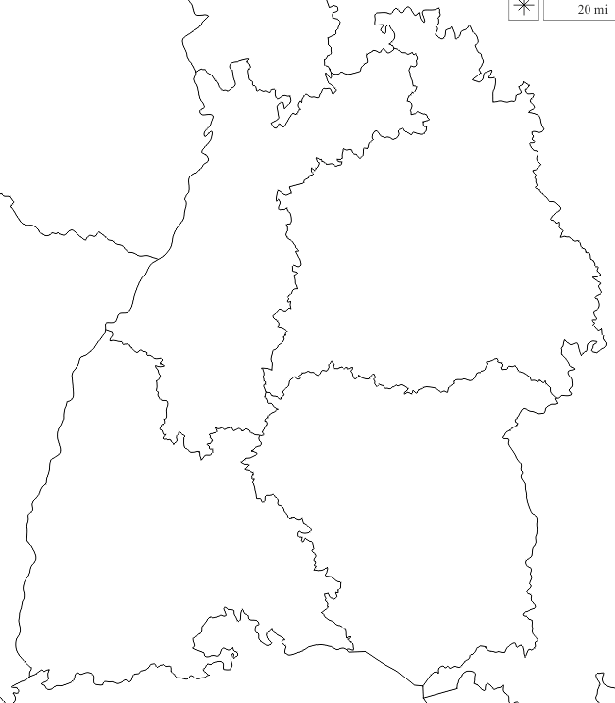





Mobility pacts in Baden-Württemberg
cross-sectoral cooperative platforms
for regional change in mobility:
address regional change in mobility
voluntary cooperation
implementation-oriented
partnership-based definition of working program & responsibilities in realization
Notes:
Mobility pacts are voluntary cooperation platforms, which address change in mobility within a dedicated region. In Baden-Württemberg there are five mobility pacts under the political leadership of the Ministry of Transport so far. These platforms are a uniqueness of the state of Baden-Württemberg – lately being followed by two other states, which launched the mobility pact of Rhein-Neckar. The innovative approach of mobility pacts is the fact that they enable constant cooperation between actors from various modes of transport and different sectors as well as diverse political and administrative levels and bodies, who would not be able to cooperate in this way under regular structures.
The goal of the mobility pacts is to swiftly overcome regional traffic problems in the network and to implement concrete solutions for more sustainable and modern mobility. Thus, partners in the mobility pacts do not consider themselves as a planning body, but rather as a regional "task force" that works together in an implementation-oriented manner, taking into account all modes of transport. Motivator and challenge at the same time is the partnership and voluntariness of the pact partners: because the usual responsibilities remain unaffected, and at the same time a mobility pact does not represent a legal commitment.

Slide 24
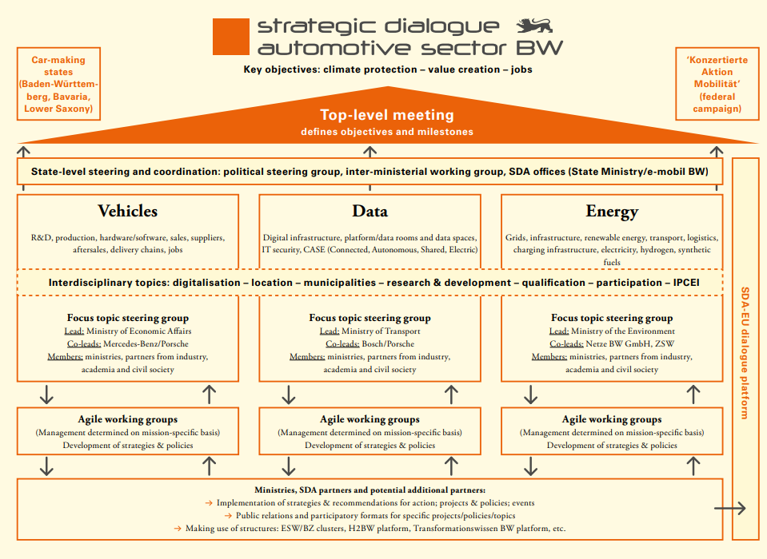
Strategic dialogue automotive sector BW
3 main missions: vehicles, data and energy
cooperations between different stakeholders to create new policies, concepts and projects
Goal: reshaping the automotive industry towards a „new age of mobility“

Slide 25
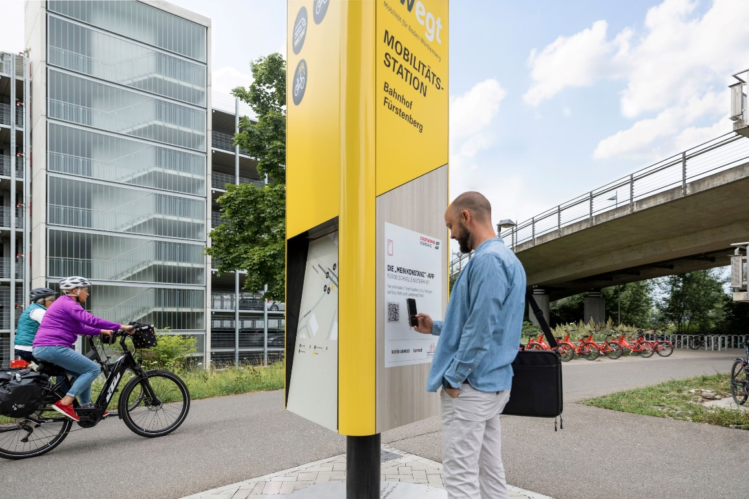
One fifth less car traffic in towns and rural areas
  In cities in particular, car traffic can be shifted to trains, buses, bicycles and pedestrians
  Even in rural areas, residents would give up a second or third car if there are good alternatives
  (re-)design and upgrade street space through parking policy
  Providing incentives to switch to public transport and bikes

Slide 26
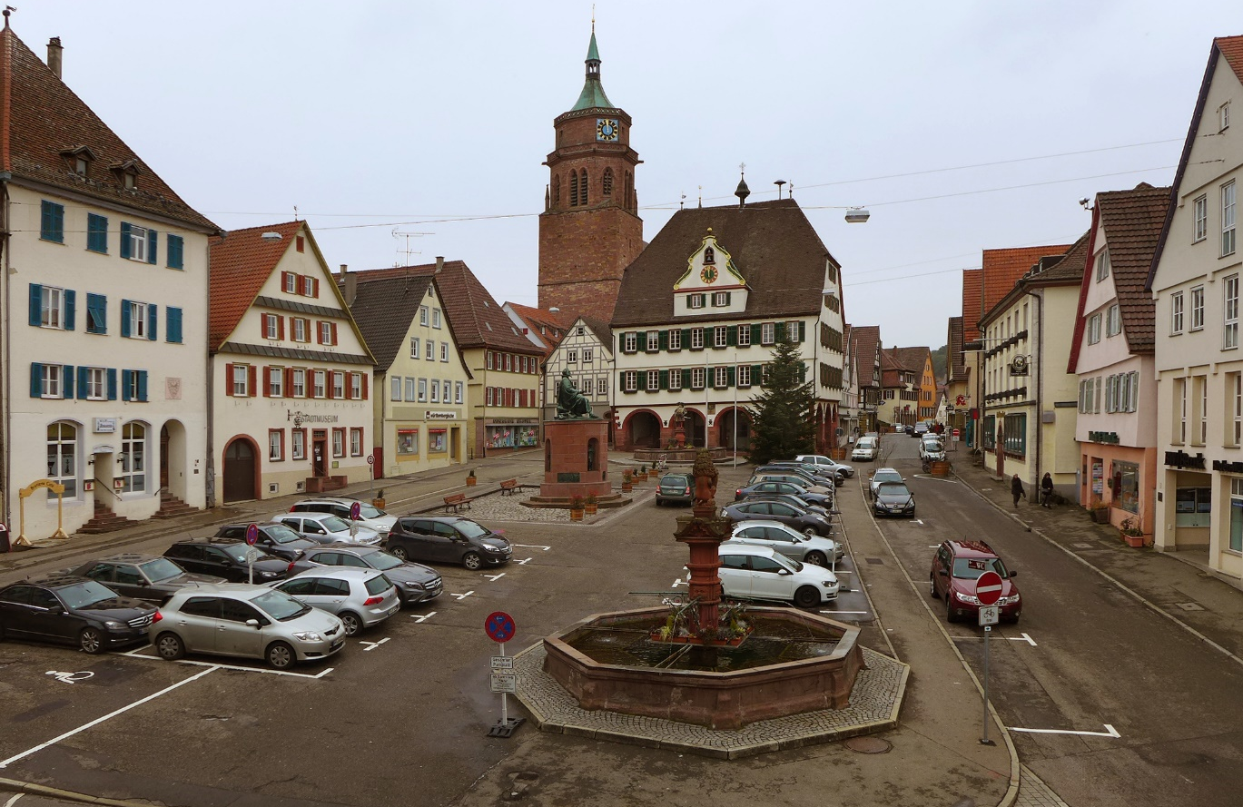
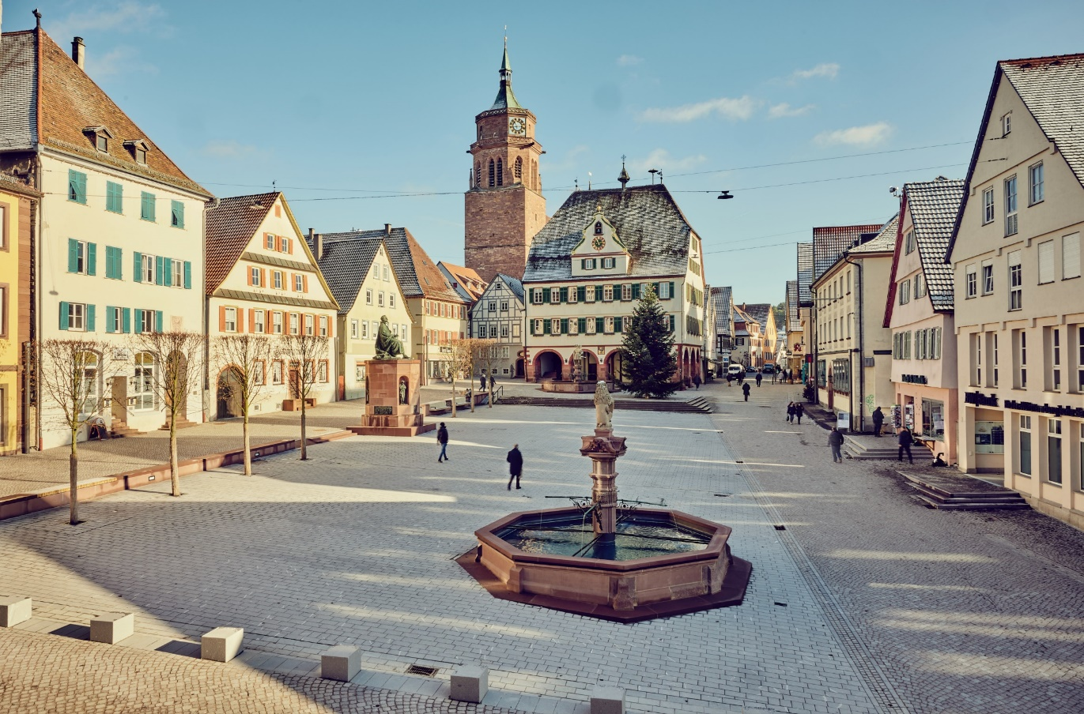
Redesigning our cities and towns
The city of Weil der Stadt

Slide 27
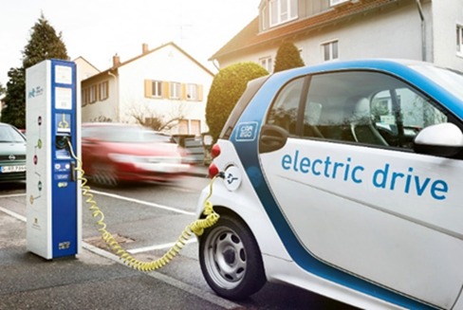
Every second car is climate neutral
  In 2022, more than 30% of new registrations have been electric
  in the existing automotive stock this share is only 4% (BEV + Plug-In hybrid)
  share must increase to 100% by 2030 (not just 55% as EU envisages)
  Key measure: expansion of the charging infrastructure for cars may have to be pushed by law
  Local user benefits (parking, fast lanes and zero emission zones)

Slide 28
Share of new passenger e-car registrations (BEV + plug-in hybrid)

Slide 29
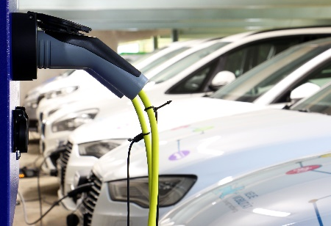
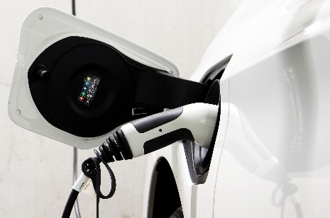
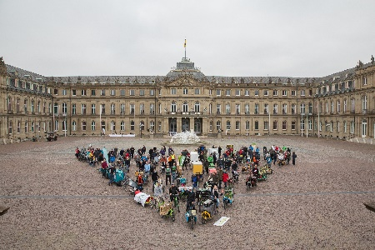

State Initiatives for electric mobility – examples of funding
Charge@BW: Almost 17.000 private and publicly accessible charging points
SAFE: State-wide charging network (10 km grid) since 2019
© Ministerium für Verkehr BW
BW-e-Voucher: More than 14.500 e-vehicles
BW-e-Solar-Voucher: Already more than 3.500 e-vehicles
© Ministerium für Verkehr BW
E-Cargo-Bikes: Already more than 4.000 e-cargo-bikes
© Ministerium für Verkehr BW, Philipp Braun
Notes:
Already in 2009, we launched a first electric mobility initiative, to foster the sale of electric fleets and the expansion of public and private charging points. Currently we are preparing the fourth state initiative.
We do not only subsidize electric cars and charging points, but also cargo bikes, e-trucks as well as public e-busses.
By the project called SAFE, Baden-Württemberg was the first area state in Germany with at least one public charging Station in a 10 km grid.

Slide 30
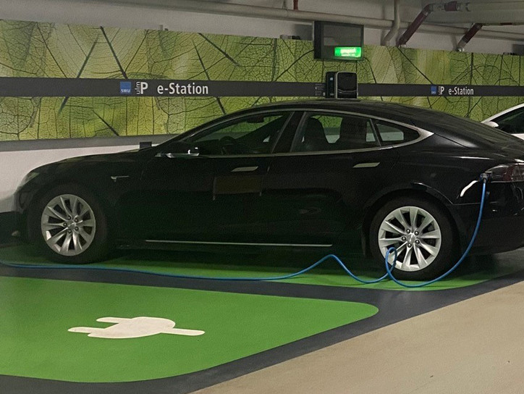
Current initiative: E-district hubs
  bundling of parking cars and charging infrastructure in parking facilities
  hubs can be combined with sharing services to a place of multimodal
  e-mobility
  aims: reducing traffic and the number
  of cars parked on the street,
  and improve quality of life
  in densely built urban districts

