Slide 1
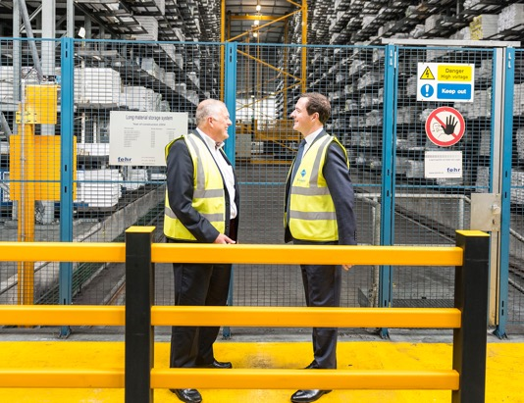
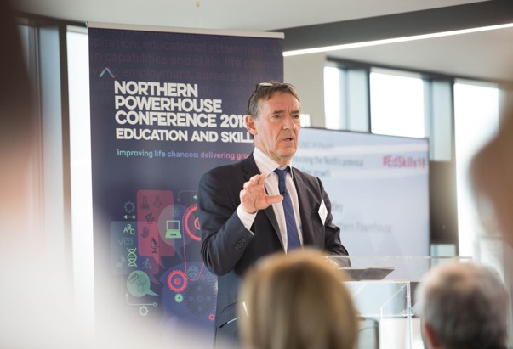
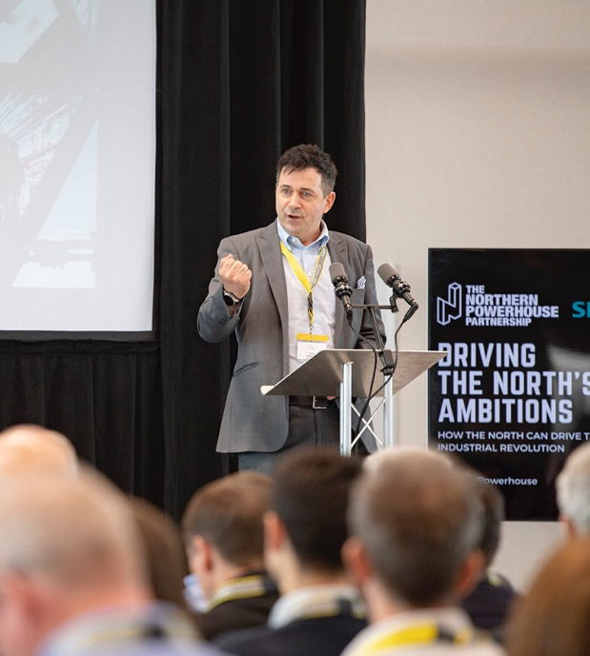
Driving the North’s Ambitions
@NP_Partnership #DTNA

Slide 2
City Growth Commission 2014
Set up with the purpose of identifying how to raise the trend growth rate of the UK.
Recognised that 61% of growth in the UK is driven by city regions.
Yet London is the only UK city that registers amongst the most significant in the world.
The UK is one of the most centralised economies in terms of tax raising and spending. Cities in the North have a considerable fiscal gap and therefore rely on transfers from London.
The benefits of agglomeration around the major cities of the UK were viewed as being key to raising growth and narrowing the gap between London and the rest of the UK.

Slide 3
What is the Northern Powerhouse?
The term ‘Northern Powerhouse’ was first used by George Osborne in June 2014 during his speech at the Power Hall in the Museum of Science and Industry.
Individually, as great and as proud as our cities are, they are quite small globally. However, the distance between our great cities is also quite small - sufficiently close to each other that if combined, can take on the world.
It is not about just one city but a collection of Northern cities – that if connectivity, collaboration and the ability to work together is improved, can create a Northern Powerhouse.
In this 2014 speech the four suggested areas set out to create the Northern Powerhouse were:
Enabling local power and control
Launching a radical transport infrastructure plan
Supporting creative thinking
Developing science and innovation
Notes:
The North of England is home some of the most iconic places in the UK. There are around 16m people and 7.2m jobs, and in 2015 the region generated an economic output of around £290bn of Gross Value Added (GVA), about one fifth of the UK’s total.

Slide 4
How large is the performance gap?
Notes:
In 2016 the NPIER was published, looking at the disparities between the north of England and the rest of the UK.
there has been a persistent gap in GVA per capita between the Northern economy and the rest of England over the last 30 years. Although there was some decrease in the gap in the mid-2000s (during the period of strong UK growth prior to the recession), following the 2008/09 recession the gap has widened, returning it to the pre-boom levels.
Once London is excluded from the comparison, the gap compared with the rest of England, falls by almost half. But, that gap has remained between 10 and 15% over the last 30 years, and most of the gains made by the North prior to the recession have since been reversed.
In 2014, this gap equated to a £4,800 per person difference in income between the North and the UK average, and a £22,500 per person difference between the North and London.

Slide 5
How large is the performance gap?
Notes:
Figure 2-2 takes a European perspective by comparing the GVA per capita of the Northern economy with that of the Rhine/Ruhr region (Germany), the Randstad (Netherland), and Lombardy (Italy). A persistent, yet stable, gap is observed up until the recent recession, after which a noticeable widening occurs.

Slide 6
How large is the performance gap?
Notes:
The early 1980s saw slow growth because of the disproportionate impact of the recession on those traditional manufacturing industries which were still important in the North. During the period of stronger output growth from the mid-1990s, employment did not quite keep pace, growing a little more slowly than the benchmark comparators. The further slowing of employment growth also started before the 2008/09 recession, with the growth gap starting to widen from 2005 onwards.
The review concluded that whilst levels of unemployment have an impact on the North’s GVA, the Review found that productivity accounts for the largest proportion of the ‘performance gap’ with the rest of England. The main factors driving this productivity gap were identified as:
Insufficient high-skilled workers and too many low-skilled workers
Not enough exploitation of innovation and technology
Lower levels of investment
Lower levels of enterprise (measured by business start-ups per capita)
Lack of agglomeration
Sub-optimal transport links and underinvestment in transport

Slide 7
The ‘transformational’ growth scenario
Notes:
‘Business as usual’ for the North would not mean zero growth or investment, but it would mean a continuation of historic trends of investment and corresponding reduced growth. This ‘business as usual’ scenario would mean that the gap between the North’s economy and the rest of England would continue to widen.
Under the ‘transformational’ scenario, by 2050 the North would have 850,000 more jobs than under the ‘business as usual’ scenario, with 1.5 million new jobs in total. If this vision is realised, by 2050 the North’s GVA is projected to be £97 billion higher than if there was ‘business as usual’.
This improved economic performance would be led by growth in the North’s distinctive offer of ‘prime’ capabilities, supported by three ‘enabling’ capabilities. For the gap to be bridged, transformational improvements to the North’s transport connectivity are critical, both between and within cities. We would also need substantial improvements in the North’s skills base and graduate retention and attraction, alongside higher levels of innovation and inward investment.

Slide 8
The ‘prime’ capabilities
Advanced manufacturing
Energy
Health Innovation
Digital
Enabling capabilities:
Financial and Professional Services
Logistics
Education
Notes:
These capabilities account for around 2.1 million jobs and over £100 billion in GVA, representing around 30% of all jobs in the North and just over 35% of GVA. Their role is also strategically significant in driving the jobs and growth in other sectors of the economy, particularly retail, construction, leisure and tourism, which in turn will then generate significant jobs and productivity growth.

Slide 9
Delivery
Connectivity is critical to creating a Northern Powerhouse capable of taking on and improving the world. We need an ultra-modern network, on road, rail, in the air and at our ports, so our school leavers and graduates can look for skilled job opportunities
The North’s high-speed rail network, Northern Powerhouse Rail, will see six services an hour between Leeds and Manchester, each taking under half an hour, making commuting quick and simple
We will focus on improving the quality of our education, with inspiring leaders and teachers, and narrowing the gap in achievement when young people leave school in the North compared with the South.
Work-based education through modern apprenticeships will be crucial in delivering this ambition. We are urging Northern businesses to commit to provide this support to inspire our young people to succeed in a changing, dynamic world of work.

Slide 10
Transport and economic development
Notes:
1.Supporting the economic growth of the Northern Powerhouse through a better-connected Bradford – connecting England’s seventh largest city¹ with a more integrated and productive economic system in the North;
2. Transforming Bradford’s economic future – NPR will act as a catalyst for new residential and commercial development and improved local infrastructure, guided by proactive planning policies and a pioneering Local Authority that is working in partnership with the private sector;
3. Raising skills levels, connecting people to opportunities and building Bradford’s business base – enabling Bradford’s people and firms to create and access the wider range of quality jobs that will be created and brought within reach by NPR, raising awareness of the opportunities (including the Bradford Opportunity Area programme), connecting the most productive firms in the North with new national and global markets, and creating the right conditions for business investment and growth;
4. Increasing the overall benefits of NPR by integrating it with improved local transport links – developing high quality local public transport links with seamless interchange at the NPR station to enable people and firms across Bradford to access the NPR network, increasing Bradford’s passenger market and improving the quality of the user journey;
5. Transforming Bradford’s brand – increasing its attractiveness as a place to visit, live, study and invest, leveraging Bradford’s nationally significant museums and art collections, world heritage site, its vibrancy and diversity, its retail and leisure offer, and its stunning countryside; and
6. Aligning policies and maximising the investment – by putting in place the right delivery mechanisms, fostering a collaborative approach between the public and private sector and by exploring innovative approaches to funding.
What can we learn from what has happened in Lille?

Slide 11
Thank you
Andrew McPhillips
Chief Economist
andrew.mcphillips@northernpowerhousepartnership.co.uk

